Slide 1
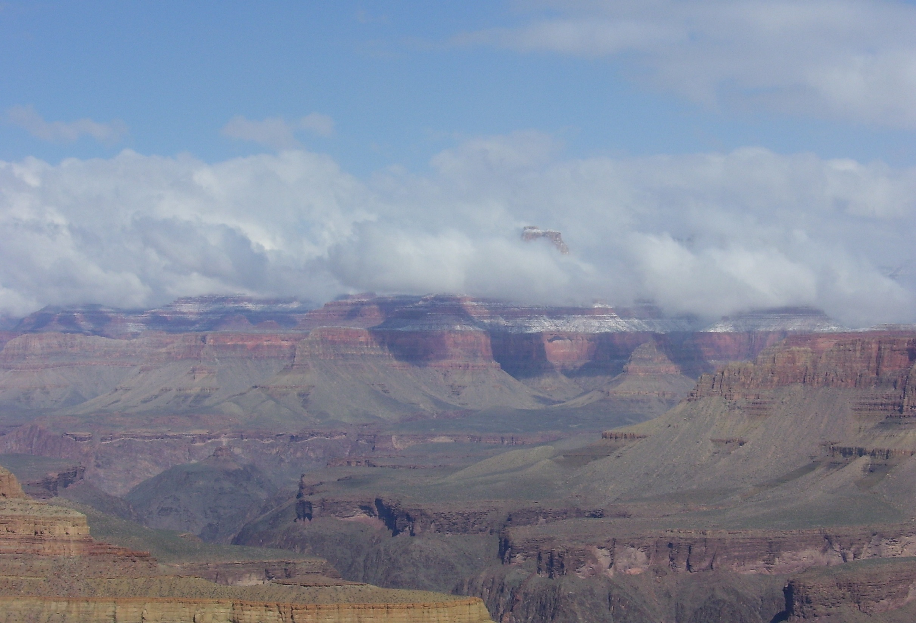
Intermediate land exchange
ILE - 2017
Notes:
Introduction of instructors
Logistics
Safety emergency exits bathrooms etc.

Slide 2
-Who you are
-Where do you work
-What is your role and experience with exchanges
The last book you read and would you recommend it.

Slide 3
Why are you here - objectives
Understand when and why land exchanges are used to accomplish agency plans
When to complete a land exchange – public interest
Steps involved in a land exchange
Notes:
Expectations capture why the class is here
Go through objectives

Slide 4
Why do we do land tenure adjustments and why are they important?
Notes:
Ask the class what do we mean by land tenure adjustments, overall picture of adjustments we can make; purchases, donations, sales and exchanges.
Then focus on why do we complete land exchanges ask them what are some reasons we do exchanges.
implement land use plans; landowner does not wish to sell or donate; convey out of parcels that the agency can’t manage. Consolidate landownership.

Slide 5
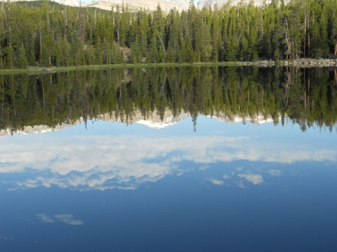
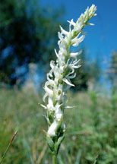
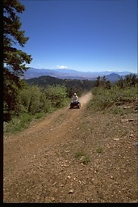
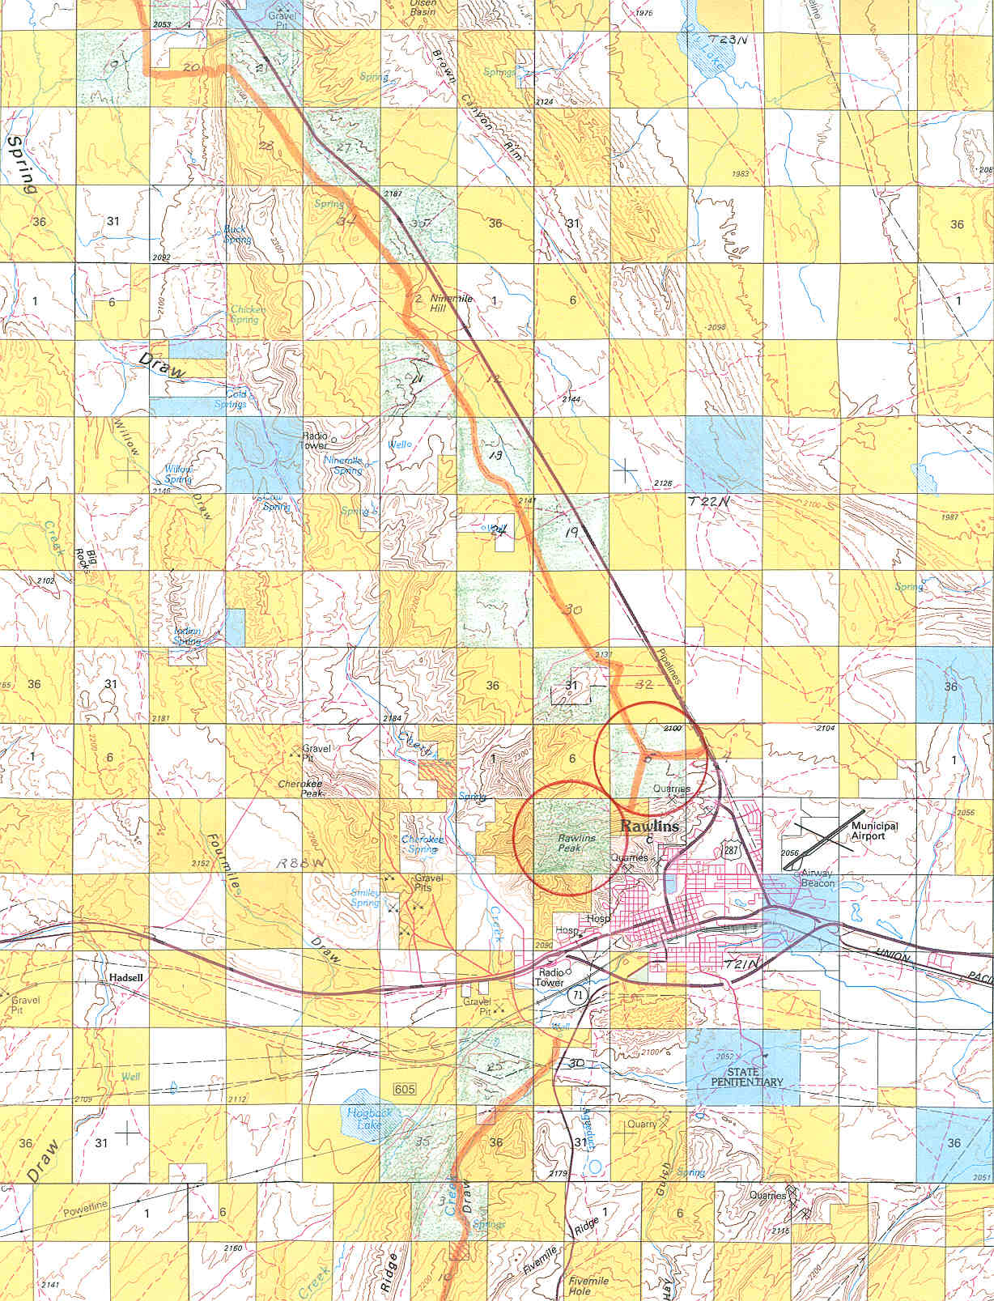
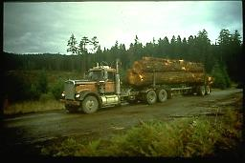
Why!!
Acquire inholdings within special areas
Acquire and protect important resource values
Access for Recreation or Commodity development
Community expansion
Las Vegas Valley
Consolidate Ownership
Notes:
Overall goal of implementing Agency Land Use Plans
Matt - Hermosa land exchange and acquisition of wilderness inholdings
Watershed protection act
Long term gains with wilderness inholding acquisitions.

Slide 7
Hermosa Land Exchange
Short-term impacts
Congressional Designation of Special Management Area/Wilderness
Reintroduction of Colorado River cutthroat trout
Better overall management of key recreation area
Better range management in a key allotment
Long-term Impacts
Better management of recreation in intensely-used watershed
Golf course development of Federal lands exchanged
Acquisition of 10-acre inholding in Weminuche Wilderness (the cherry on top!)
Notes:
Two real examples of making a difference with adjustments –
Hermosa Land Exchange the landowner was absolutely not willing to sell
The last remaining inholding in an area where they were trying to restore
Colorado greenback cuttthrouat

Slide 8
Hermosa Land Exchange “Second Phase”
Through a second land exchange acquired parcel that fell out of Hermosa LEX
L
Notes:
Too much non-federal land to be included in the exchange this parcel could not be included.
Trust for Public Land went ahead and purchased this parcel
White River National Forest included as part of their exchange.

Slide 9
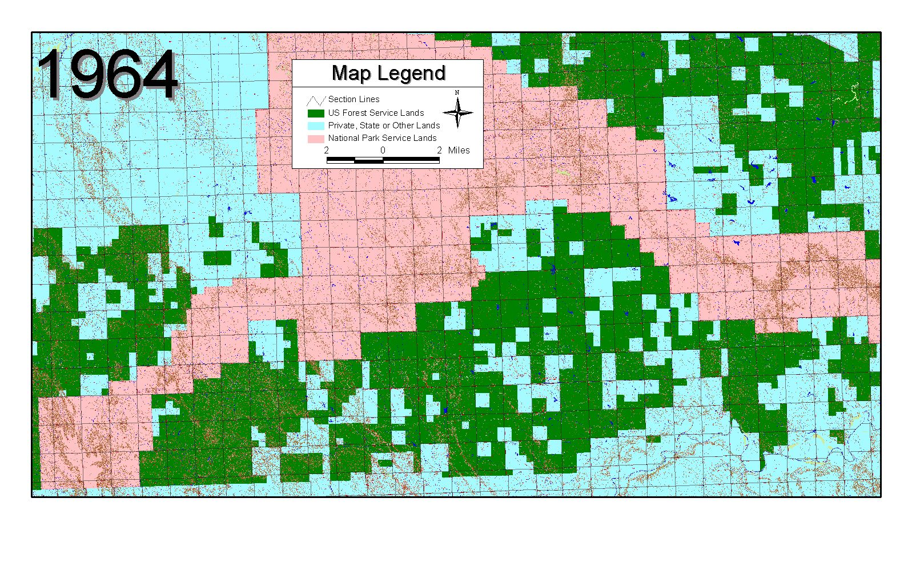
Buffalo Gap National Grasslands
Nebraska National Forest
Notes:
Those are all really great answers. This series of three slides is to me a dramatic illustration of how land adjustments can make a difference and help future managers.
These slides are on the Buffalo Gap National Grasslands, Nebraska N.F.

Slide 10
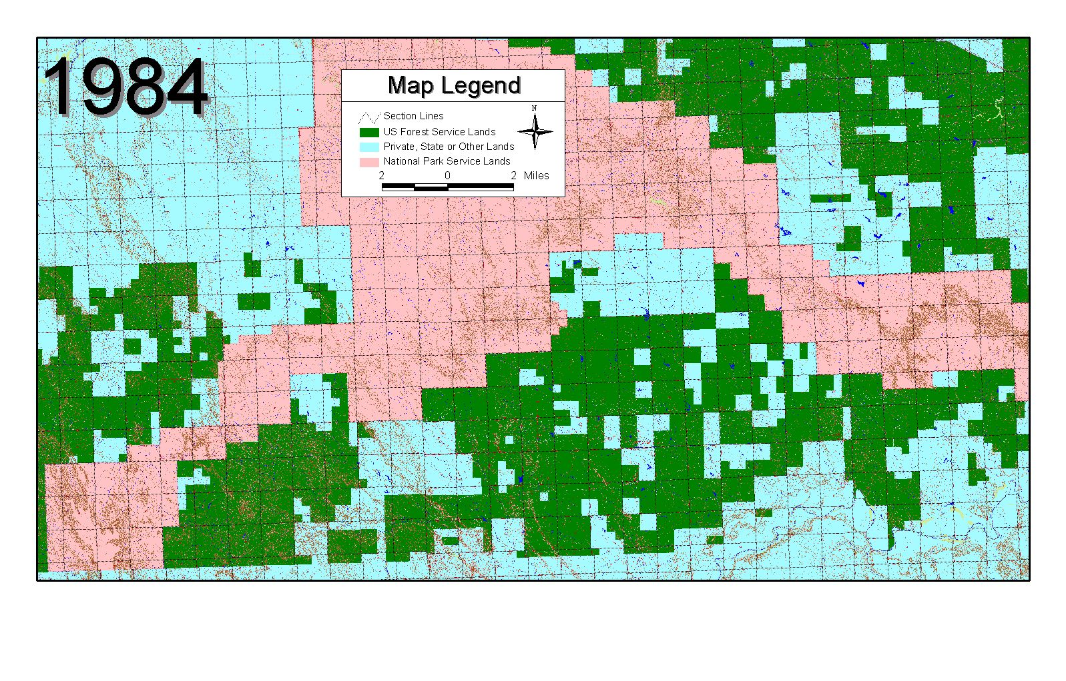
Buffalo Gap National Grasslands
Nebraska National Forest

Slide 11
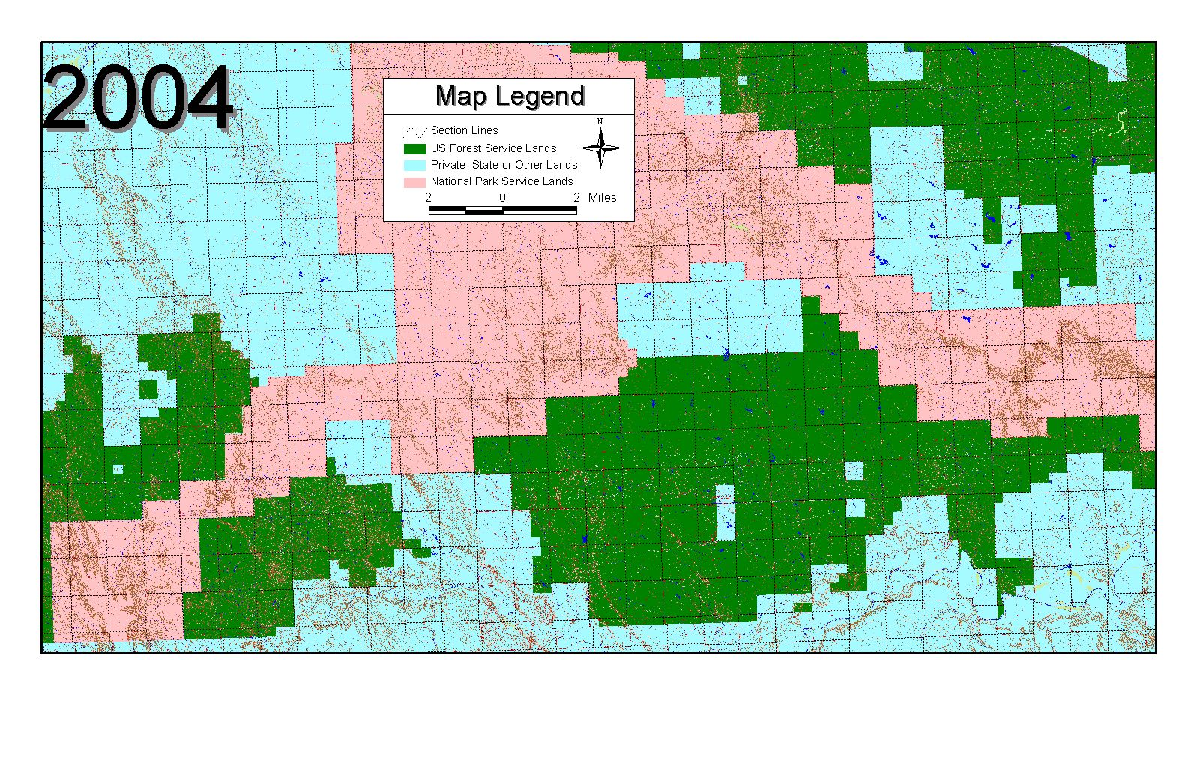
Buffalo Gap National Grasslands
Nebraska National Forest

Slide 12
Buffalo Gap National Grasslands
Nebraska National Forest

Slide 13
BLM AND FS LAND EXCHANGE PROCESS
CHECKLISTS
Notes:
Lori will discuss the land exchange process charts
Large versions will be on the wall.

Slide 14
BLM PROCESSING CHECKLIST HANDOUT

Slide 15
IMPLEMENTATION SCHEDULE
Land-for-Land Exchange
ATI Handout
Notes:
Reference and example material for ATI can be found under the ATI section of this class.

