Slide 1
Intermediate Land Exchange
Case Files & Segregation of Lands

Slide 2
Case Files
The Regulation and Policy
The Case File
The Contents and Documentation
Mandatory Documents
Proprietary and Confidential Information
Final Disposition of Case Files

Slide 3
BLM Land Exchange Handbook H-2200-1 Chapter 5
BLM Manual 1270 Records Management
BLM Manual 1274 – Serialized Case File System
BLM Lands Data Standards 8/28/2014
FSH 5409.13, 30 Land Exchange
FSH 6209.11, 20 Records Management
The Regulation and Policy

Slide 4
The Case File is the OFFICIAL Agency Record
Contains ALL Official Activities and Documents
Documents Legal Requirements
Tracks the Progress of the Case
Public Information
The Case File
Notes:
Who has handled a land exchange case file?
What is different? BIG Several Folders
BLM - Establish a case file when it is determined that the exchange warrants further study. Depending on local policy, a case file may be established before the feasibility report or after completion and approval of the feasibility report. When a case file is established, the data must be entered in the LR2000 system. See LR2000 lands data standards for required action codes for land exchanges (8/28/2014).
FS - The case file is established as part of the feasibility analysis. The data is entered into LADS upon approval of the feasibility analysis and execution of the ATI.
Case file is official Administrative Record of the land exchange proposal.
The Administrative Record is required and driven by the Administrative Procedure Act. Agency review is on the Administrative Record; a decision will be vacated or remanded if not supported by the Administrative Record (or the Case File documentation).
The case file should:
Contain the complete “story” of the agency decision-making process, including options considered and rejected by the agency;
Include important substantive information that was presented to, relied on, ore reasonably available to the decision-maker;
Establish that the agency complied with relevant statutory, regulatory, and agency requirements; and
Demonstrate that the agency followed a reasoned decision-making process.
Should be compiled as documents are generated or received during the decision-making process.

Slide 5
BLM - Create and maintain separate case files for Federal and non-Federal lands
FD folder - ALL documents related to exchange
PT folder - Documents related to non-Federal lands
FS – Use 6-way or expandable wallet folders
Prepare Preliminary Title Docket file after approvals
The Contents and Documentation
Notes:
BLM
Check for file folder type in your office and state.
Prepare separate case files for the Federal lands and the non-Federal lands using the same serial number and the suffix FD for the Federal and PT for the non-Federal.
The FD file has ALL documentation where the PT file contains documents specific to the private lands. IF IN DOUBT, FILE IN BOTH FOLDERS!!!
FS
Use six-way letter-size folders. Can also use expandable wallet folders. FS does not separate out Federal and non-Federal lands.
The Title Docket File: Prepare a Preliminary Title Docket file after obtaining all case approvals.

Slide 6
File original documents chronologically
Keep up to date
Mark documents Draft or Final
Know and understand your agency requirements for filing sensitive “Privacy Act” documents
Mandatory Documents
Notes:
Have class look at handouts
IM 2010-121 Attachment 2-1 BLM Documentation in Land Exchange Case Files
FSH 5409.13 Chapter 30
The case file is the official record of the BLM/FS and documents all official activities pertaining to the land exchange. The case file includes legal requirements, tracks the progress of the case and is public information.
Must contain original documents whenever possible.
Must be kept up-to-date.
Documentation and handwritten notes must be clear, concise, and complete.
Documents must be visibly marked draft and/or final.
Separate any and all sensitive (privacy act) information within the case file and clearly note.
Contain NO extraneous notes/comments.
Serial Register Page – Continuously update the SRP to ensure it is current, accurate, and complete. The BLM will input all the case action data upon receipt of the final title package from the FS.

Slide 7
Proprietary and Confidential Information
Definition: Information that is submitted to the government in expectation of confidentiality, the release of which would result in substantial competitive harm to the individual that submitted the information.
Government produced reports may be considered propriety/ confidential
Separate proprietary/confidential documents from the rest of the case file
Remove proprietary/confidential documents from the case file prior to public viewing
Notes:
Proprietary and Confidential Information is defined as: Information that is submitted to the government in expectation of confidentiality; the release of which would result in substantial competitive harm to the individual that submitted the information.
There are also government produced reports that may be considered propriety and confidential, e.g., mineral reports, appraisals, cultural inventory reports, and special status species inventory reports, etc. and must be safeguarded against improper disclosure.
Proprietary and confidential documents should always be separated from the rest of the case file as described in the next slides and removed from the case file prior to public viewing.
PRESENTER:
Christina Price

Slide 8
Proprietary and Confidential Information
Stored in the official case file:
In sealed envelope with Form 1273-2 securely attached to the front of the envelope
Contents/dates listed on the outside of the envelope
Envelope maintained as top document in case file for easy identification and removal prior to public viewing
Notes:
Check with your State/Regional Lands and Realty Program Lead for the appropriate method for safeguarding proprietary and confidential information in your state.
Generally, Proprietary and confidential information is to be stored in the official case file, but must be kept separated in a sealed envelope with Form 1273-2 firmly attached to the front of the envelope.
The contents and dates should be listed on the outside of the envelope.
The envelope should be maintained as the top document on the left top (or right top depending on your office policy) of the case jacket to allow for easy identification and removal before releasing the case file for public viewing.
If proprietary and confidential information is to be stored in a separate locked cabinet or locked room, the information should be in a file folder labeled with the case file serial number and Form 1273-2 to clearly identify the confidential nature of the contents.
The contents and dates should be listed on the outside of the folder.
The official case file should be noted to show where such proprietary and confidential information is stored and who is responsible for its safekeeping.
PRESENTER:
Christina Price

Slide 9
Proprietary and Confidential Information
Stored in a separate locked cabinet or locked room:
Must be in file folder labeled with serial number & Form 1273-2 securely attached
Contents/dates listed on the outside of the folder
Note official case file where proprietary/confidential information is stored and responsible party
Notes:
Check with your State/Regional Lands and Realty Program Lead for the appropriate method for safeguarding proprietary and confidential information in your state.
Generally, Proprietary and confidential information is to be stored in the official case file, but must be kept separated in a sealed envelope with Form 1273-2 firmly attached to the front of the envelope.
The contents and dates should be listed on the outside of the envelope.
The envelope should be maintained as the top document on the left top (or right top depending on your office policy) of the case jacket to allow for easy identification and removal before releasing the case file for public viewing.
If proprietary and confidential information is to be stored in a separate locked cabinet or locked room, the information should be in a file folder labeled with the case file serial number and Form 1273-2 to clearly identify the confidential nature of the contents.
The contents and dates should be listed on the outside of the folder.
The official case file should be noted to show where such proprietary and confidential information is stored and who is responsible for its safekeeping.
PRESENTER:
Christina Price

Slide 10
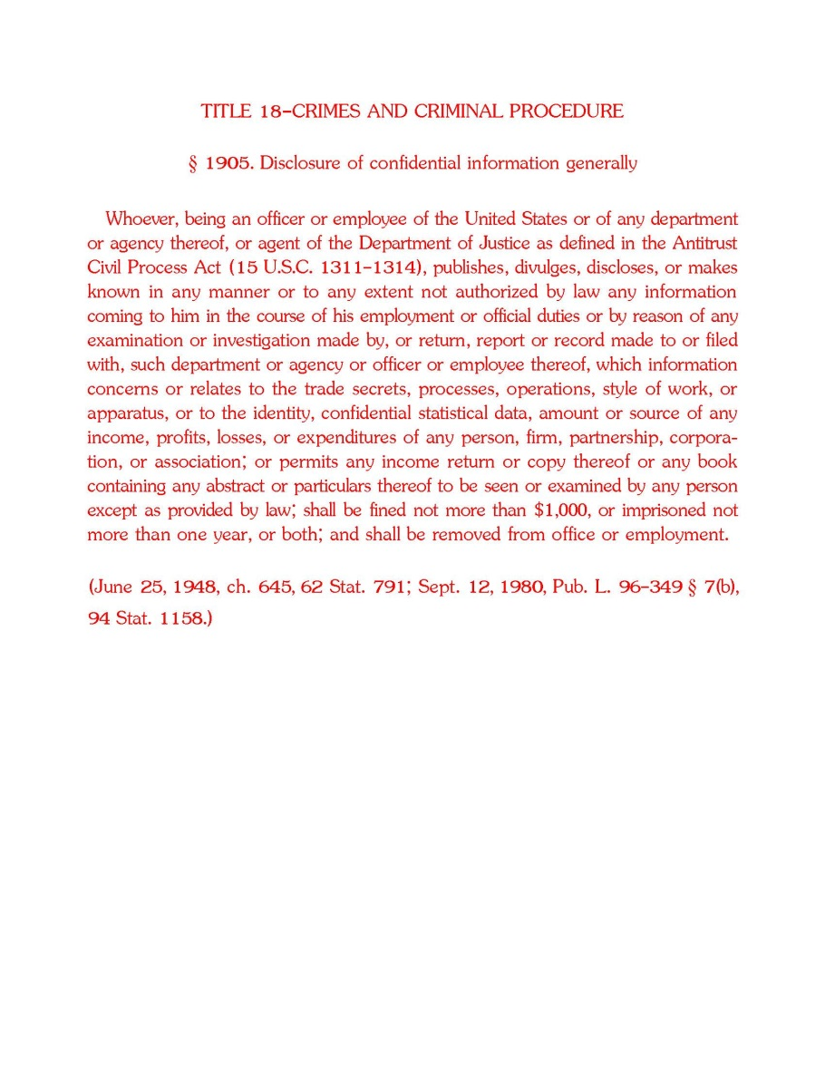
BLM Form 1273-2
Front back
Notes:
This is the front and back of BLM Form 1273-2 which should be attached to the envelope or folder containing proprietary and confidential information for all Lands and Realty cases.
PRESENTER:
Christina Price

Slide 11
BLM will have two official case files for each exchange
FS has title docket header sheets to assist set up
Keep file(s) up to date and CONSISTENT
This is a long process. There will be numerous versions of documents – discard old versions as soon as they are no longer needed
Key Points
Notes:
May want to keep a working folder with Draft documents and work sheets.
FS has Title Docket Header sheets to assist with case file setup (2 Title Docket Header Sheets Handouts).

Slide 12
Official Completed Exchange Case Files
Acquired lands file (PT) Permanent Retention. Transfer disposal lands file (FD) FRC 2 yrs after end of FY in which patent was issued.
Exchange Proposals Rejected or Withdrawn
Transfer to FRC 2 yrs after end of FY in which case was closed.
Land Exchange Proposals (not serialized) not completed
Temporary records. Transfer to FRC after 3 yrs.
BLM Final Disposition of Case Files
Notes:
BLM Records Schedule Link: https://blmspace.blm.doi.net/wo/BLMrec/default.aspx
Subject Index
Schedule 4: Property Disposal Records – search on key words, i.e., exchange, patent
Records transferred to FRC when the white records box is filled
7a - Patent Applications, Rejected or Withdrawn. Serialized case files, arranged by number, documenting applications that were rejected by the BLM or withdrawn by the applicant. Forms: BLM 2520-1; 2540-1; 2620-1; 2650-1; 2740-1. Exclusions: Pending patent applications (Schedule 4/16). Location: SO. Land Exchange Applications [2200]
PERMANENT. Cutoff EOFY in which the application is rejected or withdrawn. Use BLM 4/7a. Transfer to FRC 2 years after cutoff. FRC transfers to NARA 30 years after cutoff.
13a - Land Exchange Proposals [2200]. Documenting proposals that do not result in a completed land exchange case. Arranged by proponent name; informal proposals are not serialized. Confidentiality: Non-public record category 2.
TEMPORARY. Cutoff EOFY in which final decision is made to drop or reject the proposal.
Use BLM 4/13a. Transfer to FRC 3 years after cutoff. FRC destroys 10 years after cutoff.
7c(1) - Patent Issued Official Case Files. Includes patents and deeds issued, corrected, supplemented, amended, canceled, or reverted, quiet title, patent contests, title resolution, and recordable disclaimers of interest cases. Location: SO.
PERMANENT. Cutoff EOFY in which patent is issued, amended, supplemented, canceled, or reverted. Establish compliance files for patents requiring limited or in perpetuity reversionary clauses. Use BLM 4/7c(1). Transfer entire file to FRC 2 years after cutoff. FRC transfers to NARA 30 years after cutoff.

Slide 13
Official Completed Case Files
Permanent. Transfer entire title file and supporting case documentation to the Regional Office for entry into LSRS and LADS.
FS Final Disposition of Case Files

Slide 14
Final Key Points
Land Exchanges are controversial and receive much more attention and scrutiny than other cases you will process
Keep your case files as accurate, complete, and up to date as possible
Land Exchanges are much more likely to end up with IBLA, GAO, or OIG than other land tenure cases

Slide 15
Segregation of Lands
The Why
The When
The How

Slide 16
Segregation
The removal for a limited period, subject to valid existing rights, of a specified area of the Federal lands from appropriation under the public land laws and mineral law, pursuant to the authority of the Secretary of the Interior to allow for the orderly administration of the Federal lands.
43 CFR 2200.0-5; 43 CFR 2201.1-2
Notes:
Why do we segregate the Federal lands in an exchange proposal?
Have the class read 43 CFR 2200.0-5 and 43 CFR 2201.1-2
Ask the class if the 36 CFR’s are different? 36 CFR 254.6

Slide 17
Segregation
Must have an exchange proposal
Carver IBLA Decision
Up to 5 years – cannot extend
Effective the date of record notation
Does not preclude the issuance of ROW or SUP
Notes:
Needs a proposal for land exchange to segregate (see Michael L. Carver, et al, 163 IBLA 77 (2004) the decision state you need to have a “proposal” in order to segregate the lands).
Temporarily (up to 5 years) removes the Federal lands (with public domain status) involved in the land exchange from appropriation under the public land laws, including the mining law. We do this mainly to avoid the placement of “nuisance” mining claims on the Federal lands.
Does not preclude the issuance of rights-of-way or other discretionary land use authorizations, however, need to be sure that permitted/authorized use will not interfere with the future use of those Federal lands for the potential landowner and does not devalue the property.

Slide 18
When to Segregate . . .
Only when we have a proposal
BLM – Prior to NOEP publication
FS – Upon execution of the ATI only if lands are Public Domain; acquired lands are exempt from mineral entry
Notes:
Only when we have a proposal.
BLM – Request segregation as soon as possible prior to publication of the NOEP to preclude new encumbrances that could hinder completion of the proposed land exchange.
90 days before NOEP to avoid nuisance mining claims.
90 days before you go public with proposal or 90 days before you advertise intent to do an EA or EIS.
May want to segregate before formal scoping.
NOTE: Remember to check mining claims 90 days prior to NOEP.
FS – segregation is requested after the ATI is signed, but it is only sent to BLM if the lands are Public Domain. In the East and on the Grasslands, FS does not request segregation because they are acquired lands and exempt from mineral entry.

Slide 19
How to Segregate . . .
BLM – Memo to BLM State Office and LR2000 Serial Register Page
FS – Authorized Officer requests BLM State Office to segregate
Notes:
The date of segregation is the date it was noted to the BLM records, not the date of the memo requesting the segregation (see Ronald C. Daugherty, 143 IBLA 41 (1998)).
FS authorized officer requests the appropriate BLM State Office to segregate the Federal lands by a notation on the public land records after execution of the ATI.
The request to the BLM includes segregation, serialization, MTPs, HI, mining claims, and status of lands.
The letter can note that a formal request to revoke an existing withdrawal will be forthcoming.
Promptly notify the BLM of any changes in the status of the Federal or non-Federal lands. Example, adding or dropping lands from the exchange proposal or a decision not to proceed with the exchange.
Record Requirements. The BLM Field Offices have the primary responsibility for ensuring that the appropriate records are updated in a timely manner. This consists of notations to the master title plats (MTPs), historical indexes (HIs), and all automated information systems. All organizational levels are responsible for and expected to record their actions to the automated systems using current data standards. Official land records (MTPs and HIs) must be noted by the approved method for State Office records. Notations for all public land record systems must be kept current throughout the land exchange process. Notation to the records alerts the BLM specialists and other users of the pending action and the level of segregation. When additional lands are added, a different effective date for the segregation will be established for the added land. (H-2200-1 5.A.3.)

Slide 20
MTP/HI Notation
Notes:
Red area segregated for private exchange U 89605 PX Apln

Slide 21
Notes:
1st notation – expired after 5 yrs; close case file
2nd notation – open new case file with new serial number to start segregation over

Slide 22
Terminate Segregation
Segregation terminates upon:
Conveyance of Federal lands or interests
End of segregation period
Federal Register publication of opening order following a decision to remove any or all lands from the exchange proposal
Notes:
Terminates when any of the following occur (whichever comes first):
Issuance of the conveyance document (patent or deed) for the Federal land or interests;
The end of the segregation period;
Publication in the Federal Register of an opening order following a decision to remove any or all lands from the exchange proposal.

Slide 23
Non-Federal Lands
Non-Federal lands acquired in a land exchange are segregated for 90 days after acceptance of title by the U.S.
After 90 days, they are open to the operation of the public land laws and entry, location, and patent under the mining laws (FLPMA, Sec. 206i), unless you have processed a withdrawal action.
See 43 CFR 2201.9(b)  36 CFR 254.16(b)

Slide 24
Non-Federal Lands
Lands acquired by exchange that are within Congressionally designated areas, withdrawals, or areas established through the BLM land use planning process automatically become part of the area or unit.
Lands are managed in accord with all laws, regulations or plans applicable to such area or unit.
See 43 CFR 2200.0-6 (f-g)  36 CFR 254.3 (e-f)

Slide 25
Questions?

