Slide 1
LAND TITLE
KAREN MONTGOMERY, REALTY LEAD
CALIFORNIA STATE OFFICE
K15MONTG@BLM.GOV
916-978-4647

Slide 2
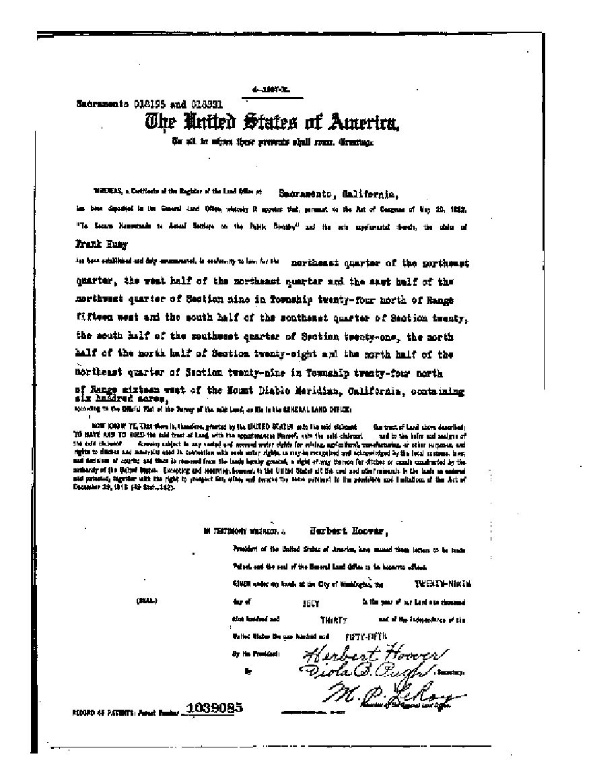
WHAT IS LAND TITLE AND WHY IS IT IMPORTANT?
What?
Title is the evidence of ownership in the land
Why?
Landowner may lawfully assert and protect their possession and use of the property

Slide 3
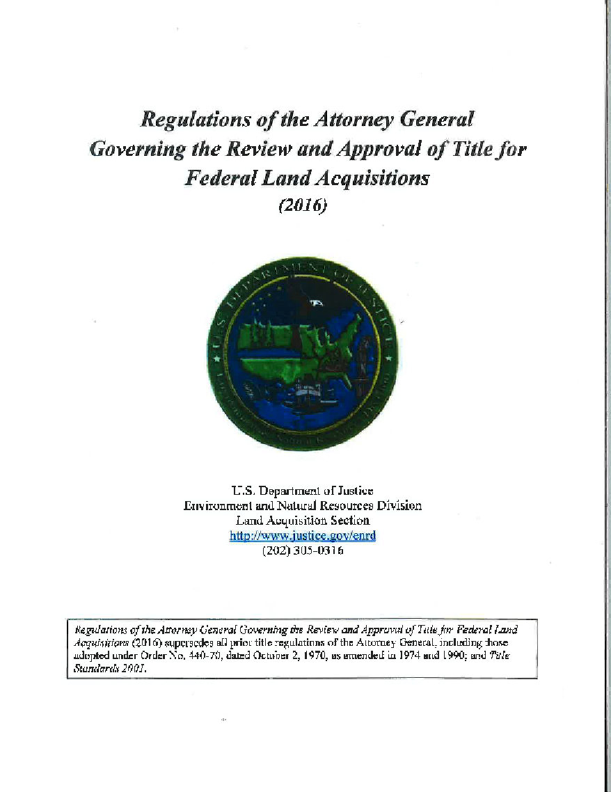
GUIDANCE AND DELEGATED AUTHORITY
Guidance
Department of Justice - DOJ Title Regulations (2016)
Delegated Authority
Office of the Solicitor and Office of General Counsel (OGC) are delegated, on behalf of the DOJ, to accept title for the United States

Slide 4
STEP 1 OBTAIN TITLE EVIDENCE
NON-FEDERAL LANDS:
Preliminary Title Report (PTR)
Vesting Deed
Corp., Trust, or Court documents
Private Surveys
Encumbrance Documents
FEDERAL LANDS:
MTP & HI, Land Status, Atlas
Survey Plats
LR2000, ALP and SUDS
Casefiles
Sec. Orders and PLOs
Notes:
Verify Ownership
Feasibility package needs to include review and concurrence from solicitors/OGC. Can be done concurrent with PRE-ACQUISITION TITLE REVIEW (PTO).

Slide 5
STEP 1 PTR, ABSTRACT, TITLE COMMITMENT OR PRO-FORMA
Preliminary Title Report (PTR)
Shows current ownership, legal description, and all encumbrances
Abstract
Chronological compilation of documents affecting a parcel
Title Commitment
Binding – Obligates the title company to issue a policy, may expire
Pro-Forma
Replica of the final title policy
Notes:
Abstract requires the client to interpret the effect of the documents

Slide 6
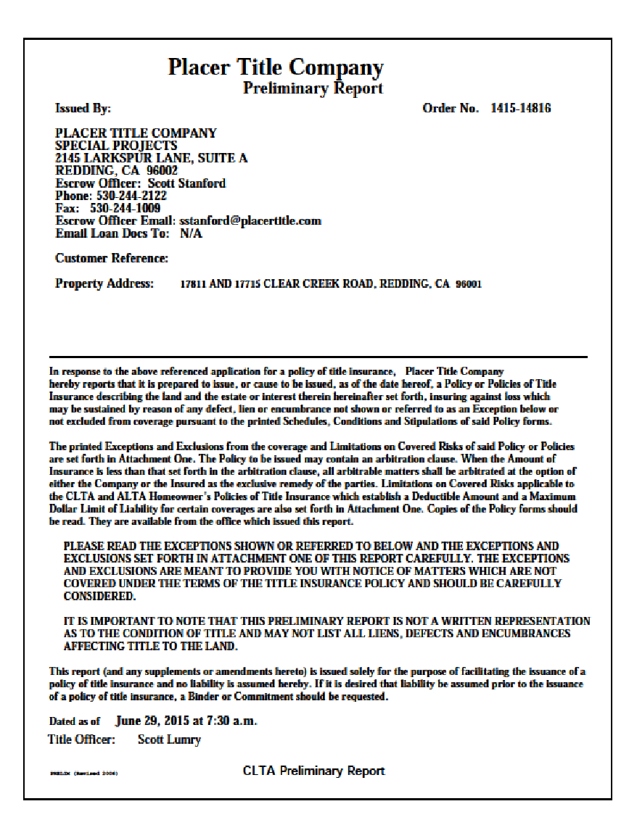
STEP 1 PARTS OF A TITLE REPORT
Cover Sheet
Preprinted - coverage and exceptions
Schedule A
Vesting and Legal Description
Schedule B
Encumbrances and Exceptions
Notes:
Vesting is who owns the property.

Slide 7
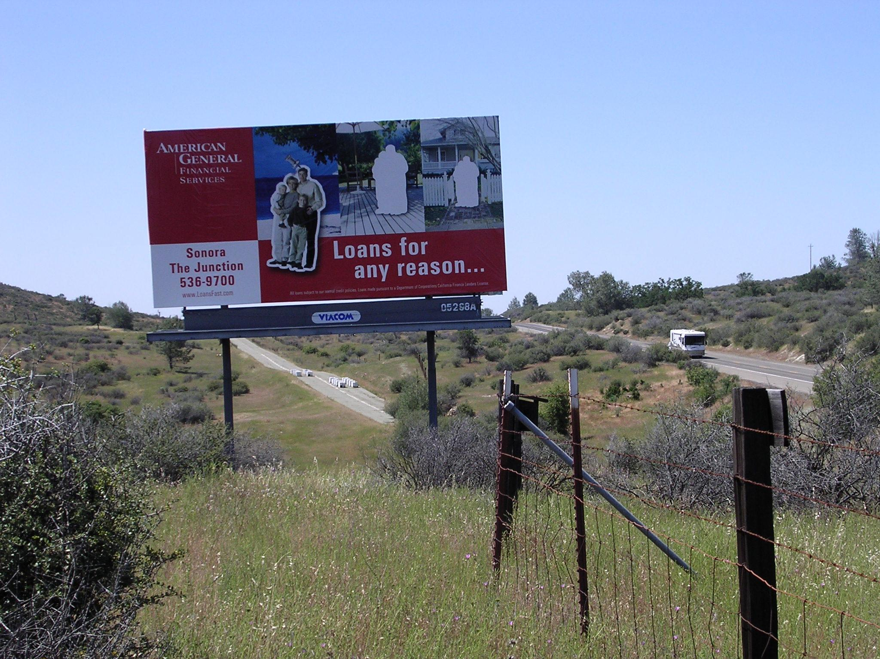
STEP 2 IDENTIFY OTHER PROPERTY RIGHTS
Minerals
Water
Timber
Items not of record
Notes:
Will these be acquired, or reserved, or have they been severed?
What about the Federal Lands?
Not of Record? Grazing leases, Billboards, Easement and CEs.

Slide 8
STEP 2 IDENTIFY SURVEY NEEDS
600 Departmental Manual 5 –
Standards for Federal Lands Boundary Evidence
Land Survey Services Request (LSSR)
Land Survey Report (LSR), Land Description Verification
Boundary Assurance Certificate – includes a field inspection
Identify Encroachments
Notes:
LSR – 4 Results
Acceptable
Minor Problems, Some Risk
More Significant Problems, Should not use
Survey is Required

Slide 9
STEP 2 REVIEW ENCUMBRANCE DOCUMENTS
NON-FEDERAL LANDS:
Certificate of Use and Consent (Forest Service)
Administrative Determination (BLM)
Certificate of Inspection and Possession (CIP)
FEDERAL LANDS:
Land Status
Public Domain
Re-Conveyed Public Domain
Acquired Lands
Encumbrances
Notes:
Land Status is important to know what kind of conveyance document to prepare.

Slide 10
STEP 3 PREPARE OR OBTAIN CURATIVE DOCUMENTS
NON-FEDERAL LANDS:
Easements
Lot Line Adjustments
Work with partner (NGO)
FEDERAL LANDS:
Easement Policy (BLM)
WO IM-97-08

Slide 11
STEP 3 PREPARE DEEDS, PATENTS AND ESCROW INSTRUCTIONS
NON-FEDERAL LANDS:
General Warranty Deed
Limited Warranty Deed
Grant Deed (CA)
FEDERAL LANDS:
Patent Issued by the BLM
Exchange Deed issued by FS
Quit Claim Deed (QCD)
Issued by BLM and FS
Notes:
GWD – Meets DOJ Regulations – 1) grantor owns the property 2) no encumbrances except for those stated 3) right to quiet enjoyment 4) grantor defends title against lawful claims
LWD – Implied warranty, but limited to only those acts committed while in grantor’s possession.
GD – Form of a Special Warranty Deed
Patents do not warrant title
See Request for Patents for specific information needed by BLM

Slide 12
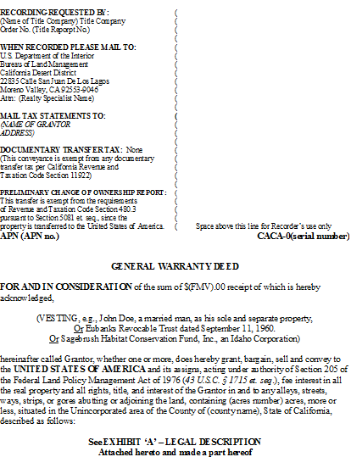
STEP 3 CONVEYANCE DOCUMENT TO THE US
General Warranty Deed
•Recite true consideration and receipt thereof
•Name of all grantors, signed exactly as listed and notarized
•Convey to “United States of America, and its assigns
•Cite the authority for the exchange
•Contains reference to the administrating agency
•Use approved legal description

Slide 13
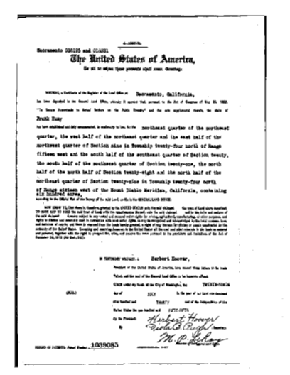
STEP 3
CONVEYING FEDERAL LANDS
Patent or Exchange Deed or Quitclaim Deed
•Authority for the conveyance
•Identification of patentee or grantee
•Reservations and Subject to
•Cash equalization, if applicable
•Use approved legal description
Notes:
The US cannot accept quitclaim deeds.

Slide 14
STEP 4 PRE-ACQUISITION TITLE REVIEW (PTO)
NON-FEDERAL LANDS:
Draft Deeds and Patents
Title Evidence, and all supporting documents
Admin Determination or Certificate of Use and Consent
Appraisal Approval
Environmental Site Assessment (ESA) and CIP
Maps
Notes:
Remember, no quitclaim deeds.
Some solicitors want escrow instructions.

Slide 15
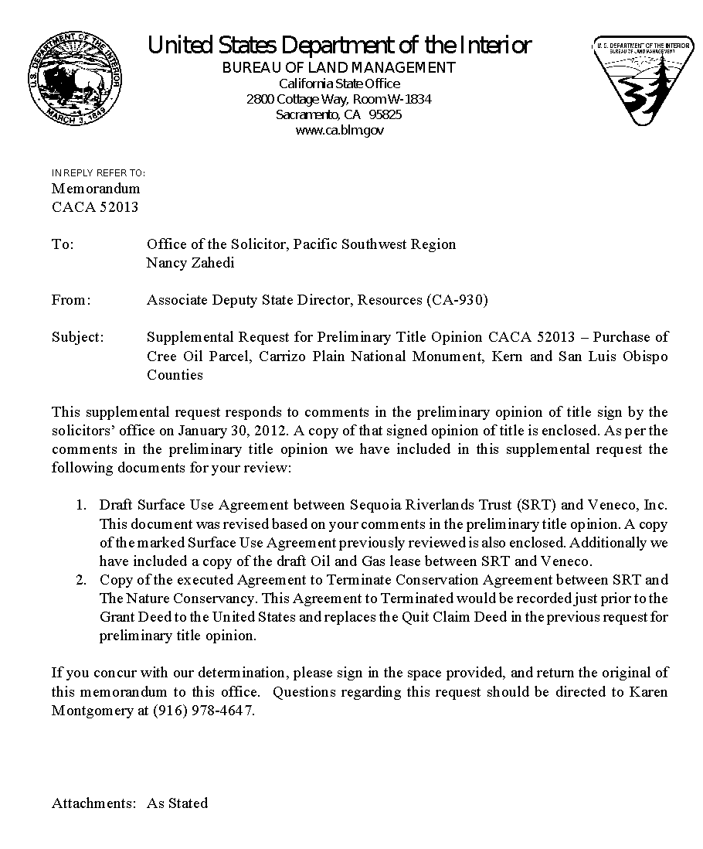
STEP 4 CURE ISSUES IDENTIFIED IN PRE-ACQUISITION TITLE REVIEW
NON-FEDERAL LANDS:
Work with Attorneys to resolve issues
May Need to Request Supplementary Pre-Acquisition Title Review
Notes:
What kind of issues?
Indemnification provisions
$ paid in advance of appropriation (Anti-deficiency Act) – Road maintenance agreements
Restrictions on use (Managers need to justify)
Curing items not found in the record

Slide 16
TITLE ENCUMBRANCES “YOU BE THE JUDGE”
Determine if the title encumbrances are:
Acceptable
Unacceptable
More Research Needed

Slide 17
QUESTION 1
Property taxes , which are a lien not yet due and payable, including any assessments collected with taxes to be levied for the fiscal year 2016‐2017.

Slide 18
QUESTION 2
An easement over said land for road and incidental purposes, as granted to Brent Owen, et al, in deed recorded October 19, 2005, Book 2815, Page 471, official records.
The exact location and extent of said
easement is not disclosed of record.

Slide 19
QUESTION 3
Deed of trust (Mortgage) to secure an indebtedness of
$250,000, dated March 27, 2006, recorded
April 13, 2006, Instrument No. 2006‐007954,
official records.

Slide 20
QUESTION 4
Reservations contained in that certain patent
recorded March 25, 1943, as Mineral Entry No. 216406
in Book Z at Page 483, official records.

Slide 21
QUESTION 5
An unrecorded power transmission line
discovered on the property during a site
inspection.

Slide 22
QUESTION 6
Subject to matters and proceedings in Bankruptcy Case No. 04‐0926 (District No. 190) in the United States Bankruptcy Court for
the District of Columbia in regards to Environmental Land Technology, Ltd.

Slide 23
QUESTION 7
Discrepancies, conflicts in boundary lines,
shortage in area, encroachments, or any facts
which a correct survey would disclose and
which are not shown by the public records.

Slide 24
QUESTION 8
A covenant, condition and restrictions (CC&R) agreement entitled
“Agreement Restricting Use of Real Property”
recorded on January 25, 2008, Instrument No.
2008‐1811‐8, of Official Records.

Slide 25
Additional Training
Forest Service Lands and Realty Title Training, Level 1 - Web Based FS-National-5400-101
BLM – stay tuned…

Slide 26
CONGRATULATIONS!

