Slide 1
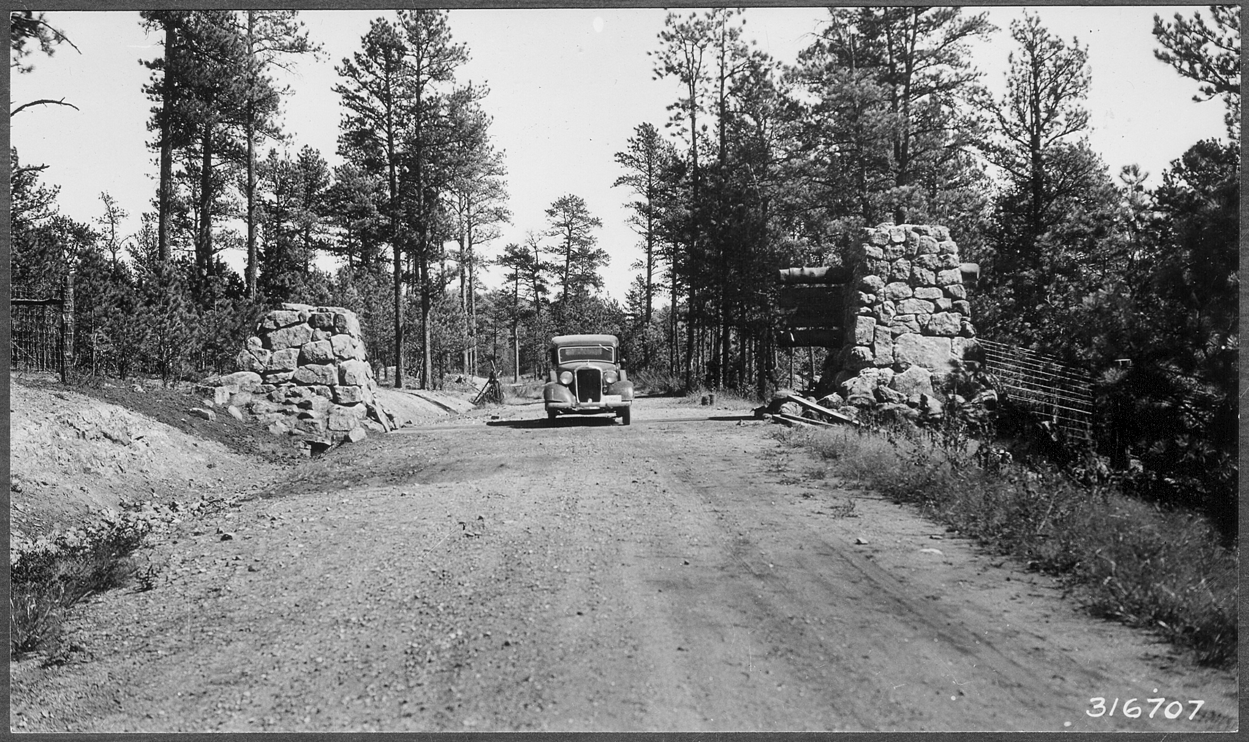


NEPA Analysis and other pertinent info

Slide 2

REFERENCES:
  -BLM Handbook Land Exchange H-2200-1, Chapter 6;
  -BLM Handbook NEPA H-'11"10, All Chapters;
  -43 CFR 2201.2(a) 4 and 5; 43 CFR 2200.0-6(h); 40 CFR 1501.3
  FSH 5409.13, 33.4, 34
  FSH 1909.15 Environmental Policy and Procedures Handbook
  - 36 CFR 254.

Slide 3

IT’S NOT JUST YOU!
-Line Officer Field Office Manager, District Ranger, Forest Supervisor
-PAO
-Forest, Zone or RO staff
Informally involve the public early in the development of a land exchange proposal. Discuss general proposal, talk with interested parties, local governments and adjacent landowners.

Slide 4
BLM, most land exchanges are processed with an Environmental Assessment (EA) and that will be the focus of this segment. An Environmental Impact Statement (EIS) is needed for actions with a significant effect or plan amendment.
Forest Service, most land exchanges are also processed with an EA. In some larger, more complicated and controversial exchanges an EIS may be used.

Slide 5

Rejection of an Exchange Proposal
NEPA is not required to consider and reject an exchange proposal.

Slide 6

§ 220.6 Categorical exclusions – Forest Service.
General. A proposed action may be categorically excluded from further analysis and documentation in an EIS or EA only if there are no extraordinary circumstances related to the proposed action and if:
(1) The proposed action is within one
of the categories established by the
Secretary at 7 CFR part 1b.3; or
(2) The proposed action is within a
category listed in § 220.6(d) and (e).

Slide 7
(7) Sale or exchange of land or interest in land and resources where resulting land uses remain essentially the same. Examples include but are not limited to:
Selling or exchanging land pursuant to the Small Tracts Act;
(ii) Exchanging NFS lands or interests with a State agency, local government, or other non-Federal party (individual or organization) with similar resource management objectives and practices;

Slide 8
NEPA compliance responsibilities associated with landownership adjustment cases, including exchanges, purchases, donations, conveyances, rights-of-way and small tracts act cases. All proposed land adjustments must follow the NEPA processes at 36 CFR 220 and guidance in FSH 1909.15.
If the proposed project does not qualify under one of these categorical exclusions, then an EA or an EIS would be required and would be subject to administrative review under 36 CFR 218.

Slide 9

Remember the primary purpose of a NEPA document: to inform the Federal decision maker of the consequences of the action, and to present viable alternatives
  CEQ:
  1. need for the proposal (and proposed action)
  2. alternatives which should be considered (affected current condition)
  3. environmental impacts of the proposed action and the alternatives (cumulative)
  4. a listing of agencies and persons consulted

Slide 10
PURPOSE AND NEED:
Describe the exchange and opportunities to be realized by describing the current condition, the desired condition and the difference between them. The purpose and need will identify why the exchange is in the public interest.
Show how the exchange relates to the goals and objectives of the Land Management Plan and include citations to the Plan.
Notes:
What are your thoughts on exchange benefits to help frame purpose and need?
What is the scope of the project? How does it meet land exchange regulations? What are the benefits?

Slide 11

What are some reasons to complete an exchange:
Purpose and Need?
Notes:
Better management of federal lands and resources.
To meet the needs of state and local residents and their economies.
To secure important objectives, including such things as: protection of fish and wildlife habitats, cultural resources, watersheds, and wilderness and aesthetic values.
Enhancement of recreation opportunities and public access.
Consolidation of lands or interests in lands, such as mineral and timber interests, for more logical and efficient management and development.
Reduce administrative costs, including consolidation in miles of property line and corners.
Eliminate the need for acquiring rights-of-way or granting special-use authorizations.
Resolve land claims and occupancy trespasses.
Consolidate split estates.
Expansion of communities.
Accommodate existing or planned land use authorization.
Implementation of applicable forest land and resource management plans.
Fulfillment of public needs.

Slide 12


Specialist
Involvement
Minerals Report
Biological Assessment and Biological Evaluation
Plants and Animals
T&E and Sensitive Species

Slide 13
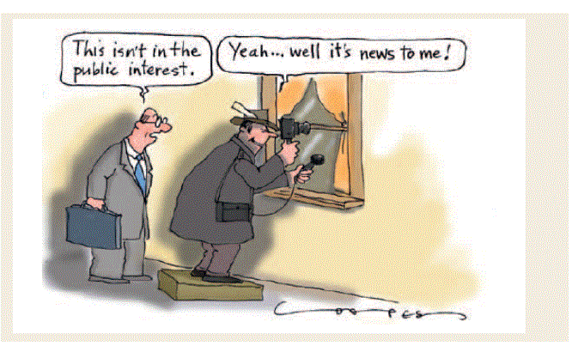

Slide 14
BLM – Public Interest Determination: The authorized officer may complete an exchange only after a determination is made that the public interest will be well served (40 CFR 2200.0-6)
FS - Public Interest Determination: The decision must conclude that the selected exchange is in the public interest (see 36 CFR 254.3b) and must include adequate rationale to support that conclusion.

Slide 15
FS EA or EIS Process
  Moves projects documented in an Environmental Assessment (EA)/Decision Notice (DN) or Environmental Impact Statement (EIS)/Record of Decision (ROD) from a post-decisional appeals process (36 CFR 215) to a pre-decisional objection process.
  Notice and comment process
    Legal notice of opportunity to comment
      30 days for an EA; no extension allowed
      45 days for an EIS; extension allowed
      Must post a copy of the legal notice of opportunity to comment on web within 4 days of its publication. This is a new requirement!

Slide 16
    Objection time periods
      45 day objection period for EAs
      45 day objection period for EISs
    Objection response period
      45 days for Reviewing Officer to respond
        Discretion to extend for 30 days

Slide 17
BLM NEPA Unique to Land Exchanges
Must include purchase and sale alternative
Disposition of Structures
Foreseeable use of Lands
Outstanding Rights and Deed Restrictions
Value Information
Notes:
Cumulative effects needs to consider the foreseeable use of lands fed and non-fed

Slide 18
Legislated Exchanges
FSH 1909.15 - national environmental policy act handbook
Chapter - zero code
Level of NEPA may require consultation with OGC.
Notes:
There are some ministerial actions which a Federal agency is required by law to undertake, and the Agency does not have discretion not to act, or to control the action. Occasionally, Congress may direct the Forest Service to take certain actions, such as sale, exchange, or disposal of land, and the Forest Service has no discretion whether or how to take the action. In these cases it is not likely that the Forest Service is obligated to perform analysis and documentation under NEPA. The specific statutory wording is key in these circumstances and therefore it is important to consult with an Office of General Counsel attorney to verify whether or not NEPA applies in each specific situation.

Slide 19
FS - Certificate of Inspection and Possession
  There is an updated Certificate of Inspection and Possession (CIP). All FS Regions should start using the new CIP immediately. March 2017 Briefing Paper to Regions from WO**.
Checklist in DOJ Regulations very handy for CIP form.
** Your region may not be using this form!

Slide 20
BLM Certificate of Inspection and Possession
  Form 2000-5 (August 2005)
  Form 2000-6 (August 2006)
(trivia – what is different about the two forms?)
Notes:
BLM has not adopted the new DOJ forms as of this date.

Slide 21
Environmental Site Assessments
  Designation: E1527 − 13
  Standard Practice for Environmental Site Assessments: Phase I Environmental Site Assessment Process
Purpose—The purpose of this practice is to define good
commercial and customary practice in the United States of
America for conducting an environmental site assessments of a
parcel of commercial real estate with respect to the range of
contaminants within the scope of the Comprehensive Environmental
Response, Compensation and Liability Act (CERCLA)
(42 U.S.C. §9601) and petroleum products.
Notes:
Environmental Professional Environmental Professionals. Pre-acquisition environmental assessments consistent with EPA’s AAI rule can be performed by either contractors or Forest Service personnel. However, the contractor or the Forest Service personnel responsible for the preparation of the assessment must be qualified as an Environmental Professional (EP) prior to beginning the AAI process.
Assistant Environmental Professional The regulation allows for participation of individuals who do not qualify as Environmental Professionals provided the activities are conducted under the supervision or responsible charge of an Environmental Professional

Slide 22
Environmental Site Assessments
United States Environmental Protection Agency (EPA) issued new regulations for performance of environmental site assessments conducted as part of the land acquisition screening process. These new regulations, promulgated as the final Standards and Practices for All Appropriate Inquiries (AAI) (40 CFR 312)

Slide 23
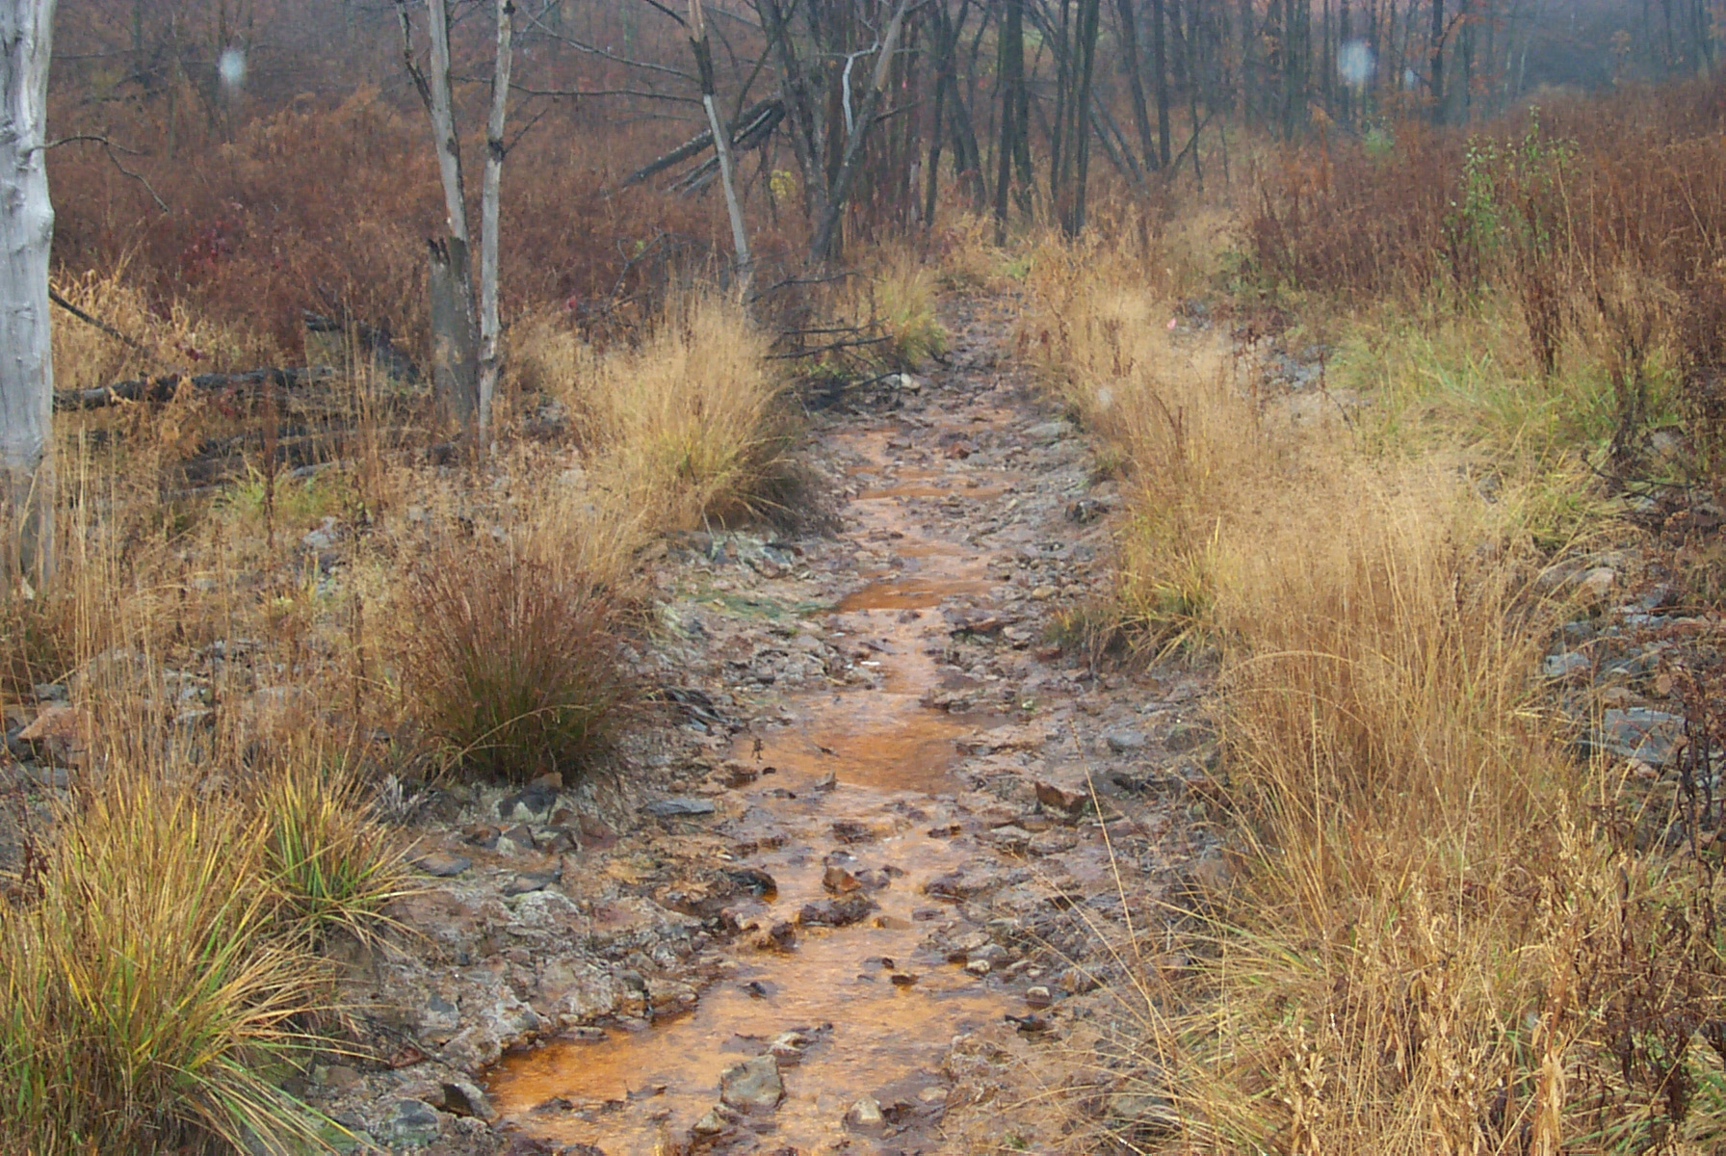
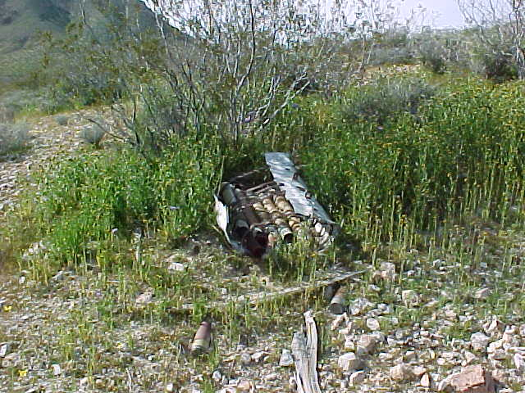
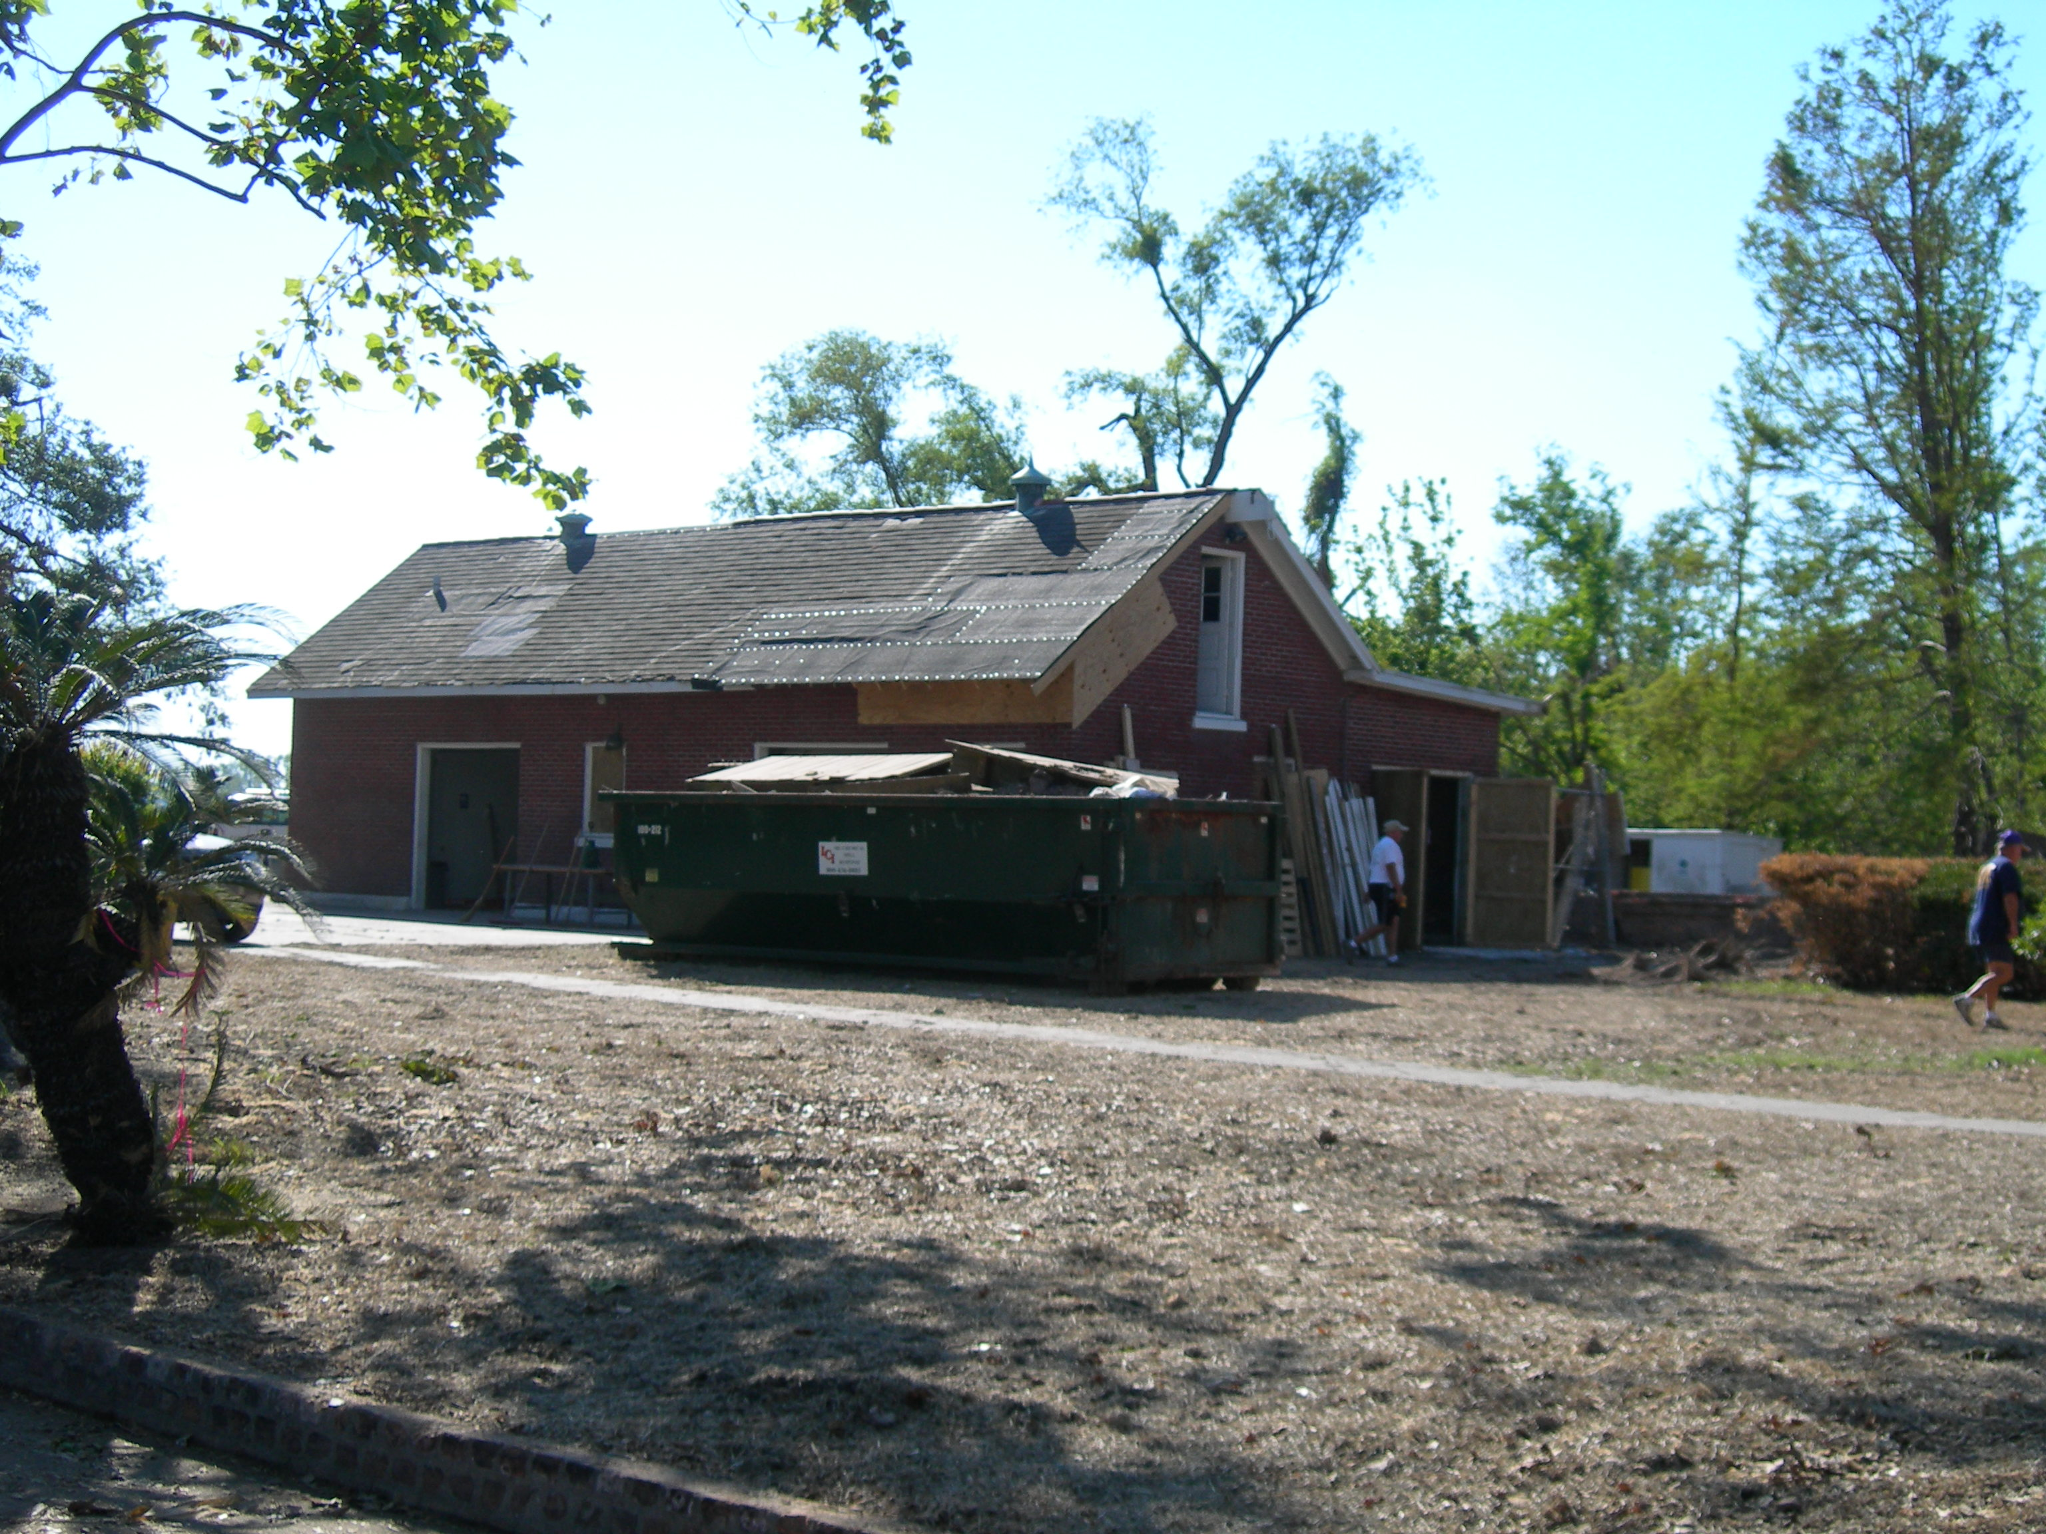


Pre-Acquisition Environmental Assessment Guidance
for Federal Land Transactions

Slide 24
BLM Handbooks
602 Departmental Manual 2
H-2000-01 Pre-acquisition handbook
H-2000-02 environmental site assessment for disposal
FS currently does not have a Handbook

Slide 25
All Appropriate Inquiry - Land Acquisition Screening
Worksheet 1: RECORDS SEARCH
All Appropriate Inquiry - Land Acquisition Screening
Worksheet 2: INTERVIEWS WITH PAST and PRESENT OWNERS, OPERATORS, and OCCUPANTS
All Appropriate Inquiry - Land Acquisition Screening
Worksheet 3: SITE VISIT SURVEY-VISUAL ON-SITE INSPECTION OF THE PROPERTY AND OF ADJOINING PROPERTIES

