Slide 1
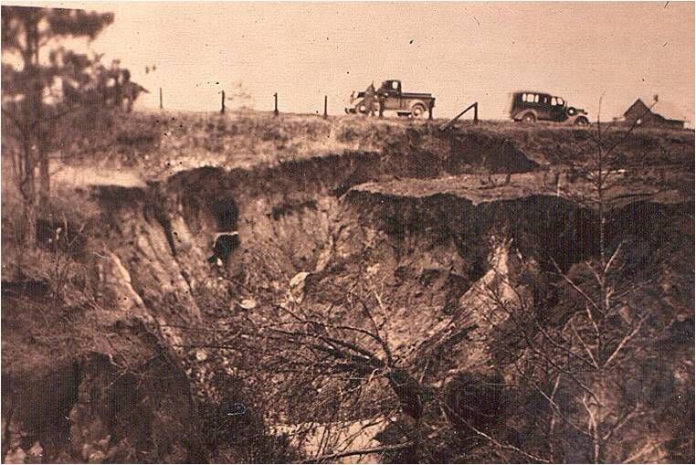
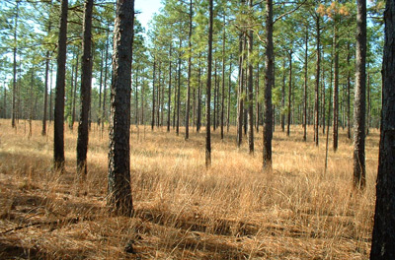
Celebrating a
Century of Conservation

Slide 2
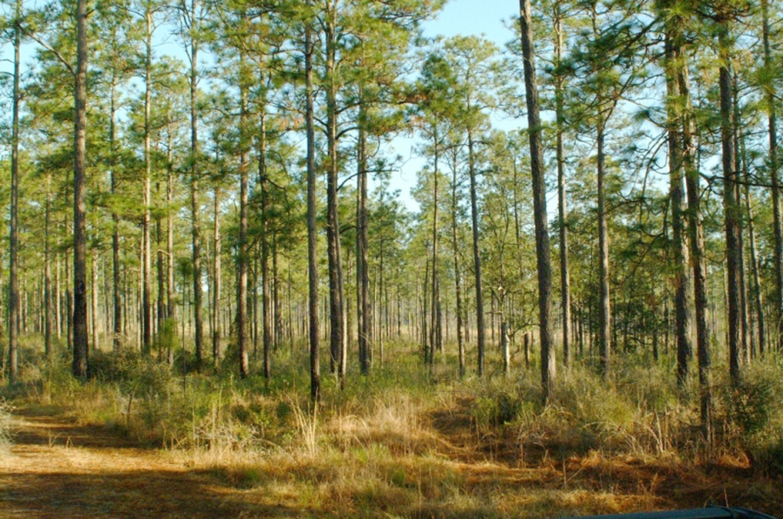
Weeks Forest Purchase Act
The Weeks Act, passed in 1911, led to the creation and restoration of many beautiful forests
we enjoy today—
52 national forests
in 26 eastern states.

Slide 3
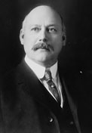
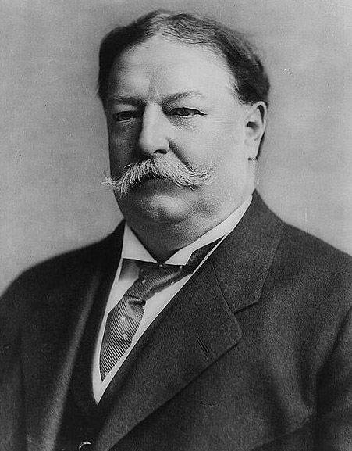
Weeks Forest Purchase Act
Named after U.S. Rep. John Weeks (R-MA)
Signed into law by President Taft on March 1, 1911

Slide 4
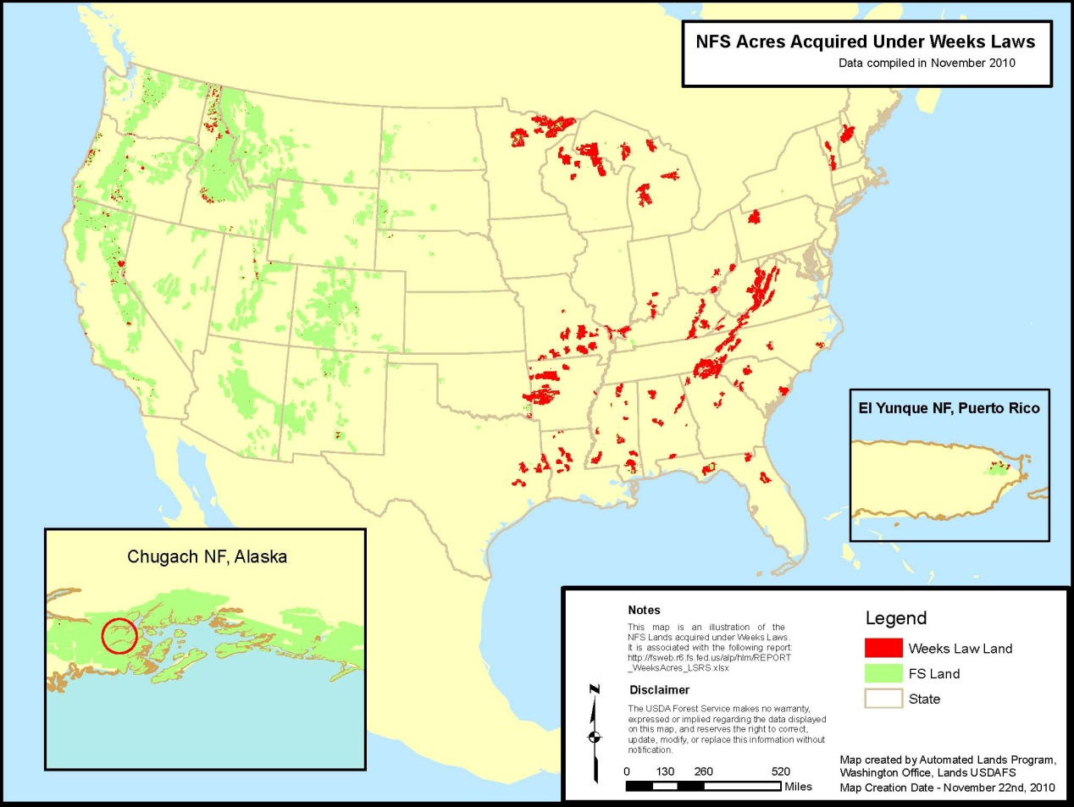
Weeks Forest Purchase Act
Approximately 25 million acres of national forests, mostly in the East, were born out private land purchases made possible by the Weeks Act.

Slide 5
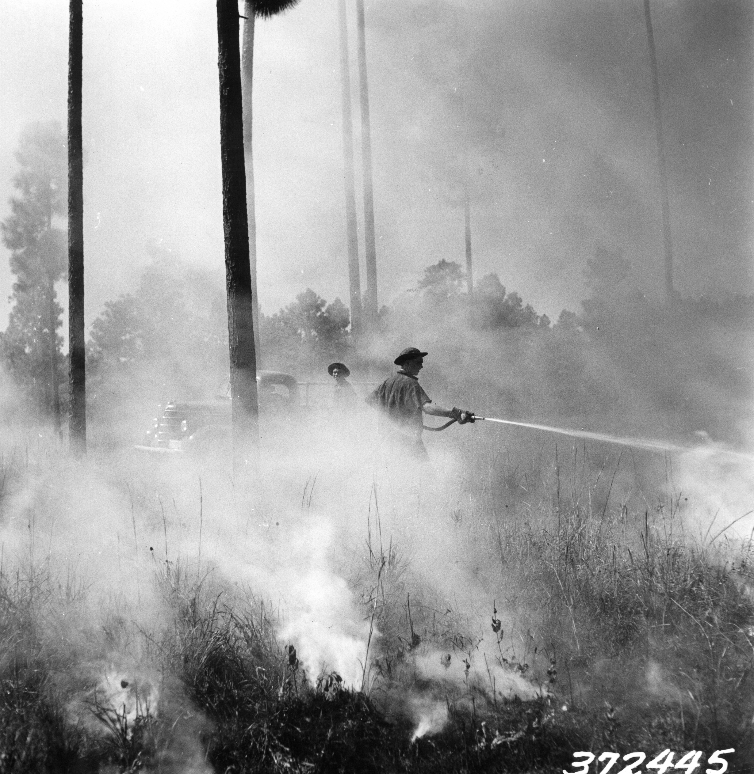
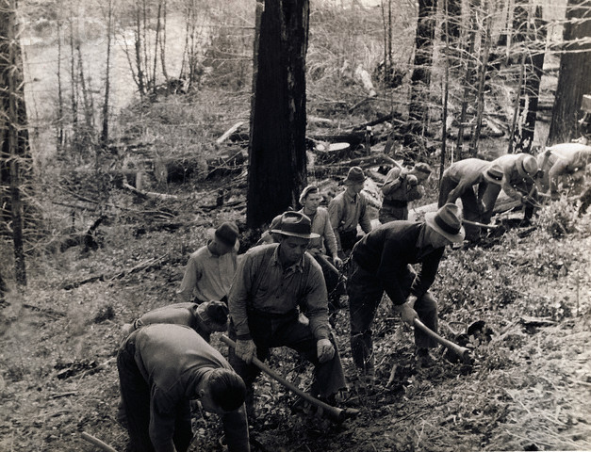
Three Major Focus Areas
The Weeks Act, the first law of its kind, launched a century of conservation.
Reducing
Catastrophic Wildfires
Protecting Water
Restoring Forests

Slide 6
Protecting Water
Today, one fifth of the entire nation’s clean drinking water flows from land acquired through the Weeks Act.
The Weeks Act Centennial 1911-2011

Slide 7
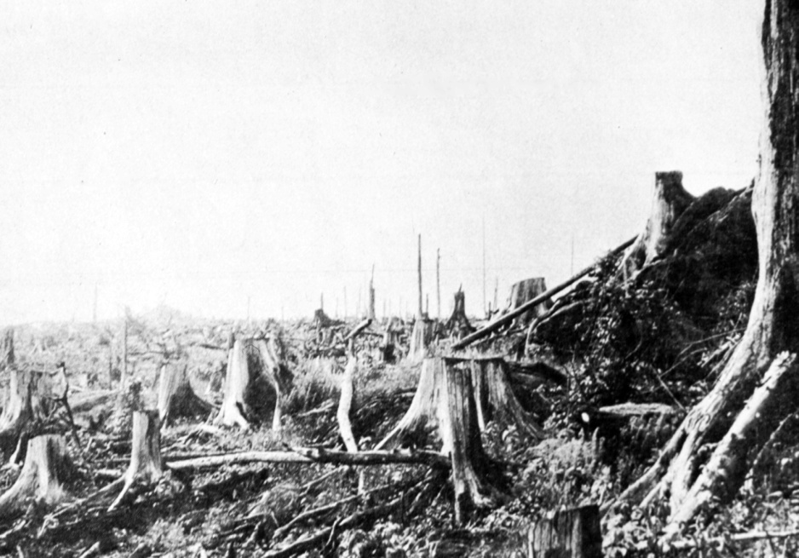
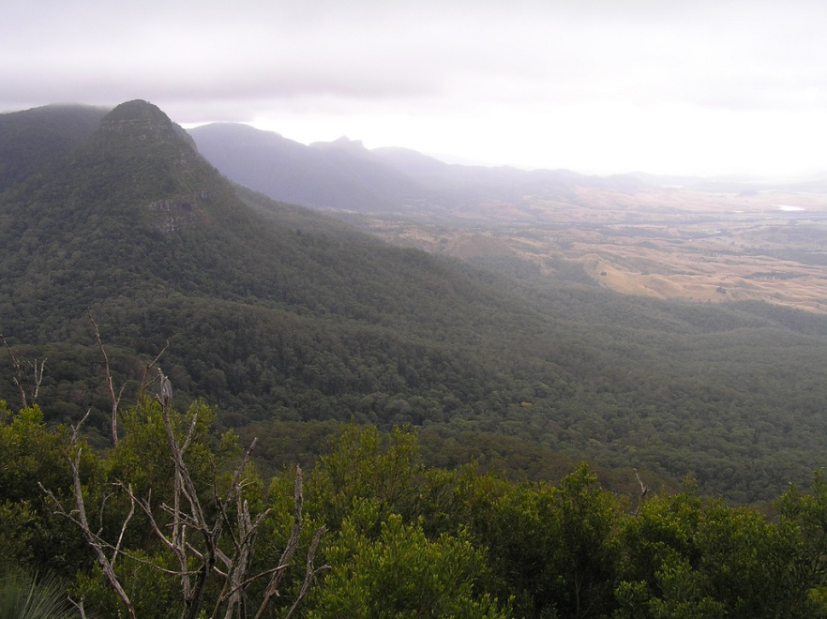
Restoring Forests
Forest Service employees, working with partners, restored and replanted millions of acres of bare and eroded land.
Mt. Mitchell, NC in 1923
Mt. Mitchell, NC today

Slide 8
The Weeks Act – as it pertains to LEX
“The General Exchange Act of the East*”
Value greater than $150,000 must submit for Congressional Oversight.
Value greater than $250,000 requires Secretary of Agriculture approval – then sent for Congressional Oversight.
*Except for PD and Bankhead Jones Status Lands

Slide 9
The Weeks Act – as it pertains to LEX
1. Decision document.
2. Exchange agreement.
3. Appraisal review.
4. Wetland and floodplain report.
5. Hazardous substances report.
6. Certificate of use and consent.
7. Case summary (not needed for Weeks Law cases under $250,000).
8. Exchange digest, Form FS 5400-10, Proposed Exchange.
9. Two full-size forest maps that identify the Federal and non-Federal lands involved in the exchange and contain a legend and name of the exchange. Only one map is needed for Weeks Law cases valued under $250,000.

