Slide 1
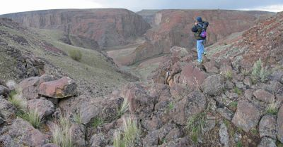
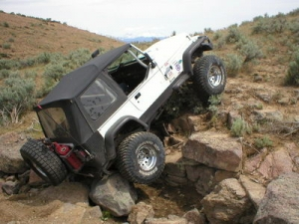
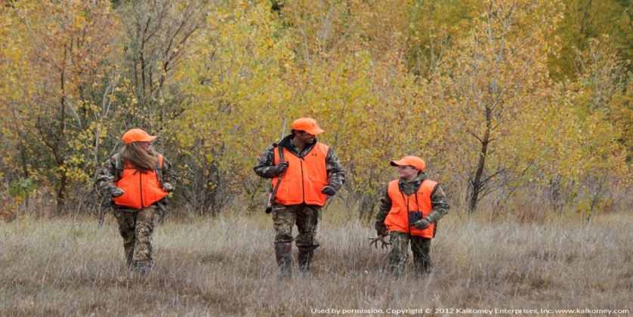
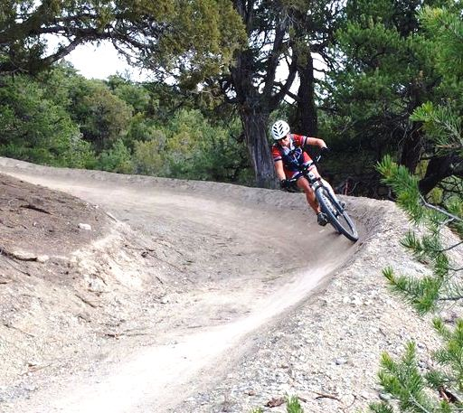
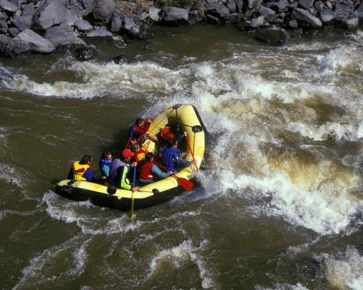
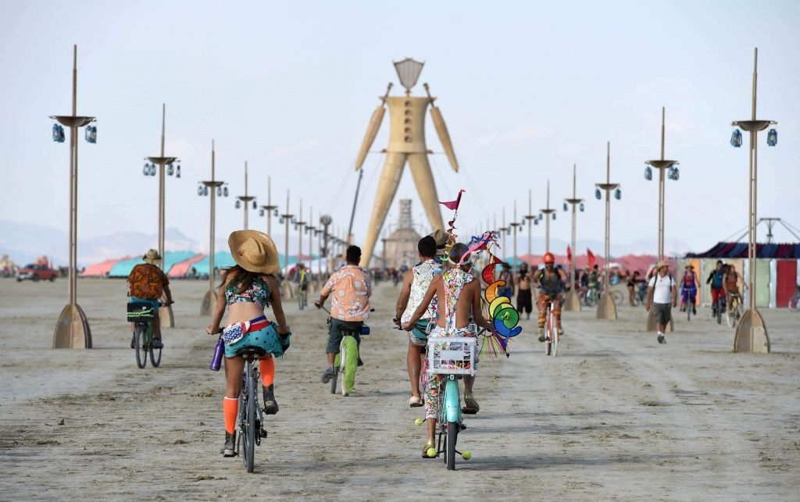
Planning for Recreation and Visitor Services

Slide 2
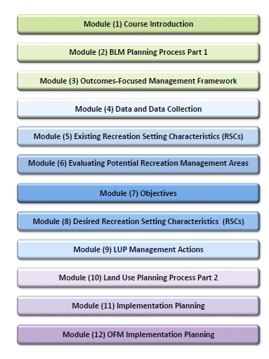

Slide 3
Course Introduction
Part 1: WO Perspective
  Who's who in WO-250
  What's new: BCAs, NEPA streamlining
  Leadership Priorities
Part 2:
  What's happening in Recreation and Visitor Services.
  Changing public values and Expectations of Land Management Agencies

Slide 4

Dorothy Morgan
Who’s Who in WO-250
Recreation Planning
Land Use Plan/NEPA reviews
Federal Register Notice review/assistance
Supplementary Rules

Slide 5

Peggi Brooks
Who’s Who in WO-250
Recreation.gov
Recreation Use Permits
Special Rec. Permit support
Business Plans
Commercial Services/Concession Support
Visitor Safety

Slide 6

David Ballenger
Who’s Who in WO-250
Rec Permits and Fees Lead:
Special Recreation Permits
Recreation Use Permits support
Federal Land Recreation Enhancement Act (FLREA)
Interagency Passes
Rec 1 Stop (rec.gov)
Business Plans
SRP audits
State permit & fee evaluations

Slide 7
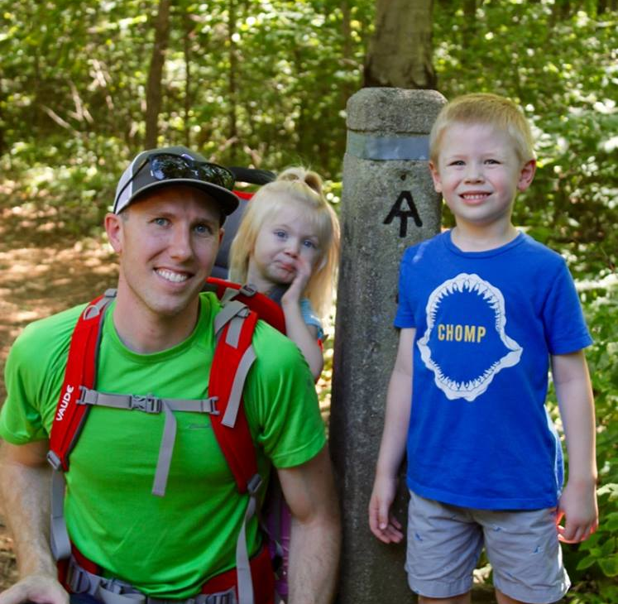
Cory Roegner
Who’s Who in WO-250
Recreation (L1220) Program Lead
Shooting Sports MOU/partnership liaison
Federal Register Notice & Legislative Reviews
Land & Water Conservation Fund Support
Liaison to the Recreation & Visitor Services Advisory Team (State Rec leads)
Permit & Fee Program Support
National budget development

Slide 8

Remembering Rob Perrin
Who’s Who in WO-250
Travel and Transportation Management lead
Trails lead
Fixing America’s Surface Transportation Act liaison with Engineering (9420)
RMP reviews
Notes:
Rob passed away May 13, 2017 after battling cancer for eight years. During this time, his mind remained as sharp as ever and his passion for his work, as the Trails and Travel Management Program lead shined through. Rob did not let his illness define him and the strength, courage and resiliency he displayed were a great inspiration to us all.

Slide 9
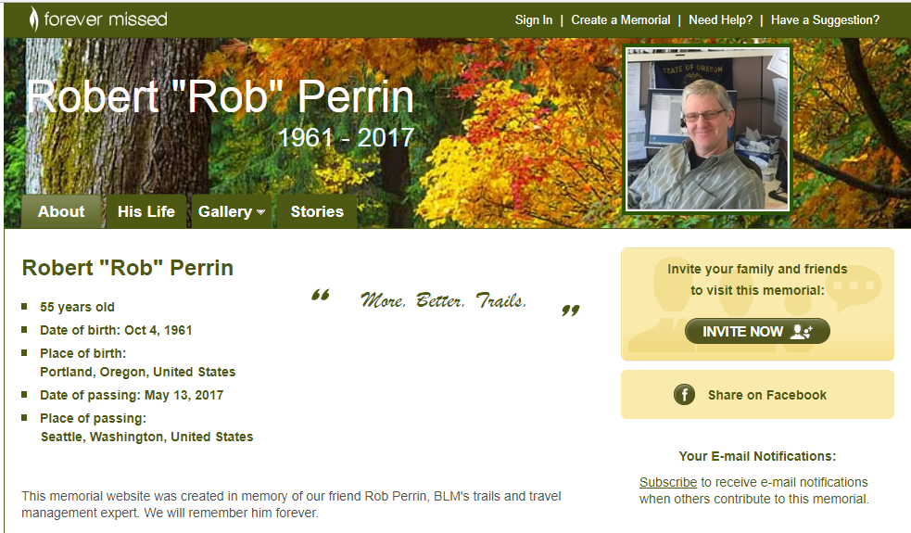
Who’s Who in WO-250
Notes:
Rob passed away May 13, 2017 after battling cancer for eight years. During this time, his mind remained as sharp as ever and his passion for his work, as the Trails and Travel Management Program lead shined through. Rob did not let his illness define him and the strength, courage and resiliency he displayed were a great inspiration to us all.

Slide 10

Dennis Byrd
Who’s Who in WO-250
Recreation Data Standards lead
Recreation Management Information System user representative
Recreation Mapping/ website/sharepoint lead

Slide 11

John McCarty
Who’s Who in WO-250
Chief Landscape Architect
Visual Resource Management
Quality Built Environment Guidelines
Dark Skies
Energy Program liaison

Slide 12
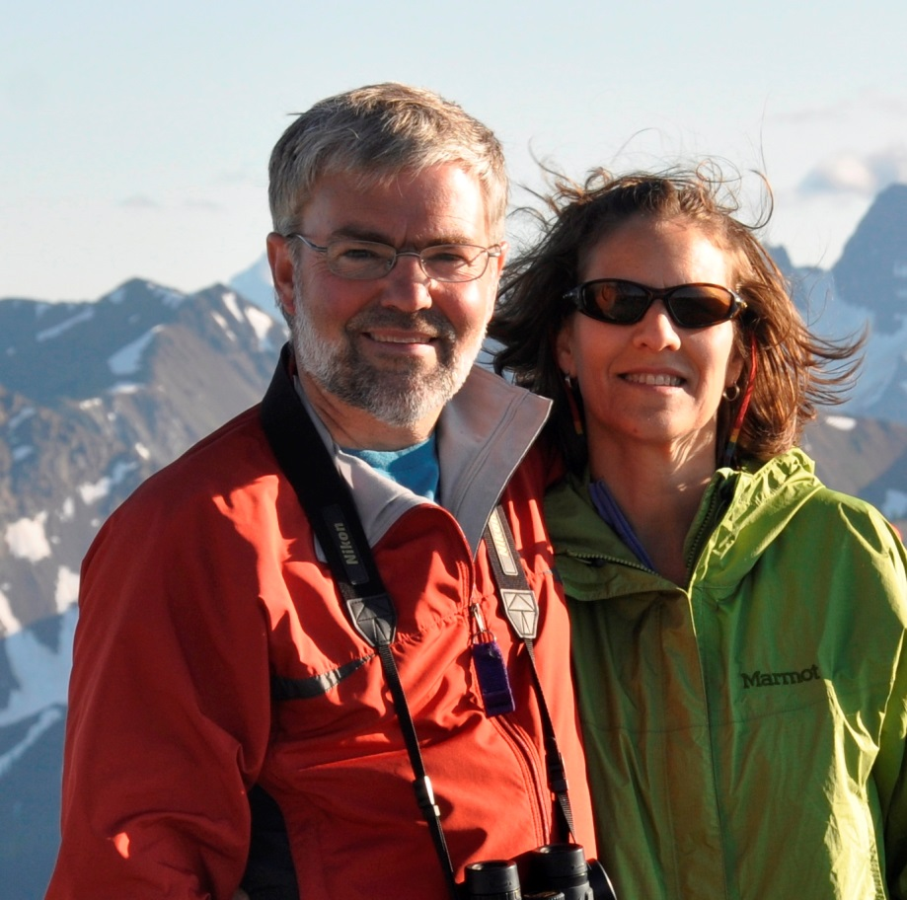
Larry Ridenhour
Who’s Who in WO-250
Accessibility Coordinator
  Accessibility program policy guidance
  Technical assistance and support
  Facility action plans
  RMIS Business Manager

Slide 13
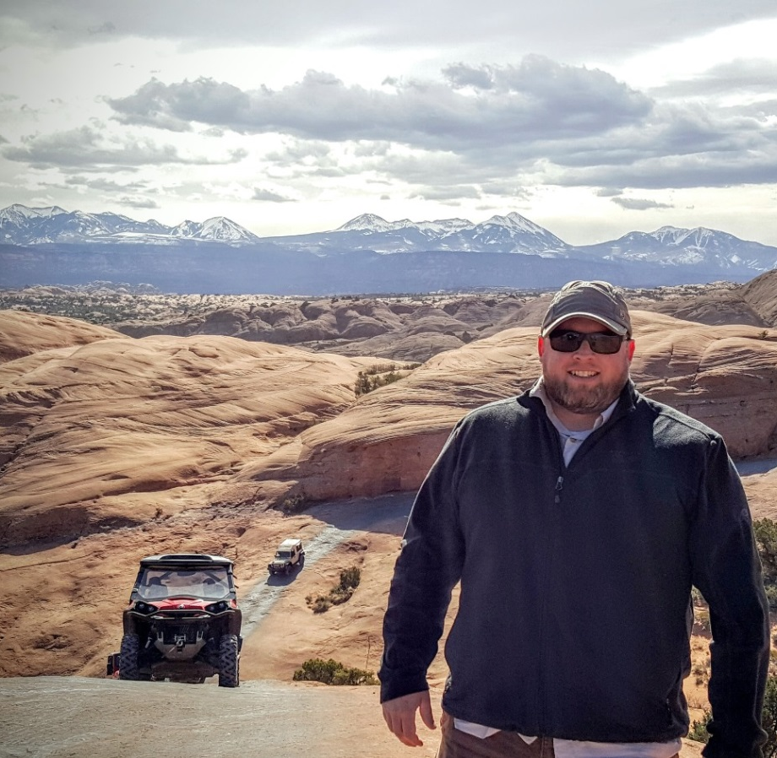
David Jeppesen
Who’s Who in WO-250
Travel and Transportation Management
Travel Plan Implementation Strategy for Greater Sage Grouse Habitat Areas
Travel Management Training Instructor
Field Support

Slide 14

Katlyn Burns
Who’s Who in WO-250
Website development
Data integration
Rec Mapping
RIDB support

Slide 15
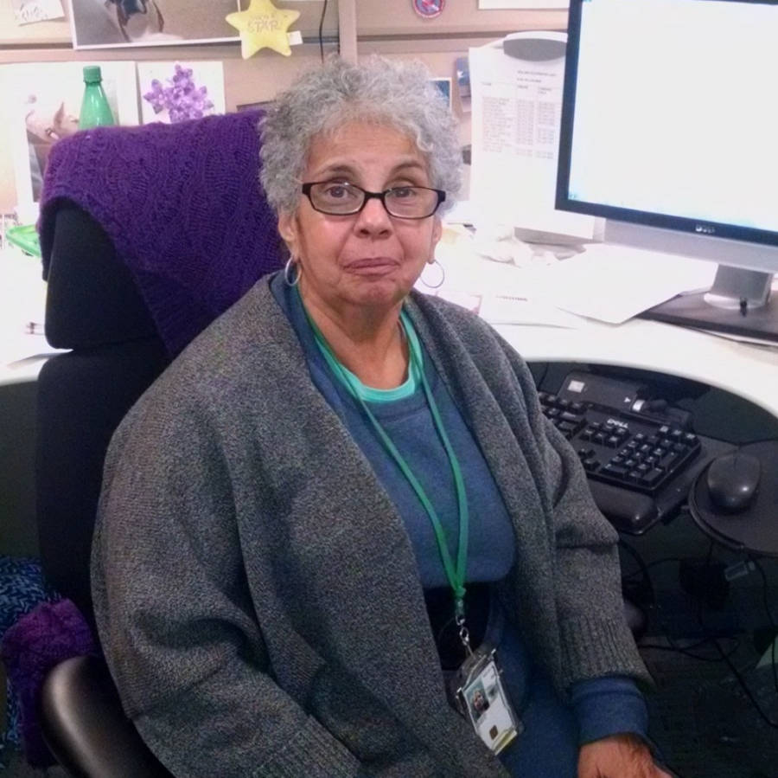
Karen Glascoe
Who’s Who in WO-250
Staff Assistant
Division administrative and technical business operations support; process & track correspondence and policy guidance; maintain administrative/personnel records; process personnel & procurement actions; timesheets, and travel/voucher coordinator.

Slide 16

Jeff McCusker
Who’s Who in WO-250
Deputy Division Chief-Recreation & Visitor Services
Provides day to day program staff and workload supervision, personnel actions; Division budget oversight; track division/program priorities: workforce strategic planning; AD-200 inter-program; internal/external program briefings.

Slide 17

Andy Tenney
Who’s Who in WO-250
Division Chief - Recreation and Visitor Services
Workforce planning
National budget
Division priorities
DSD relations
Program briefings
NTC and NOC coordination
Training policy oversight

Slide 18
What’s New
Backcountry Conservation Areas (BCAs)
Streamlining
Reorganization

Slide 19
What’s New
BACKCOUNTRY CONSERVATION AREAS
Purpose
To preserve generally intact, undeveloped public lands:
That contain priority HABITATS for recreationally-important fish and wildlife species,
and
That provide high-quality wildlife-dependent RECREATION OPPORTUNITIES afforded by those species.

Slide 20
What’s New
BACKCOUNTRY CONSERVATION AREAS
Criteria:
  Generally Intact and Undeveloped
  2. Habitat for Recreationally-Important Fish and/or Wildlife Species

Slide 21
What’s New
BACKCOUNTRY CONSERVATION AREAS
A Special Recreation Management Area (SRMA) with commensurate wildlife objectives.
From IM2017-036, Considering Backcountry Conservation Management in Land Use Planning Efforts
“…use the Special Recreation Management Area (SRMA) designation process to designate as Backcountry Conservation Areas (BCA) those areas that will be managed to maintain or enhance high-quality wildlife-dependent recreation opportunities.”
See H-8320-1 Planning for Recreation and Visitor Services,
Appendix 4 – Special Recreation Management Area Template

Slide 22
What’s New
STREAMLINING
The Office of Management and Budget (OMB) has directed each Executive Branch Department to develop a plan to enhance efficiency:
- Leveraging technology
Streamlining processes
Considering other serviced delivery models
Leveraging existing requirements
Identify which functions their agencies perform that are not core to their mission, are redundant with other organizations or can be restructured
Notes:
Email from Mike Nedd, Acting Director sent May 8, 2017.

Slide 23
What’s New
REORGANIZATION -
March 13, 2017, the President issued an Executive Order calling for a Comprehensive Plan for Reorganizing the Executive Branch.
“Washington East” ?
“Washington West” ?

Slide 24
Leadership Priorities
New leadership, new priorities.

Slide 25
Leadership Priorities
We’ve taken the approach of dividing the BLM workload into three categories or buckets.
1) The first bucket is the priority workload that would be most responsive to the Leadership Priorities.
2) The second bucket includes the work we must do by law or regulation that is not already in the first bucket. Leadership will review and prioritize the work in this second bucket and allocate resources accordingly.
3) The third bucket includes any remaining low-priority work that leadership will review and assess, using any remaining funds available.

Slide 26
Leadership Priorities
1) Making America Safe Through Energy Independence (encouraging environmentally responsible development of energy and minerals on public lands)
2) Making America Great Through Shared Conservation Stewardship
(by working with our partners to promote multiple-use on public lands)
3) Making America Safe – Restoring Our Sovereignty
(through effective management of the borderlands and cooperation with the Department of Defense on public land issues)
4) Getting America Back to Work
(by promoting job creation and supporting working landscapes)
5) Serving the American Family (by being good neighbors, supporting traditional land uses such as grazing, and providing access to hunting, fishing, and other recreational opportunities)
Notes:
What are the Leadership Priorities?
BLM leadership has developed a set of high-level priorities consistent with the themes and related goals of the Administration and our guiding legislation, the Federal Land Policy and Management Act. The priorities are organized along five themes.

Slide 27
Leadership Priorities
1) Making America Safe Through Energy Independence (encouraging environmentally responsible development of energy and minerals on public lands);
2) Making America Great Through Shared Conservation Stewardship
(by working with our partners to promote multiple-use on public lands);
3) Making America Safe – Restoring Our Sovereignty (through effective management of the borderlands and cooperation with the Department of Defense on public land issues);
4) Getting America Back to Work
(by promoting job creation and supporting working landscapes)
5) Serving the American Family
(by being good neighbors, supporting traditional land uses such as grazing, and providing access to hunting, fishing, and other recreational opportunities.
Notes:
What are the Leadership Priorities?
BLM leadership has developed a set of high-level priorities consistent with the themes and related goals of the Administration and our guiding legislation, the Federal Land Policy and Management Act. The priorities are organized along five themes.

Slide 28
Leadership Priorities
2) Making America Great Through Shared Conservation Stewardship
(by working with our partners to promote multiple-use on public lands);
Enhance opportunities for volunteer service and youth engagement on public lands
Create opportunities to engage at least 25,000 volunteers annually by providing meaningful projects that directly support the BLM’s multiple-use mission.
Maximize the impact of national programs that engage youth, families, and local communities (i.e. National Public Lands Day, National Trails Day, Every Kid in a Park, etc.) by hosting local events and providing adequate financial support at the national level.
Notes:
What are the Leadership Priorities?
BLM leadership has developed a set of high-level priorities consistent with the themes and related goals of the Administration and our guiding legislation, the Federal Land Policy and Management Act. The priorities are organized along five themes.

Slide 29
Leadership Priorities
2) Making America Great Through Shared Conservation Stewardship
(by working with our partners to promote multiple-use on public lands);
Emphasize BLM’s multiple-use mandate through strategic communication efforts and educational outreach
Launch a national BLM multiple-use campaign to engage the public, academia, NGOs, and other stakeholder groups through increased activity on new media platforms, and by hosting a variety of education and outreach events at the local level.
Expand BLM’s communication and education outreach efforts to emphasize the variety of ways the public can access, enjoy, and benefit from BLM lands as a result of our multiple-use mandate.
Notes:
What are the Leadership Priorities?
BLM leadership has developed a set of high-level priorities consistent with the themes and related goals of the Administration and our guiding legislation, the Federal Land Policy and Management Act. The priorities are organized along five themes.

Slide 30
Leadership Priorities
4) Getting America Back to Work
(by promoting job creation and supporting working landscapes)
Modernize critical information systems
Enhance web-based public access to resource and geospatial data related to energy and minerals, grazing permit processing, recreation, and other BLM programs.
Notes:
What are the Leadership Priorities?
BLM leadership has developed a set of high-level priorities consistent with the themes and related goals of the Administration and our guiding legislation, the Federal Land Policy and Management Act. The priorities are organized along five themes.

Slide 31
Leadership Priorities
4) Getting America Back to Work
(by promoting job creation and supporting working landscapes)
Pursue maintenance and capital improvement projects that address infrastructure needs
Prioritize Deferred Maintenance and Capital Improvement projects emphasizing projects that create jobs in local communities, improve recreation access, and enhance visitor safety.
Work closely with Federal Highways on Federal Lands Transportation Program (FLTP), Federal Lands Access Programs (FLAP), and Emergency Relief for Federally Owned Roads (ERFO) to accomplish high-priority projects in order to increase public access to BLM lands.
Notes:
What are the Leadership Priorities?
BLM leadership has developed a set of high-level priorities consistent with the themes and related goals of the Administration and our guiding legislation, the Federal Land Policy and Management Act. The priorities are organized along five themes.

Slide 32
Leadership Priorities
4) Getting America Back to Work
(by promoting job creation and supporting working landscapes)
Provide employment opportunities for veterans, youth, and others to work on public lands
Maximize use of existing hiring authorities to strengthen the Bureau’s diversity, including veterans, youth, and individuals with disabilities.
Strengthen recruitment, outreach efforts, and partnerships with local stakeholder groups to promote employment opportunities for local tribes and other underrepresented communities.
Notes:
What are the Leadership Priorities?
BLM leadership has developed a set of high-level priorities consistent with the themes and related goals of the Administration and our guiding legislation, the Federal Land Policy and Management Act. The priorities are organized along five themes.

Slide 33
Leadership Priorities
5) Serving the American Family (by being good neighbors, supporting traditional land uses such as grazing, and providing access to hunting, fishing, and other recreational opportunities.
Maintain a capable, ethical, and diverse professional workforce and an inclusive and motivating work culture that drives high productivity
Assess and improve BLM’s leadership development programs, technical training … and course offerings at the National Training Center to align with national priorities.
Enhance the future workforce by engaging a diverse cadre of youth in meaningful internship or service-learning programs.
Notes:
What are the Leadership Priorities?
BLM leadership has developed a set of high-level priorities consistent with the themes and related goals of the Administration and our guiding legislation, the Federal Land Policy and Management Act. The priorities are organized along five themes.

Slide 34
Leadership Priorities
5) Serving the American Family (by being good neighbors, supporting traditional land uses such as grazing, and providing access to hunting, fishing, and other recreational opportunities.
Enhance our relationships with States and local communities
Actively engage the public, local communities, and Resource Advisory Councils in decisions that may affect local public land resources, including economic opportunities, responsible development, recreational access, cultural sites, habitat management, and subsistence issues.
Notes:
What are the Leadership Priorities?
BLM leadership has developed a set of high-level priorities consistent with the themes and related goals of the Administration and our guiding legislation, the Federal Land Policy and Management Act. The priorities are organized along five themes.

Slide 35
Leadership Priorities
5) Serving the American Family (by being good neighbors, supporting traditional land uses such as grazing, and providing access to hunting, fishing, and other recreational opportunities.
Enhance our relationships with States and local communities
Expand outreach and education efforts with States and local communities (across diverse social, ethnic, and cultural settings) to increase awareness and appreciation of BLM’s multiple-use mission and the public lands.
Notes:
What are the Leadership Priorities?
BLM leadership has developed a set of high-level priorities consistent with the themes and related goals of the Administration and our guiding legislation, the Federal Land Policy and Management Act. The priorities are organized along five themes.

Slide 36
Leadership Priorities
5) Serving the American Family (by being good neighbors, supporting traditional land uses such as grazing, and providing access to hunting, fishing, and other recreational opportunities.
Enhance our relationships with States and local communities
Develop county level metrics of socio-economic benefits from activities on public lands including energy and mineral development and National Conservation Lands.
Develop annual economic contribution estimates associated with BLM activities and programs at a state and national level.
Notes:
What are the Leadership Priorities?
BLM leadership has developed a set of high-level priorities consistent with the themes and related goals of the Administration and our guiding legislation, the Federal Land Policy and Management Act. The priorities are organized along five themes.

Slide 37
Leadership Priorities
5) Serving the American Family (by being good neighbors, supporting traditional land uses such as grazing, and providing access to hunting, fishing, and other recreational opportunities.
Enhance our relationships with States and local communities
Finalize and implement BLM Travel and Tourism Action Plans to increase economic opportunities, jobs, and recreational access in local communities.
Notes:
What are the Leadership Priorities?
BLM leadership has developed a set of high-level priorities consistent with the themes and related goals of the Administration and our guiding legislation, the Federal Land Policy and Management Act. The priorities are organized along five themes.

Slide 38
Leadership Priorities
5) Serving the American Family (by being good neighbors, supporting traditional land uses such as grazing, and providing access to hunting, fishing, and other recreational opportunities.
Expand recreational, hunting, and wildlife conservation opportunities
Implement Secretarial Order 3347 to enhance conservation stewardship, increase recreation, and improve the management of habitat, including for game species.
Assess and improve BLM’s recreation-related websites, including Rec.gov, to identify local opportunities for families to access and enjoy public lands; streamline trip planning and reservation services; and offer updated, engaging, and relevant visitor information.
Notes:
What are the Leadership Priorities?
BLM leadership has developed a set of high-level priorities consistent with the themes and related goals of the Administration and our guiding legislation, the Federal Land Policy and Management Act. The priorities are organized along five themes.

Slide 39
Leadership Priorities
5) Serving the American Family (by being good neighbors, supporting traditional land uses such as grazing, and providing access to hunting, fishing, and other recreational opportunities.
Expand recreational, hunting, and wildlife conservation opportunities
Continue developing Resource Management Plans to increase the focus on providing access, recreation, hunting, and wildlife conservation opportunities through designation of recreation management areas and consideration of Backcountry Conservation Areas.
Collaborate with State, Tribal, county, local and Federal agencies, as well as other partners, to identify and secure opportunities for increased recreation access to public lands.
Notes:
What are the Leadership Priorities?
BLM leadership has developed a set of high-level priorities consistent with the themes and related goals of the Administration and our guiding legislation, the Federal Land Policy and Management Act. The priorities are organized along five themes.

Slide 40
Leadership Priorities
5) Serving the American Family (by being good neighbors, supporting traditional land uses such as grazing, and providing access to hunting, fishing, and other recreational opportunities.
Expand recreational, hunting, and wildlife conservation opportunities
Enhance opportunities for sustainable OHV recreation by continuing to apply for State Grants for Development, Restoration, Acquisition, Education and Law Enforcement.
Strengthen local and national partnerships to improve access for hunting, fishing, and other recreational activities and to enhance wildlife habitat, including for game species and migratory birds.
Offer access to the public for critical resource and geospatial data by increasing the number of national data sets available, and providing data to show recreation, hunting, and fishing opportunities.
Notes:
What are the Leadership Priorities?
BLM leadership has developed a set of high-level priorities consistent with the themes and related goals of the Administration and our guiding legislation, the Federal Land Policy and Management Act. The priorities are organized along five themes.

Slide 41
Leadership Priorities
5) Serving the American Family (by being good neighbors, supporting traditional land uses such as grazing, and providing access to hunting, fishing, and other recreational opportunities.
Enhance State and local law enforcement partnerships to increase safety and improve the visitor experience on public lands
Continue to develop Memoranda of Understanding with local law enforcement to improve incident response, conduct cross-training, and address illegal activity on public land in support of public safety and resource management goals.
Provide resources, as needed, to law enforcement to address public safety and resource protection, including drug trafficking, border issues, wildland interface fires, vehicle crashes, search and rescue, high use recreation areas, and oil field crimes.
Notes:
What are the Leadership Priorities?
BLM leadership has developed a set of high-level priorities consistent with the themes and related goals of the Administration and our guiding legislation, the Federal Land Policy and Management Act. The priorities are organized along five themes.

Slide 42


PLANNING FOR
RECREATION AND VISITOR SERVICES
www.nature-rx.org (part 1)
Notes:
Show video

Slide 43

PLANNING FOR
RECREATION AND VISITOR SERVICES
Module 1 – Part 2
What’s happening in Recreation and Visitor Services (R&VS)
Changing public values & expectations of land management agencies
H-8320-1 - Pages I-1 to I-6
Notes:
Ice-breaker question

Slide 44

PLANNING FOR
RECREATION AND VISITOR SERVICES
What’s Happening in R&VS?
What's happening in Recreation & Leisure Services?
Growing recognition of how much recreation contributes to the quality of our lives
What have you experienced?
Notes:
In the last several decades, there has been a growing recognition of how much recreation contributes to the quality of life, economy, society, and environment. Changing public values and expectations of land management agencies to meet the demand for diverse recreation uses has created the need for changes in managing R&VS.

Slide 45

Health and healing
Notes:
Personal/Individual Benefits. Accrue when recreation activities contribute to personal well-being and human development …
such as improved physical fitness and
mental health

Slide 46
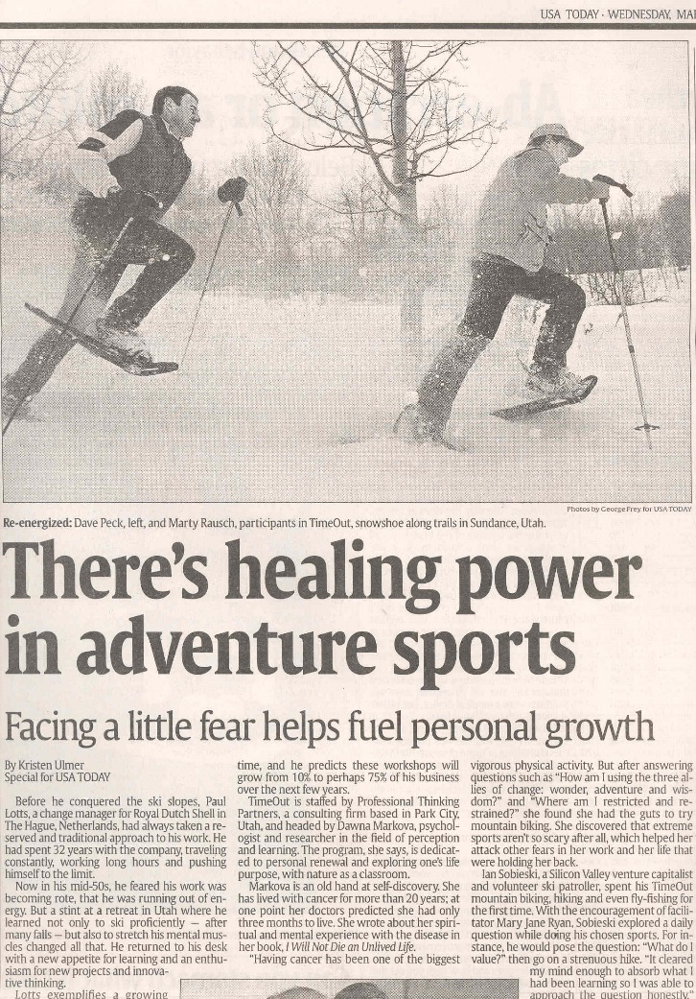

PLANNING FOR
RECREATION AND VISITOR SERVICES
What’s Happening in R&VS?
Notes:
Healing power of recreation… The underlying philosophy largely refers to experiential education.
Programs are designed to offer students experiences that can test and refine their skills, strengthen their compassion, commitment, and tenacity, all while having fun.
Existing research in adventure therapy reports positive outcomes in effectively improving self-concept and self-esteem, help seeking behavior, increased mutual aid, pro-social behavior, trust behavior and more.

Slide 47

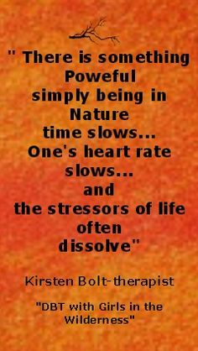
PLANNING FOR
RECREATION AND VISITOR SERVICES
What’s Happening in R&VS?
Notes:
Using the outdoors to make positive social

Slide 48
PLANNING FOR
RECREATION AND VISITOR SERVICES
What’s Happening in R&VS?
Addressing O.D.D.
Outdoor Deficit Disorder
Notes:
outdoor recreation deficit disorder

Slide 49
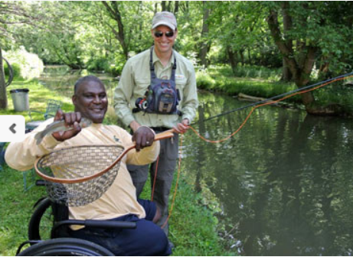

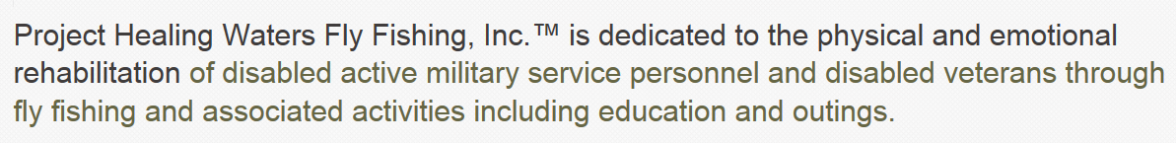
PLANNING FOR
RECREATION AND VISITOR SERVICES
What’s Happening in R&VS?
Notes:
Therapy Programs based around different recreation activities

Slide 50



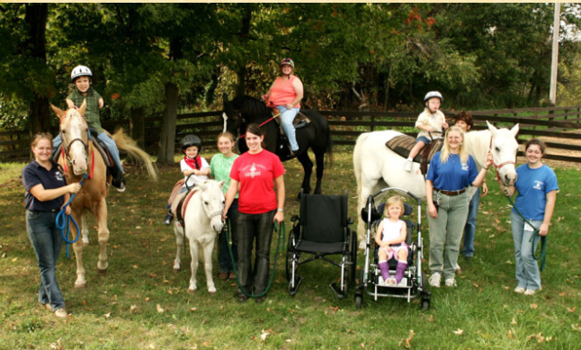
PLANNING FOR
RECREATION AND VISITOR SERVICES
What’s Happening in R&VS?
Notes:
Therapy Programs …Using riding and horses to motivate at-risk kids

Slide 51

PLANNING FOR
RECREATION AND VISITOR SERVICES
What’s Happening in R&VS?
Times change. Traditions don't.
This is the prime time to create a bond between you and your kids, nephews and nieces. Instead of sharing a video game or TV, why not show them how you spent time as a youth - shooting and hunting. http://www.takemehuntingandshooting.com/index.php
Notes:
TAKE ME HUNTING - This is the prime time to create a bond between you and your kids, nephews and nieces. Instead of sharing a video game or TV, why not show them how you spent time as a youth - shooting and hunting. http://www.takemehuntingandshooting.com/index.php

Slide 52
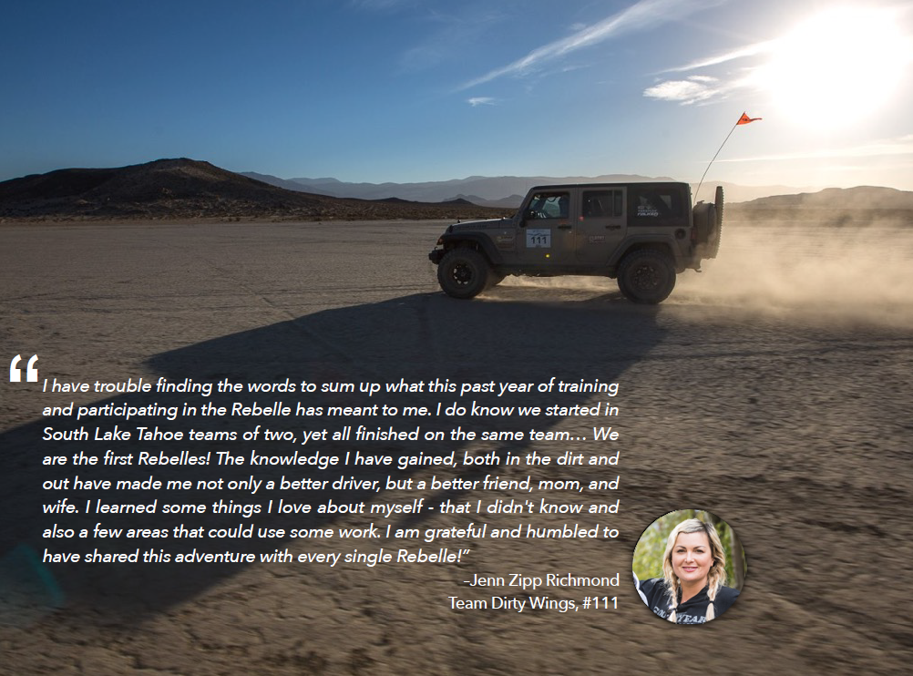
“Rebelle Rally…made me not only a better driver, but a better friend, mom, and wife.”

Slide 53



PLANNING FOR
RECREATION AND VISITOR SERVICES
What’s Happening in R&VS?
Notes:
Recreation Works… Recreational programming is crucial to the health and well-being of our communities. Recreation programs help our children grow, our youth learn important life skills, and reduce isolation amongst our senior citizens.

Slide 54
PLANNING FOR
RECREATION AND VISITOR SERVICES
What’s Happening in R&VS?
Please Insert:
Recreation Works!
https://www.youtube.com/watch?v=tpz3NPWPq8Q&index=9&list=PLb7UGCN5cPJKJ0mgvciOCG5OlC9HMto60
Notes:
Recreation Works video 1

Slide 55
PLANNING FOR
RECREATION AND VISITOR SERVICES
What’s Happening in R&VS?
Please Insert:
In Saskatchewan, Green is the Colour! (HD)
https://www.youtube.com/watch?v=7Bpkf6aCI-U&index=8&list=PLb7UGCN5cPJKJ0mgvciOCG5OlC9HMto60
Notes:
Green is the Colour!

Slide 56

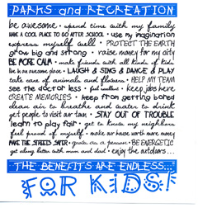

PLANNING FOR
RECREATION AND VISITOR SERVICES
What’s Happening in R&VS?
Campaign to show the importance of recreation by describing benefits
Notes:
Several years ago the National Parks and Recreation Assoc. launched a campaign called “Recreation, The Benefits are Endless”.
The campaign aimed to show the importance of recreation by describing benefits associated with individuals, communities, the environment and the economy.

Slide 57

PLANNING FOR
RECREATION AND VISITOR SERVICES
What’s Happening in R&VS?
Notes:
Many parks and recreation departments immediately adopted the “The benefits are endless” campaign.

Slide 58

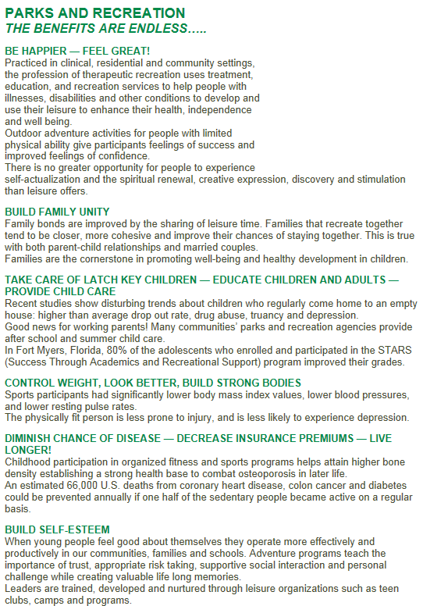
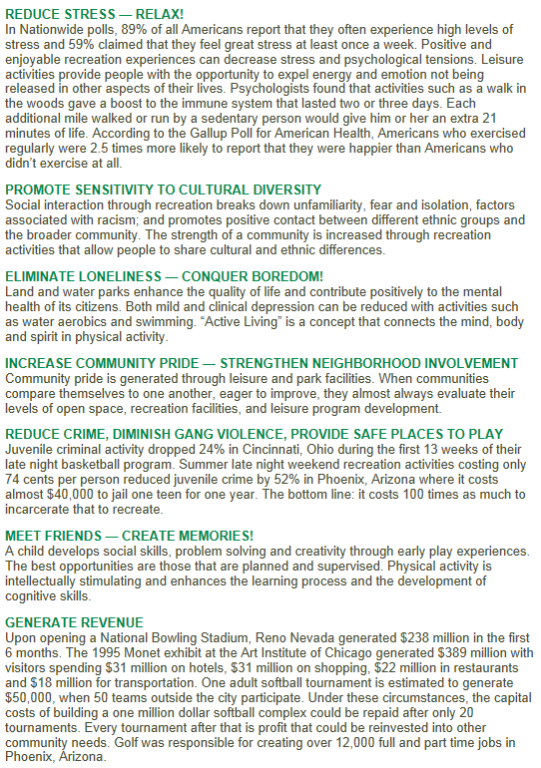
PLANNING FOR
RECREATION AND VISITOR SERVICES
What’s Happening in R&VS?
Notes:
Massachusetts P&RA

Slide 59
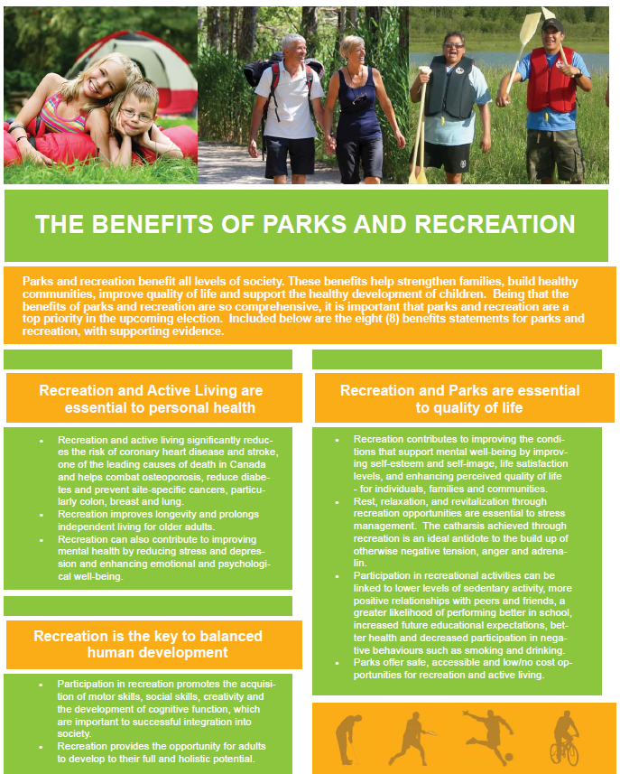
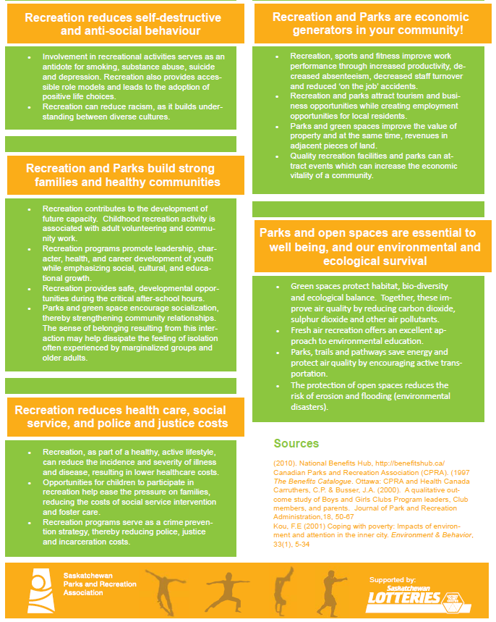
PLANNING FOR
RECREATION AND VISITOR SERVICES
What’s Happening in R&VS?
Notes:
Another example - not only in the US but around the world parks and recreation departments were publicizing the benefits of recreation. Here is an example from Canada.

Slide 60
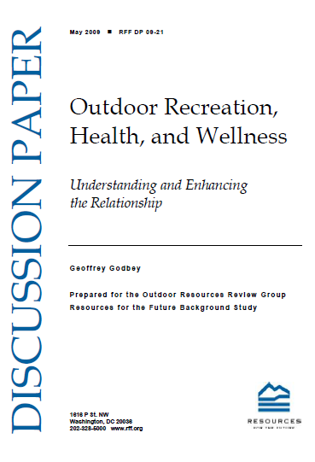
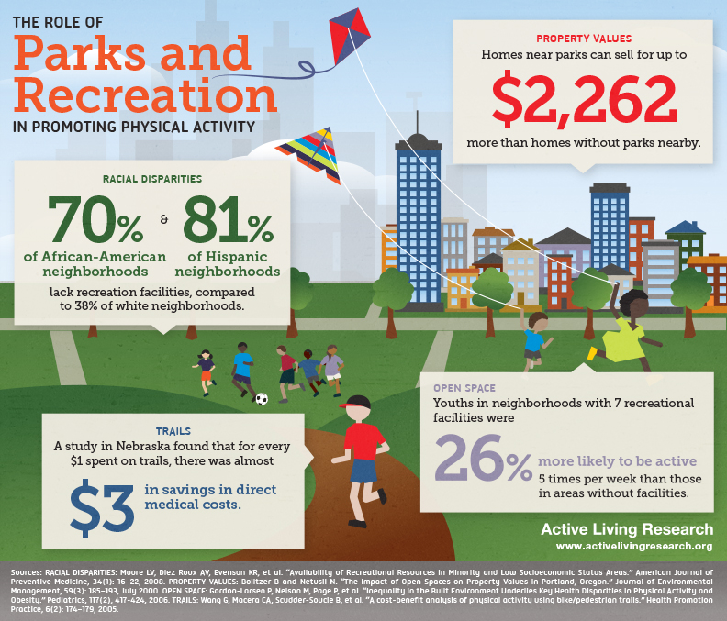
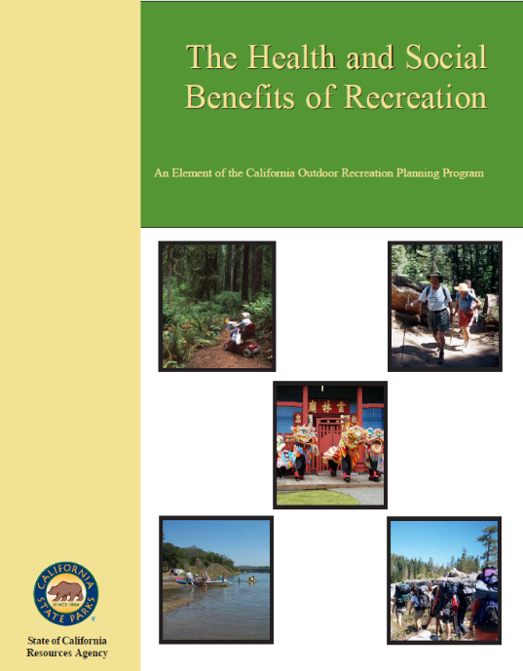
PLANNING FOR
RECREATION AND VISITOR SERVICES
What’s Happening in R&VS?
Research to Practice
Notes:
The research literature on outdoor recreation as it relates to human health is growing.
Being outside in natural surroundings may improve health and how outdoor physical activities benefit participants. Living in comparatively natural areas, viewing nature, and having outdoor recreation areas and facilities nearby appear to provide health benefits.
Social Benefits - Calif Outdoor Resources Planning Program
Research to Practice

Slide 61



PLANNING FOR
RECREATION AND VISITOR SERVICES
What’s Happening in R&VS?
Notes:
Economic Benefits - around the world parks and recreation departments are publicizing the benefits of recreation.

Slide 62
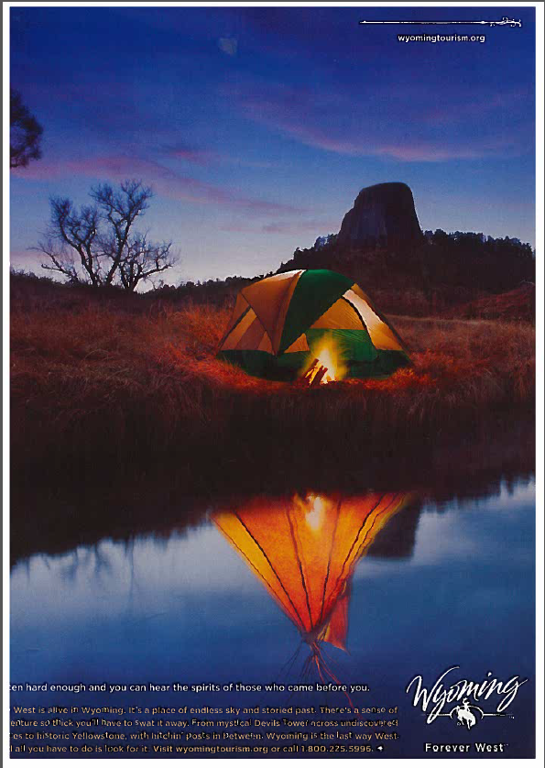
PLANNING FOR
RECREATION AND VISITOR SERVICES
What’s Happening in R&VS?
Listen hard enough and you can hear the spirits of those who came before you
Notes:
No matter where you look the value of the outdoors and outdoor recreation is all around us.
Advertisement

Slide 63

PLANNING FOR
RECREATION AND VISITOR SERVICES
What’s Happening in R&VS?
Notes:
Two word ad from Montana is my all-tine favorite

Slide 64
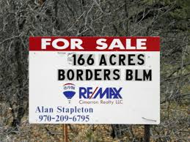
PLANNING FOR
RECREATION AND VISITOR SERVICES
What’s Happening in R&VS?
Parks and trails and open spaces are among the top community amenities.
Notes:
And real estate companies are quick to sell the amenities and opportunities and benefits of buying parcels next to BLM
Parks and trails and open spaces are among the top community amenities.
Living in comparatively natural areas, viewing nature, and having outdoor recreation areas and facilities nearby appear to provide health benefits - Outdoor Recreation,Health, and Wellness by Godbey
Another example from my FO … these exclusive homesites back up to open space or BLM, providing with a backyard extension of mother nature herself …

Slide 65
PLANNING FOR
RECREATION AND VISITOR SERVICES
www.nature-rx.org (part 2)
Notes:
Show video and discuss

Slide 66

PLANNING FOR
RECREATION AND VISITOR SERVICES
Changing Public Expectations?
What's happening in Recreation & Leisure Services?
Growing recognition of how much recreation contributes to the quality of our lives
Changing public values & expectations of land management agencies
How have Federal agencies responded?
Notes:
Discuss: Changing public values & expectations of land management agencies
Ask: How have federal land management agencies responded to growing recognition of how much recreation contributes to the quality of our lives?

Slide 67

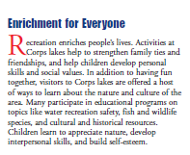
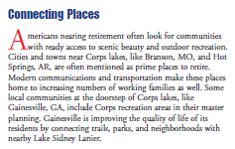
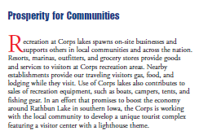
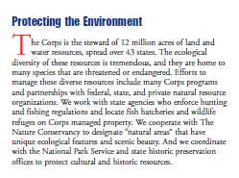
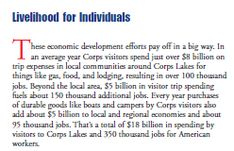
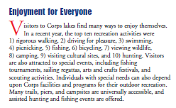
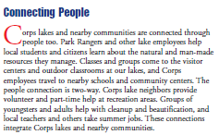
PLANNING FOR
RECREATION AND VISITOR SERVICES
Changing Public Expectations?

Slide 68

PLANNING FOR
RECREATION AND VISITOR SERVICES
Changing Public Expectations?
“Outdoor recreation is fun -- and so much more.”
“Participation in recreational activities is the way that most Americans come to know their National Forests and Grasslands.”
“Recreation thereby contributes greatly to the physical, mental, and spiritual health of individuals, bonds family and friends, instills pride in their heritage, and provides economic benefits to communities, regions, and the nation.”
Notes:
“Outdoor recreation is fun -- and so much more.”
“Participation in recreational activities is the way that most Americans come to know their National Forests and Grasslands.”
“Recreation thereby contributes greatly to the physical, mental, and spiritual health of individuals, bonds family and friends, instills pride in their heritage, and provides economic benefits to communities, regions, and the nation.”

Slide 69

PLANNING FOR
RECREATION AND VISITOR SERVICES
Changing Public Expectations?
Guide for incorporating public health considerations in the development of a park or trail.
Facilitate interagency and stakeholder discussion and collaboration related to parks, trails, and community health issues.
Find data and information to engage and enlist new health partners, funding resources and stakeholders.
Assess the health and community needs for a new park/trail project or enhancement.
Notes:
This workbook is intended as an outline and quick guide for incorporating public health considerations in the development of a park or trail.
Its intended and potential uses include helping you:
Facilitate interagency and stakeholder discussion and collaboration related to parks, trails, and community health issues.
Find data and information to engage and enlist new health partners, funding resources and stakeholders.
Assess the health and community needs for a new park/trail project or enhancement.
Prepare for a health impact assessment (http://www.cdc.gov/healthyplaces/hia.htm) or for health grant applications.

Slide 70
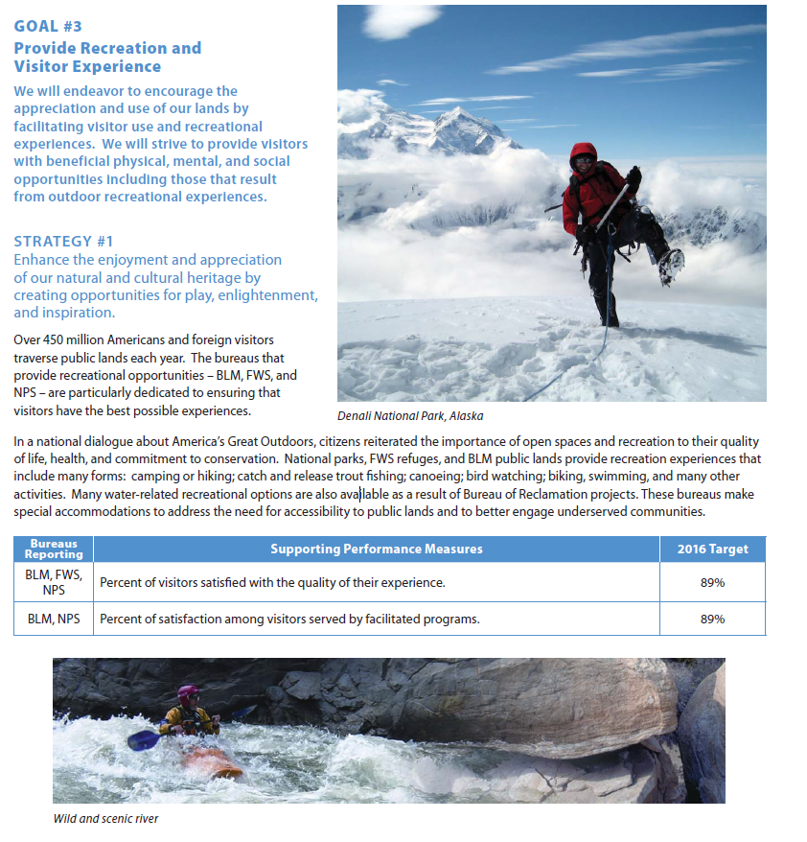

PLANNING FOR
RECREATION AND VISITOR SERVICES
Changing Public Expectations?
Notes:
The Department of the Interior’s 2011-2016 Strategic Plan provides the framework for the programs and activities that are performed by nine bureaus and multiple offices, and that take place at 2,400 locations throughout the Nation.
The Strategic Plan facilitates the integration of programs, the allocation and alignment of resources to achieve key goals, and
collaboration and coordination with stakeholders.

Slide 71
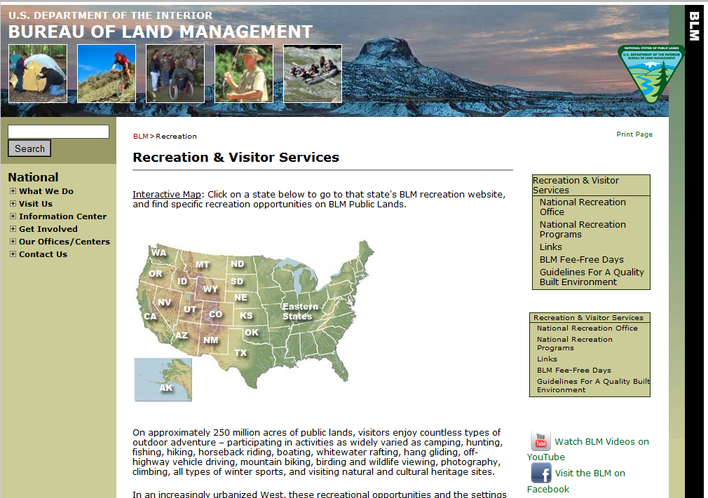
PLANNING FOR
RECREATION AND VISITOR SERVICES
Changing Public Expectations?
So what about BLM?
Notes:
Ask “So what about BLM?
In the last several decades, there has been a growing recognition of how much recreation contributes to the quality of life, economy, society, and environment. Changing public values and expectations of land management agencies to meet the demand for diverse recreation uses has created the need for changes in planning for and managing R&VS.

Slide 72
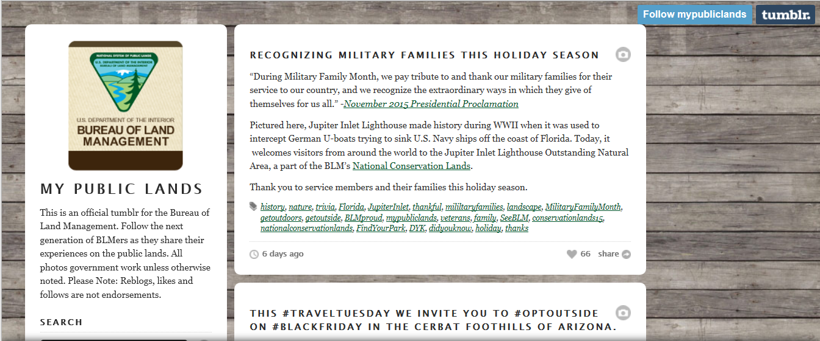
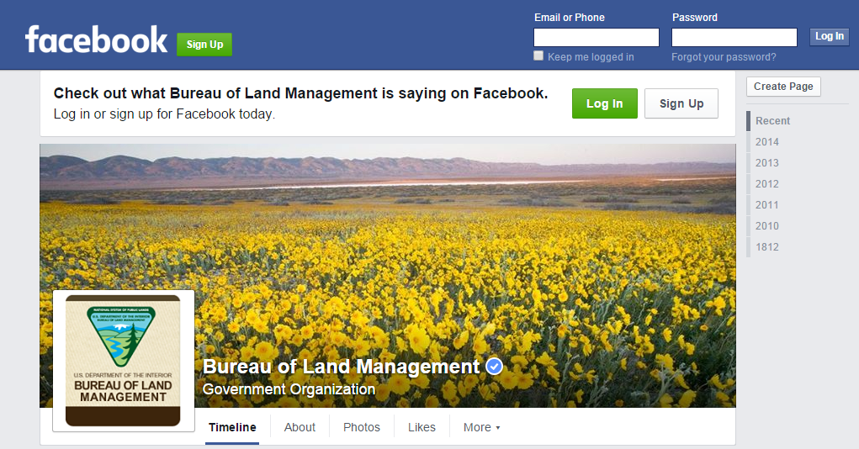
PLANNING FOR
RECREATION AND VISITOR SERVICES
Changing Public Expectations?
BLM changing the way we communicate
with our publics
Notes:
Ask “So what about BLM?
Changing the ways we communicate

Slide 73
PLANNING FOR
RECREATION AND VISITOR SERVICES
Recreation at the BLM
Please Insert:
Recreation at the BLM
<iframe width="560" height="315" src="https://www.youtube.com/embed/pbT6QZHf_sc" frameborder="0" allowfullscreen></iframe>
Notes:
Add video

Slide 74
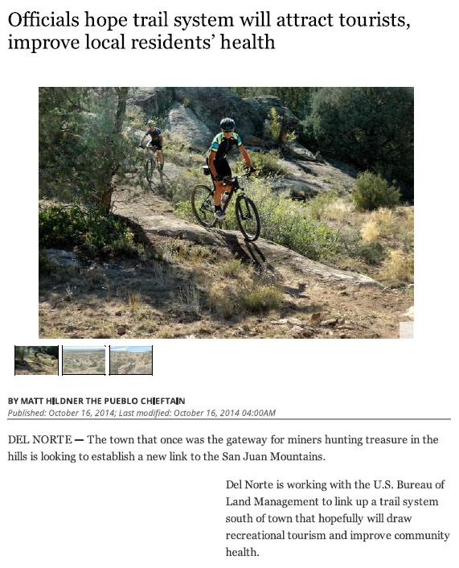
PLANNING FOR
RECREATION AND VISITOR SERVICES
Changing Public Expectations?
OUR
MESSAGES
Notes:
Ask “So what about BLM?
Changing the ways we communicate

Slide 75

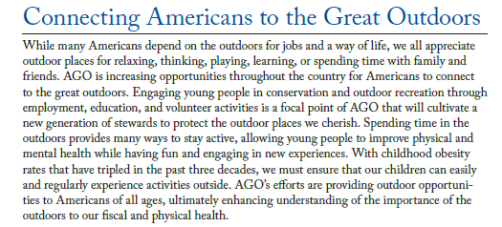
PLANNING FOR
RECREATION AND VISITOR SERVICES
Changing Public Expectations?
Discussed the benefits of being outdoors.
Notes:
BLM example

Slide 76

PLANNING FOR
RECREATION AND VISITOR SERVICES
What’s Happening in R&VS?
Strategy that will increase participation in recreational angling and boating and thereby increase public awareness and appreciation of the need to protect, conserve and restore this nation's aquatic natural resources.
Notes:
TAKE ME FISHING Program - To implement an informed, consensus-based national outreach strategy that will increase participation in recreational angling and boating and thereby increase public awareness and appreciation of the need to protect, conserve and restore this nation's aquatic natural resources.

Slide 77

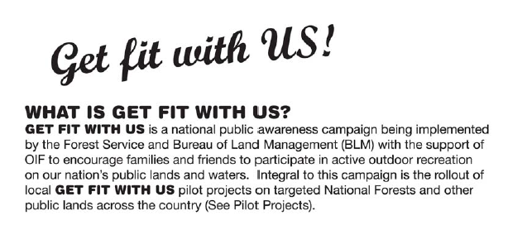
PLANNING FOR
RECREATION AND VISITOR SERVICES
Changing Public Expectations?
Campaign by the BLM and USFS to encourage people to participate in outdoor recreation
Notes:
BLM example

Slide 78
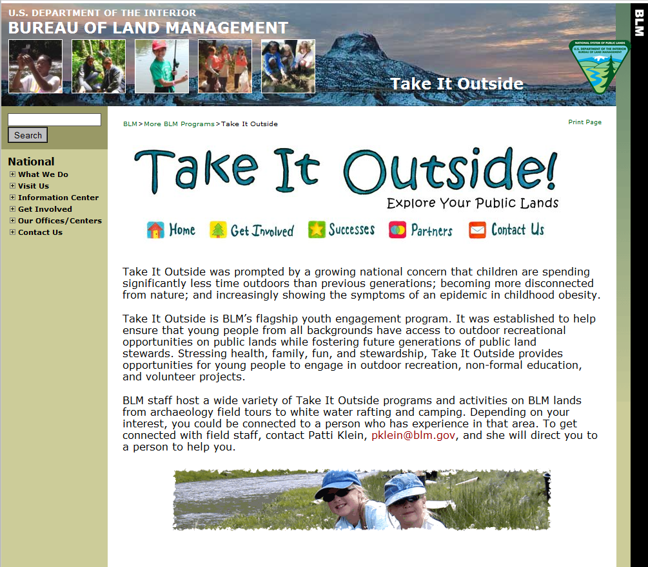
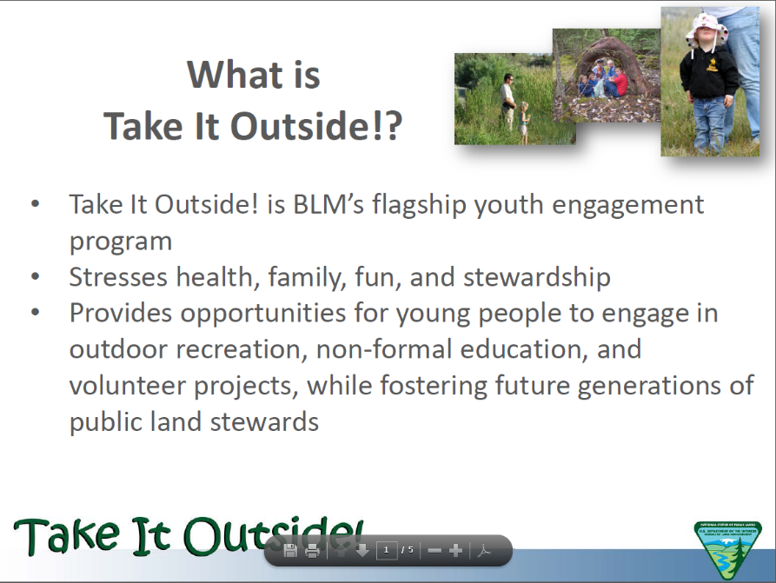
PLANNING FOR
RECREATION AND VISITOR SERVICES
Changing Public Expectations?

Slide 79

PLANNING FOR
RECREATION AND VISITOR SERVICES
Changing Public Expectations?
PLAY on public lands through recreation and outdoor activities, to
LEARN about these lands through education and interpretation programs,
to SERVE as volunteers and active stewards of the land,
and to WORK on public lands and pursue natural resource careers.
Notes:
The Bureau of Land Management (BLM) has a long tradition of connecting people of all ages to their public lands. In March of 2014, the Secretary of the Interior’s goal of “engaging the next generation” expanded this tradition and brought renewed attention to reaching out to young people, the future stewards of public lands. The initiative has four pillars: it calls upon the BLM and other Department of the Interior agencies to strengthen and increase opportunities for people to PLAY on public lands through recreation and outdoor activities, to LEARN about these lands through education and interpretation programs, to SERVE as volunteers and active stewards of the land, and to WORK on public lands and pursue natural resource careers.

Slide 80
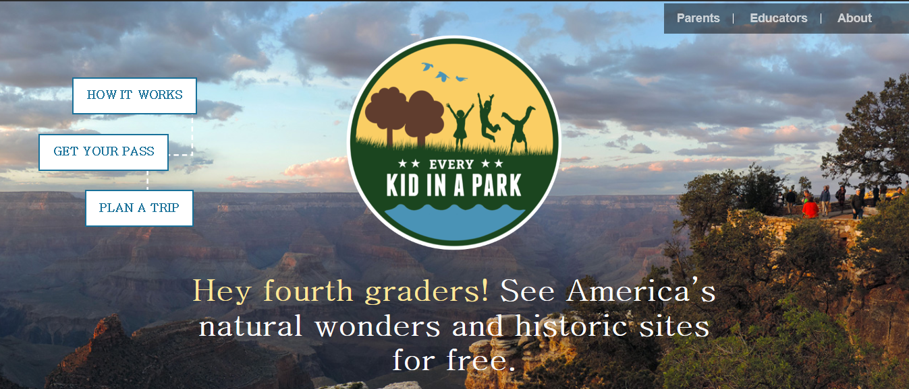
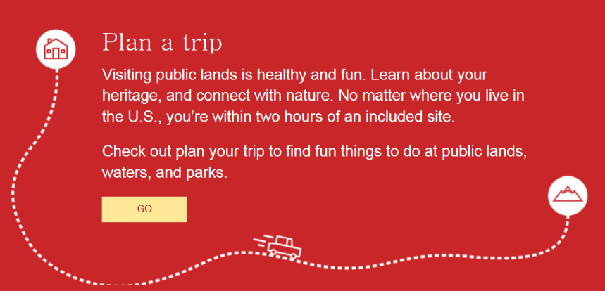
PLANNING FOR
RECREATION AND VISITOR SERVICES
Changing Public Expectations?
Notes:
President Barack Obama created Every Kid in a Park so fourth graders and their families could discover our wildlife, resources, and history for free

Slide 81


PLANNING FOR
RECREATION AND VISITOR SERVICES
Changing Public Expectations?
Notes:
Anybody hear of this strategy….know what it means?
This strategy provides a framework for BLM offices at all levels to develop action plans that will increase the efficiency and effectiveness of the BLM’s Recreation & Visitor Services Program by more fully integrating with community-based service delivery systems.
The BLM’s Recreation & Visitor Services Program manages recreation resources and visitor services to offer the greatest benefits possible to individuals and communities and to better enable communities to achieve their own desired social, economic, and environmental outcomes.
The lands nobody wanted”—are now recognized as America’s Great Outdoors, a “Backyard-to- Backcountry” treasure.

Slide 82

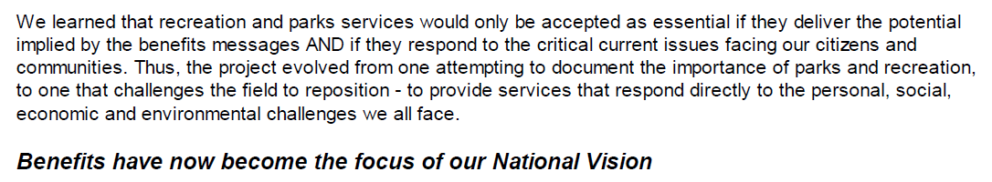
PLANNING FOR
RECREATION AND VISITOR SERVICES
Changing Public Expectations?
Canadian Parks/Recreation Association
http://lin.ca/sites/default/files/attachments/Complete1997Benefits%20Catalogue.pdf
Notes:
1997 Benefits of Parks and Recreation Catalogue
http://lin.ca/sites/default/files/attachments/Complete1997Benefits%20Catalogue.pdf
We learned that recreation and parks services would only be accepted as essential if they deliver the potential
implied by the benefits messages AND if they respond to the critical current issues facing our citizens and
communities. Thus, the project evolved from one attempting to document the importance of parks and recreation,
to one that challenges the field to reposition - to provide services that respond directly to the personal, social,
economic and environmental challenges we all face. Benefits have now become the focus of our National Vision

Slide 83

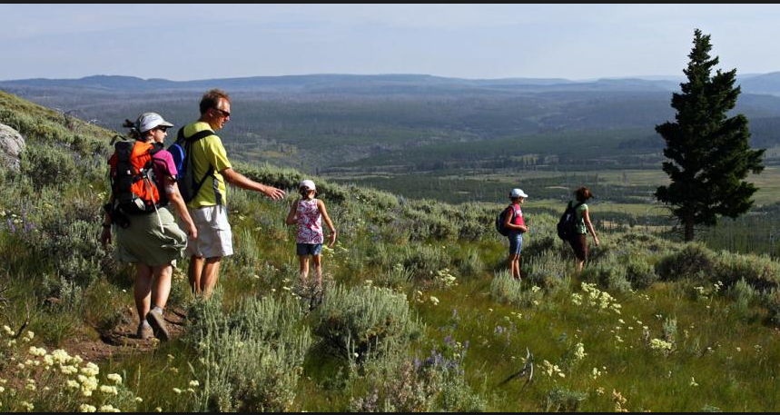


PLANNING FOR
RECREATION AND VISITOR SERVICES
Changing Public Expectations?
So how do we go from strategy or initiative to reality?
Notes:
Ask the question “How do we go from strategy to reality?”

Slide 84
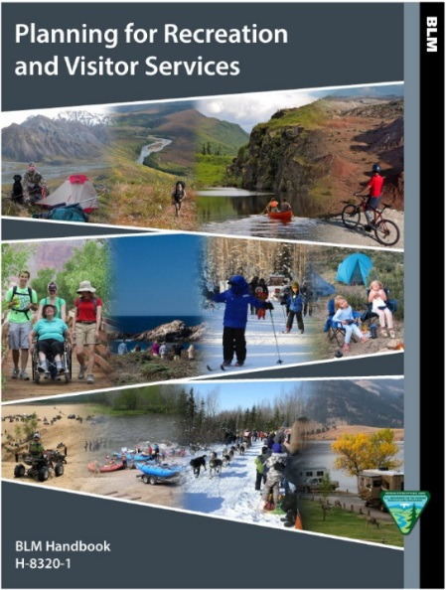

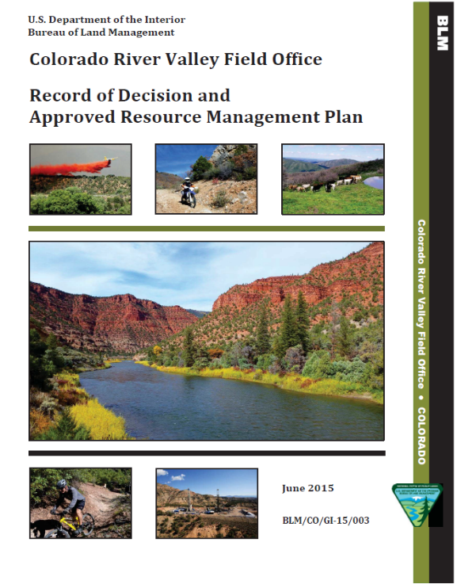
PLANNING FOR
RECREATION AND VISITOR SERVICES
Changing Public Expectations?
Provide a foundation in our plans for the implementation of strategies and programs
Notes:
Answer: Provide a better foundation in our plans for the implementation of strategies and programs

Slide 85
NATURE Rx PART 3
https://www.youtube.com/watch?v=JBTzOn3xxkE
Notes:
Add video

Slide 86


PLANNING FOR
RECREATION AND VISITOR SERVICES

Slide 87


PLANNING FOR
RECREATION AND VISITOR SERVICES

Slide 88

PLANNING FOR
RECREATION AND VISITOR SERVICES

Slide 89

Up to $20 in prizes!!!

Slide 90


Name one of the Platinum Level Donors to the 2002 Olympic Winter Games

