Slide 1
Vernal Field Office
August 2019

Slide 2



Project Planning & Environmental Factors
Notes:
Here I see the ages move, feel the earth shake, the wind cut and the water carve, feel the hot volcanic blast and smell the fumes...
Why do I intrude? There’s no intrusion. My footfall is its tremor, its wind my breath, my bones its substance.
Jerry DeLaughter, Big Bend Diary
Did you know that trees talk? Well they do. They talk to each other, and they’ll talk to you if you listen. Trouble is, [many] people don’t listen … But I have learned a lot from the trees: sometimes about the weather, sometimes about animals, sometimes about the Great Spirit.
Tatanga Mani or Walking Buffalo (1871-1967), Stoney Nation, Alberta, Canada
I talk to the trees, But they don't listen to me
I talk to the stars, But they never hear me
The breeze hasn't time, To stop and hear what I say
I talk to them all … in vain
– Clint Eastwood, Paint Your Wagon
Seriously, what Clint needed was an introduction to “The Language of Landscapes” to gain an understanding of visual characteristics that our actions will influence, hopefully in the most harmonious way possible.

Slide 3
Project Planning & Environmental Factors
Unit Objective
Recognize the need to incorporate visual resource concepts and values early and throughout all phases of project planning
Understand the distinctions between Land Use Plan Conformance and NEPA Compliance for project proposals
Learn how environmental factors affect how we experience a project

Slide 4
Project Planning & Environmental Factors
Project Planning
Analzye Visuals on all Types of Projects
  Linear alignments (roads, bridges, transmission corridors, pipelines)
  Energy production (oil and gas, wind, solar, geothermal, hydro)
  Mineral extraction (mining, gravel operations )
  Vertical development (communication sites, radio, cellular)
  Vegetative manipulation (fire and fuels, restoration and rehabilitation, timber)
  Wildlife and Range (habitat or range improvement, enclosures, water sources)
  Recreation and administrative sites (trails, toilets, campgrounds, visitor centers)

Slide 5
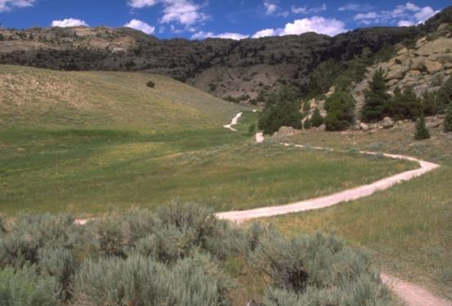
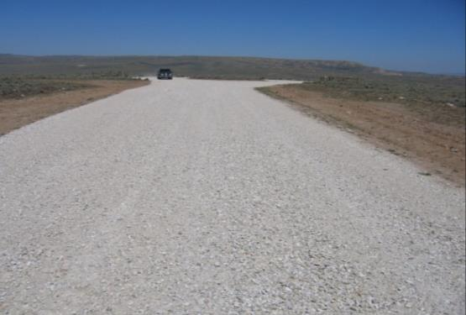
Project Planning & Environmental Factors
Project Planning
Incorporation of Visuals EARLY
  Better efficiency
  Better chance of acceptance by public and agency
  Better projects
  Less chance for costly, time delaying court challenges
  Avoid/minimize mitigation
Image Caption (if needed)
Image Caption (if needed)

Slide 6
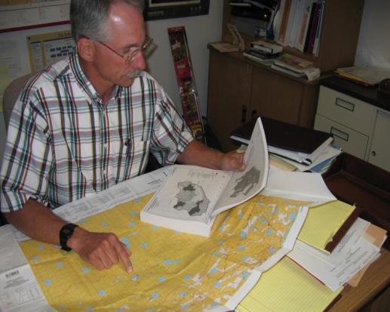
Project Planning & Environmental Factors
Project Planning
Understand Existing Constraints
  Law, management strategies, and guidance
  RMPs, FMP, city and county plans
  VRM Management Classes
  Activity plans, including
    Travel Management Plans
    Transportation Plans
    Master Plans
    Recreation Area Management Plans
  Project plan, design, guidance and standards
  Existing facilities and site conditions

Slide 7
Project Planning & Environmental Factors
Project Planning
Plan Conformance versus NEPA Compliance
  Plan Conformance: Does the project meet VRM Class Objectives and other Visuals Decisions?
  NEPA Compliance: What are the effects to visual resources and values (VRI) and how can they be avoided, reduced, or mitigated offsite?
Both analyses use visual resource concepts and tools

Slide 8
Project Planning & Environmental Factors
Project Planning
Incorporate Visuals EARLY (continued)
  Understand the proposed project
    Who, what, when, where, how, and why
    Details are important
  Understand existing constraints
  Consider a viewshed analysis – where is the project visible from?
  Consider a “first impression” of plan conformance
    Clear and obvious versus Contrast Rating
  Coordinate with the project proponent and internal BLM

Slide 9
Project Planning & Environmental Factors
Project Planning
Google Earth Pro Viewshed Analysis Demo

Slide 10
Project Planning & Environmental Factors
Project Planning
Getting Deeper into Planning
  VRI – existing environment
  Establish Key Observation Points (KOP) – where you’ll observe the project from
  Contrast Rating – objectively judge project impacts to KOP
    A team approach is best
    Field review is essential
    Consider how types of projects influence planning and design
  Consider Alternatives
  Decision Signed
  Monitor project after implementation

Slide 11
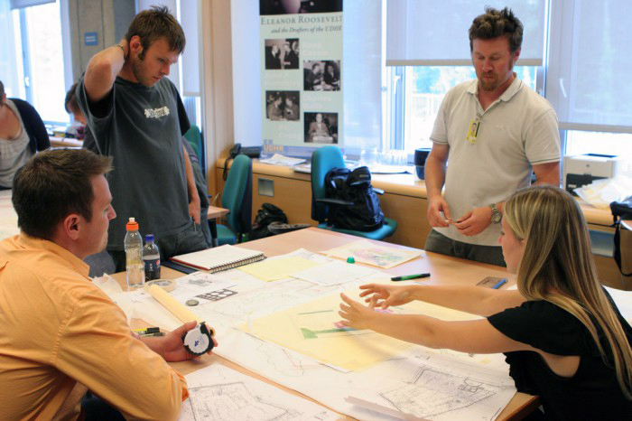

Project Planning & Environmental Factors
Project Planning
Team Approach
  Minimizing visual impacts is everyone’s job
  Include all of the disciplines that have a significant stake
  Include external stakeholders early
  Increases the credibility of recommendations and makes project easier to implement

Slide 12
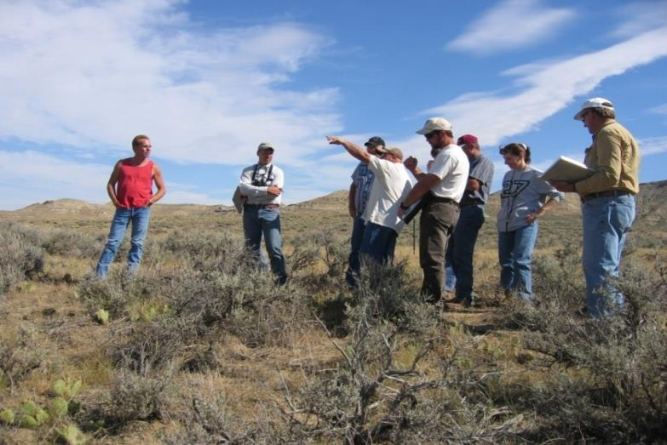
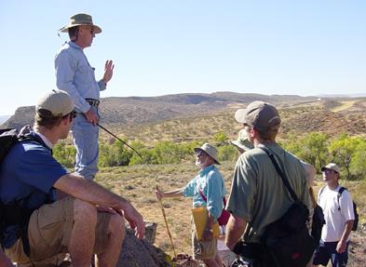
Project Planning & Environmental Factors
Project Planning
Field Review
  Project proponent and planning team can only have meaningful discussion about project on site
  Keeps everyone on the same page
  Misunderstandings can be avoided
  Project parameters can be determined more easily

Slide 13
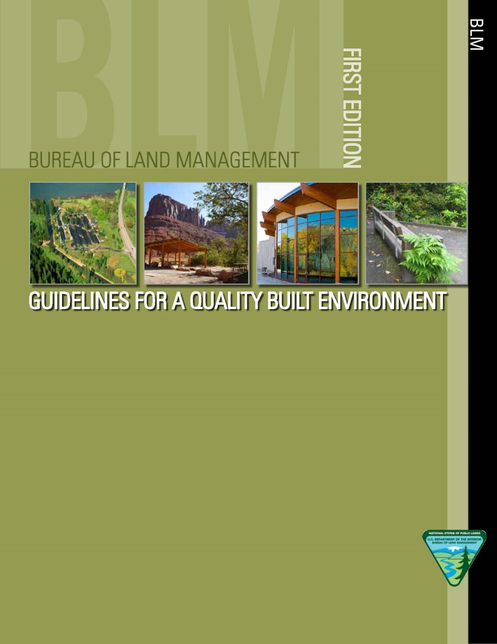
Project Planning Essentials
Project Planning
  https://partnerteamspace.blm.doi.net/sites-oc/vrm/Case%20Studies/BLM%20Guidelines%20for%20a%20Quality%20Built%20Environment.pdf

Slide 14
Project Planning & Environmental Factors
Environmental Factors
What are Environmental Factors?
  Viewing Distance
  Angle of Observation
  Length of time in view
  Relative size or scale
  Season of use
  Light conditions
  Recovery time
  Spatial relationships
  Atmospheric conditions
  Motion

Slide 15
Project Planning & Environmental Factors
Environmental Factors
Why environmental factors are important?
  They affect the viewer’s perspective of objects and activities in the landscape
  May help identify potential project locations and facility design
  May help identify alternatives (Chapter 2 NEPA) that would have otherwise gone unrealized
  May help in developing an understanding of how a casual observer will be affected by visual contrast
  May be the difference between being in conformance with the land use plan or not
  Will help in selecting Critical Key Observation Points (KOPs), (a subject we will discuss in further detail later)

Slide 16
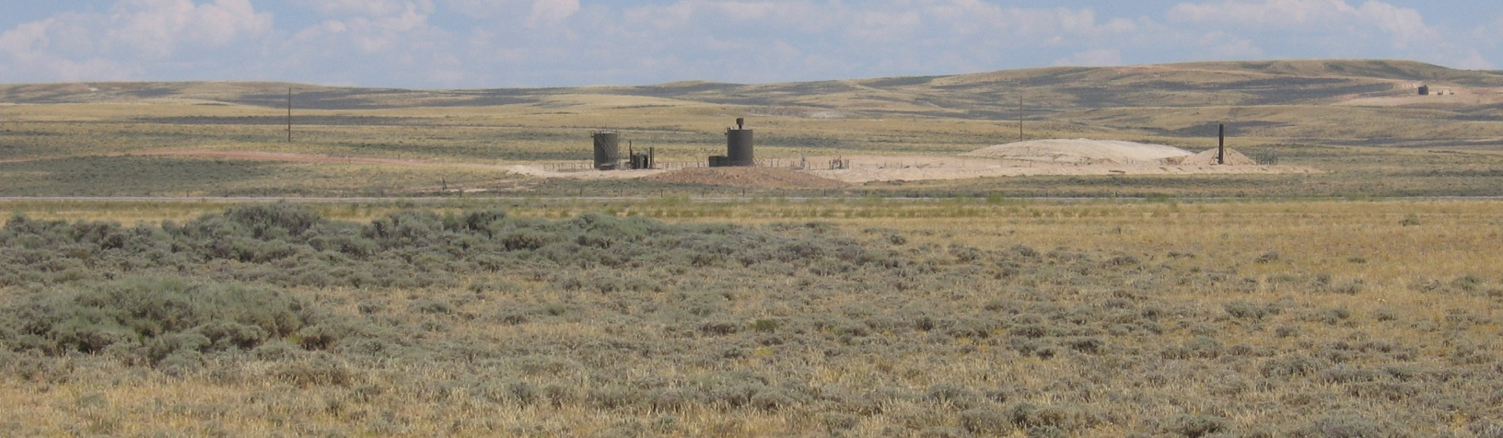
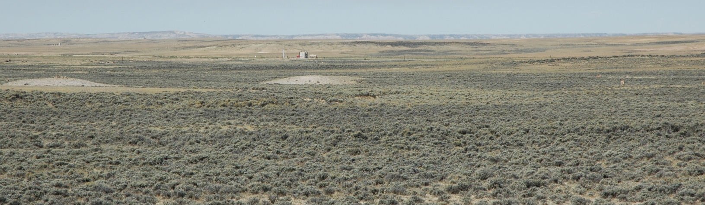
Project Planning & Environmental Factors
Environmental Factors – Viewing Distance
How far is the viewer from the proposed project?

Slide 17
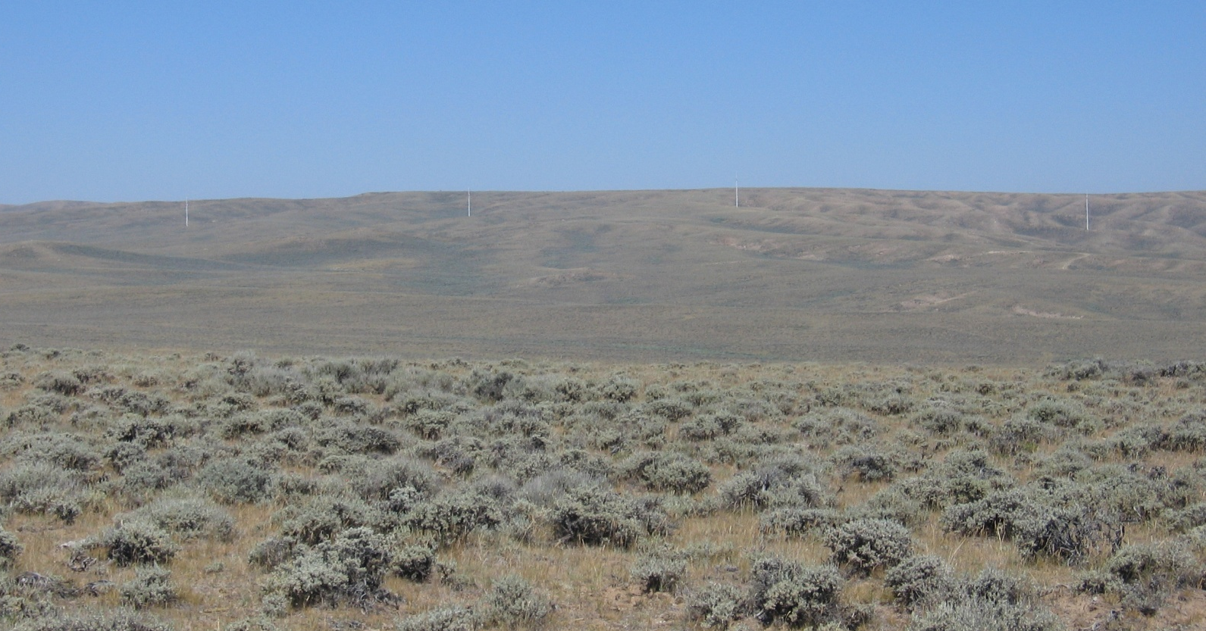
Project Planning Essentials & Envi Factors
Environmental Factors – Viewing Distance
As viewing distance increases, the project becomes less visually dominant and color value decreases toward uniformity

Slide 18
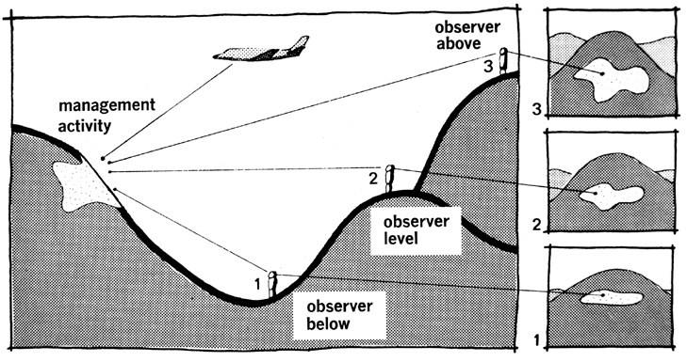
Project Planning Essentials & Envi Factors
Environmental Factors – Angle of Observation
Are you looking up at the project, looking down at the project, or are you at the same level?

Slide 19
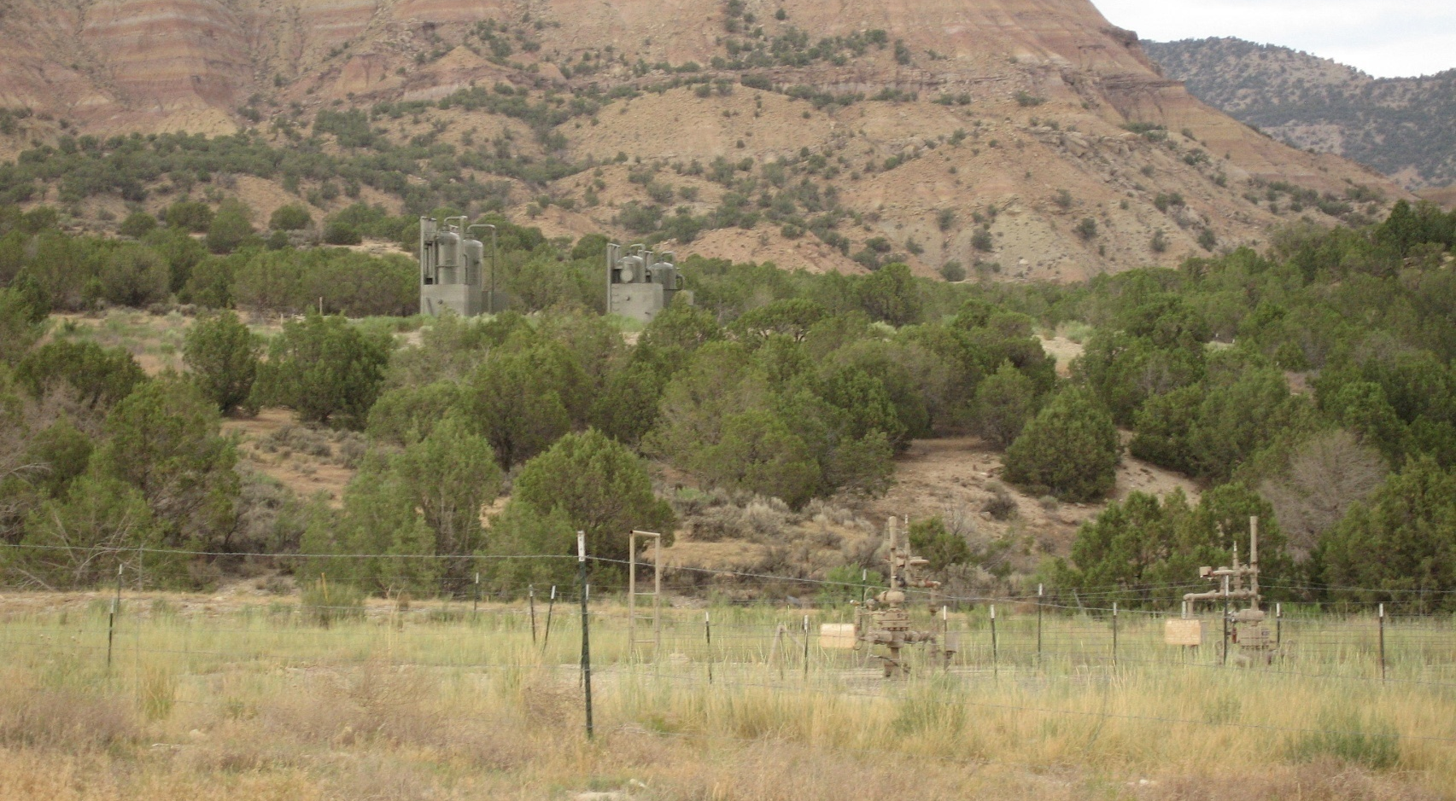
Project Planning Essentials & Envi Factors
Environmental Factors – Angle of Observation
Observer below – surface disturbance not visible

Slide 20
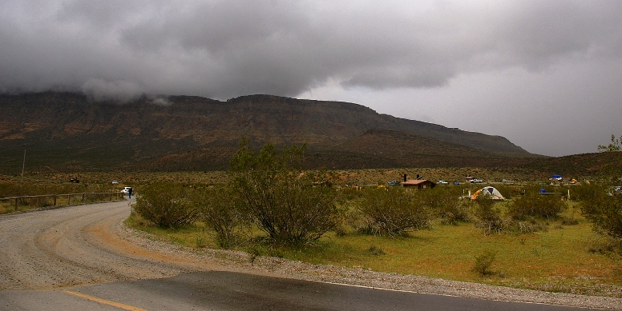
Project Planning Essentials & Envi Factors
Environmental Factors – Angle of Observation
Observer level – surface disturbance mostly not visible

Slide 21
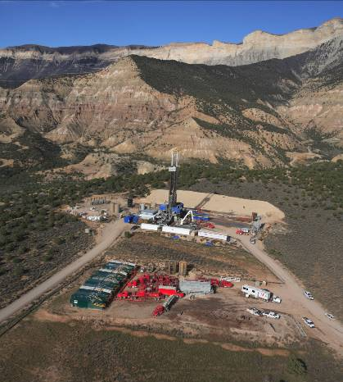
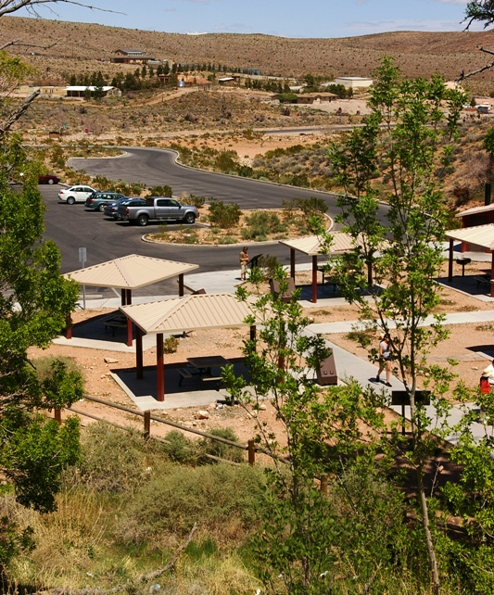
Project Planning Essentials & Envi Factors
Environmental Factors – Angle of Observation
Observer above – in addition to structures, surface disturbance is visible

Slide 22
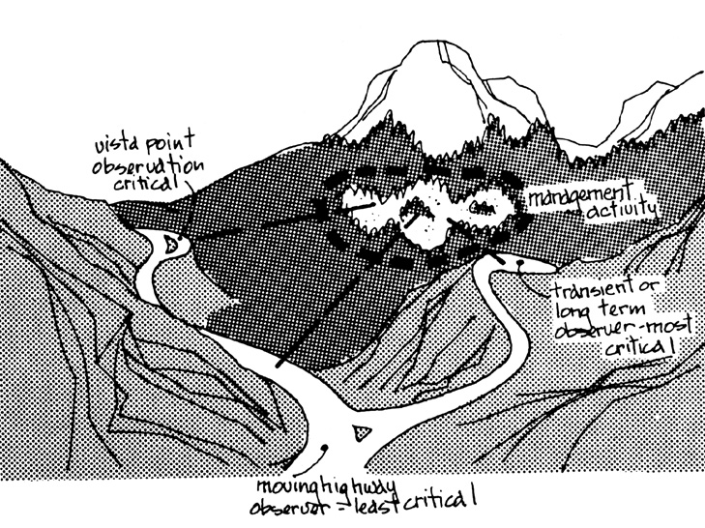
Project Planning Essentials & Envi Factors
Environmental Factors – Length of Time in View

Slide 23
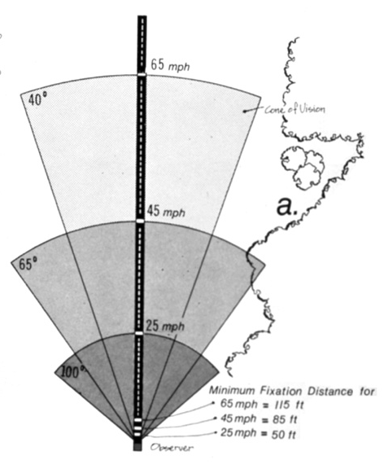
Project Planning Essentials & Envi Factors
Environmental Factors – Length of Time in View
Three-tenths of a second
is needed for the eye to
fixate on an object
Cone of vision decreases
as speed increases along
a linear corridor

Slide 24
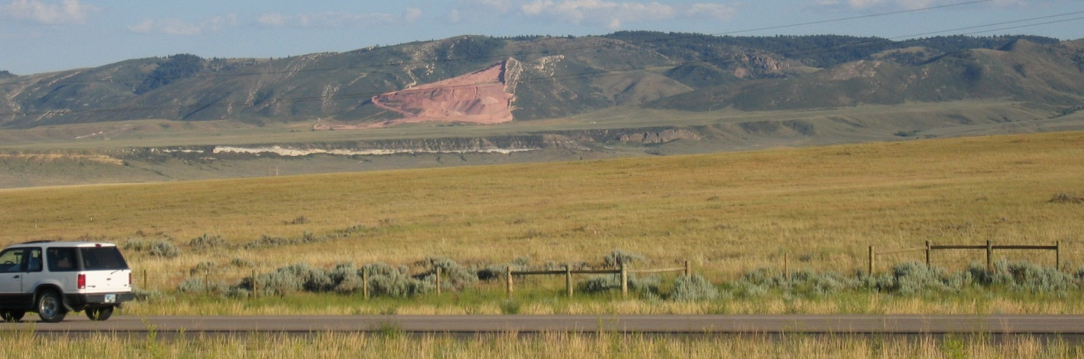
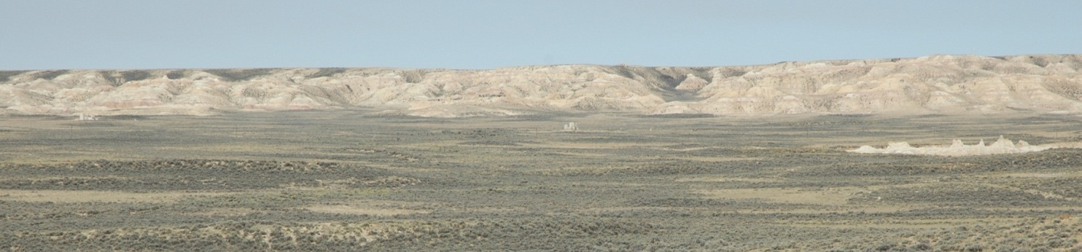
Project Planning Essentials & Envi Factors
Environmental Factors – Relative Size and Scale
The contrast created by a project is directly related to its size and scale compared to the surrounding landscape in which it is located

Slide 25
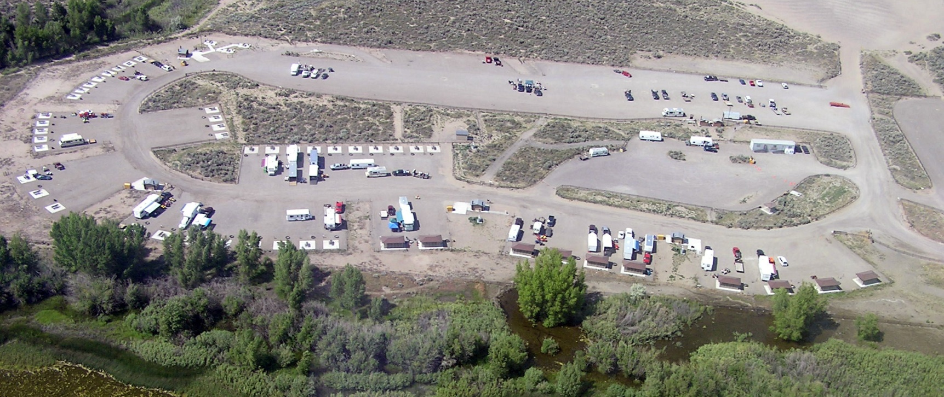
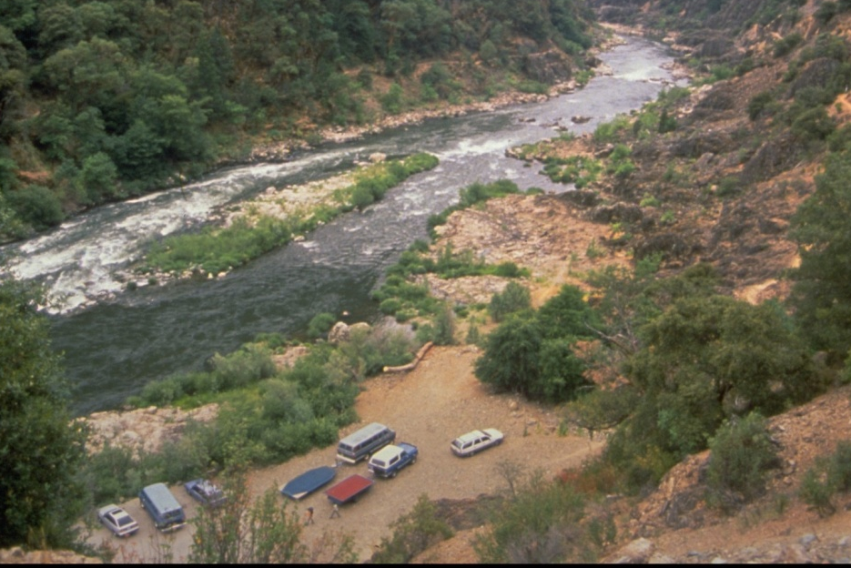
Project Planning Essentials & Envi Factors
Environmental Factors – Relative Size and Scale

Slide 26
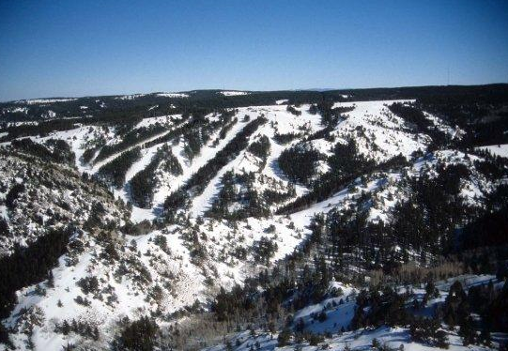
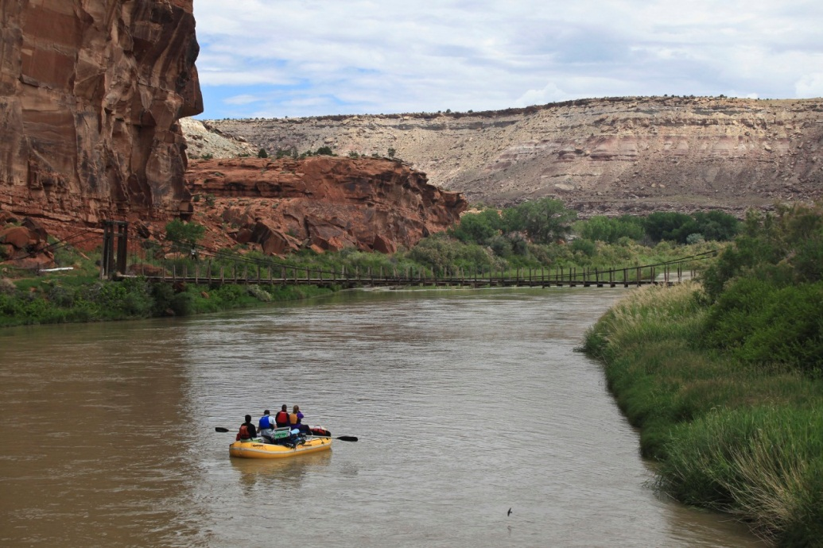
Project Planning Essentials & Envi Factors
Environmental Factors – Season of Use
Consider the physical conditions that exist during the heaviest or most critical visitor use season
Ski Season
Rafting Season

Slide 27
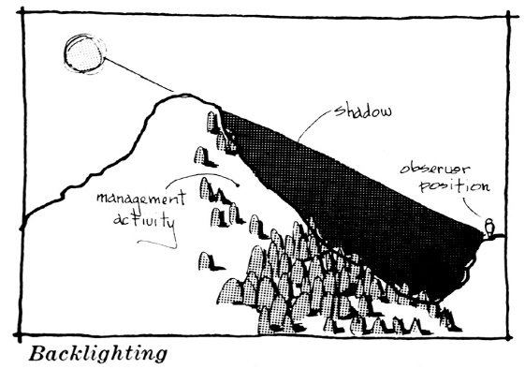
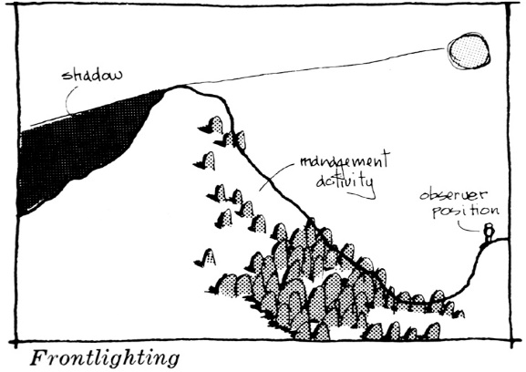
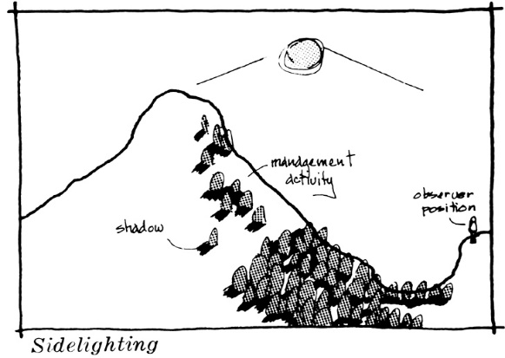
Project Planning Essentials & Envi Factors
Environmental Factors – Light Conditions
The direction, angle and quality
of light affects the color intensity,
reflection, shadow, form, and
texture
Also, consider time of day and
time of year

Slide 28
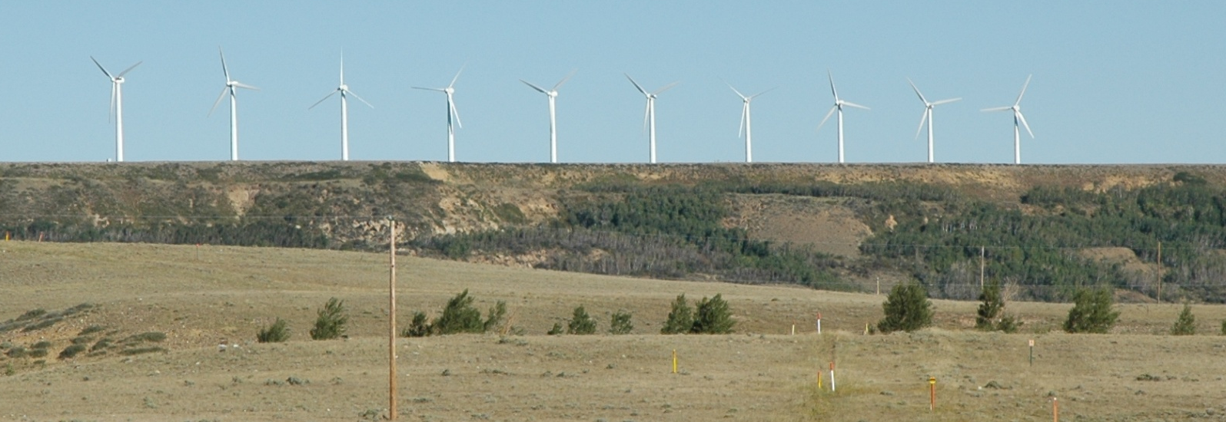
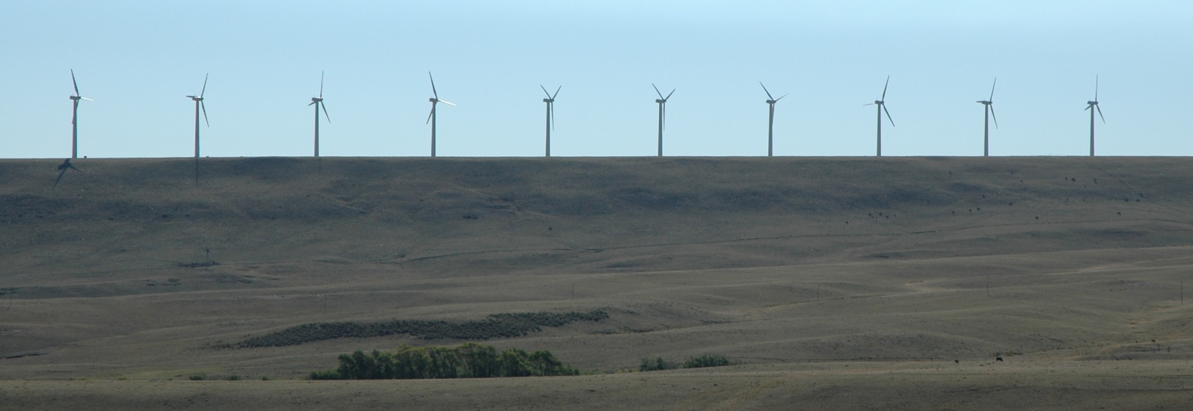
Project Planning Essentials & Envi Factors
Environmental Factors – Light Conditions
Front Lighting versus Back Lighting

Slide 29
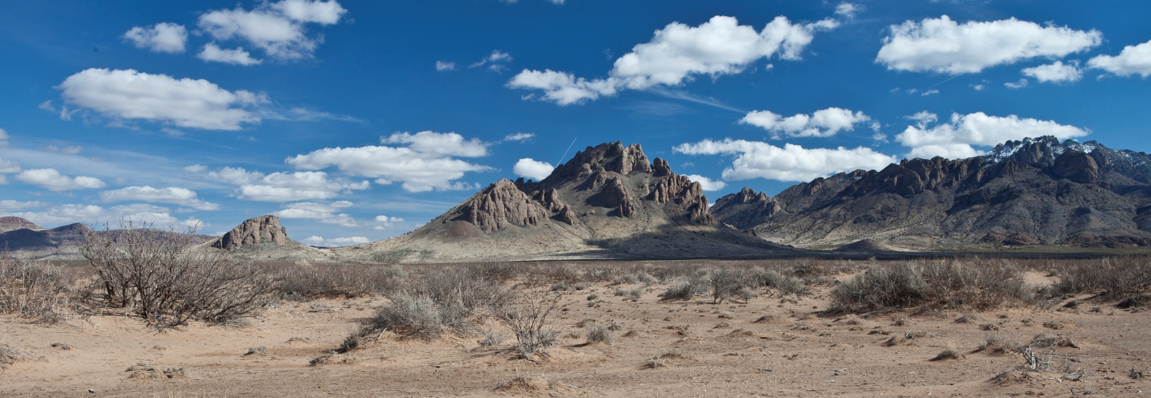
Project Planning Essentials & Envi Factors
Environmental Factors – Light Conditions
Side lighting causes shadows and creates contrast, accentuating features

Slide 30
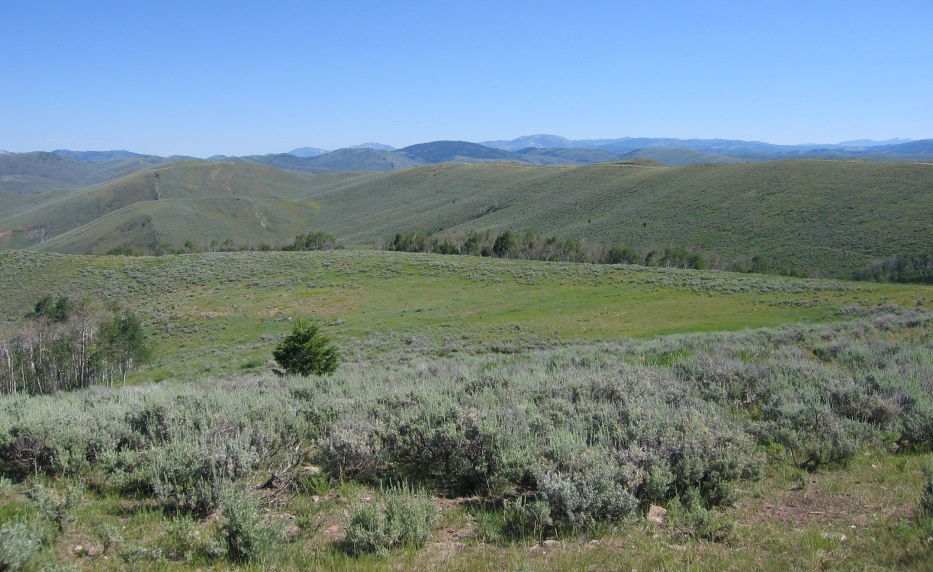
Project Planning Essentials & Envi Factors
Environmental Factors – Recovery Time
The amount of time successful revegetation/reclamation is expected to take

Slide 31
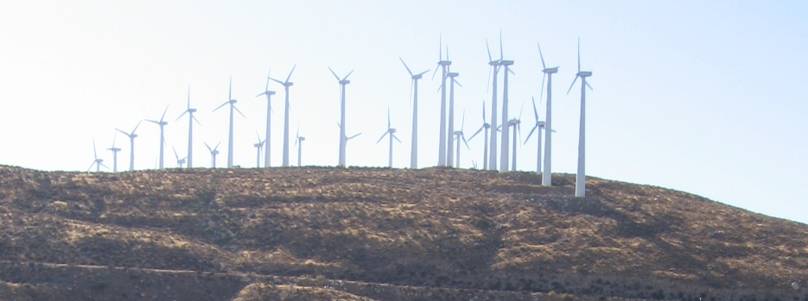
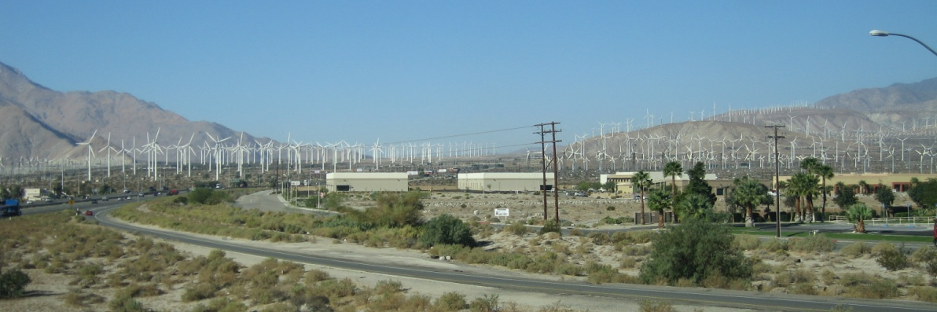
Project Planning Essentials & Envi Factors
Environmental Factors – Spatial Relationships
Spatial qualities of a landscape are determined by three-dimensional arrangement of objects and voids

Slide 32
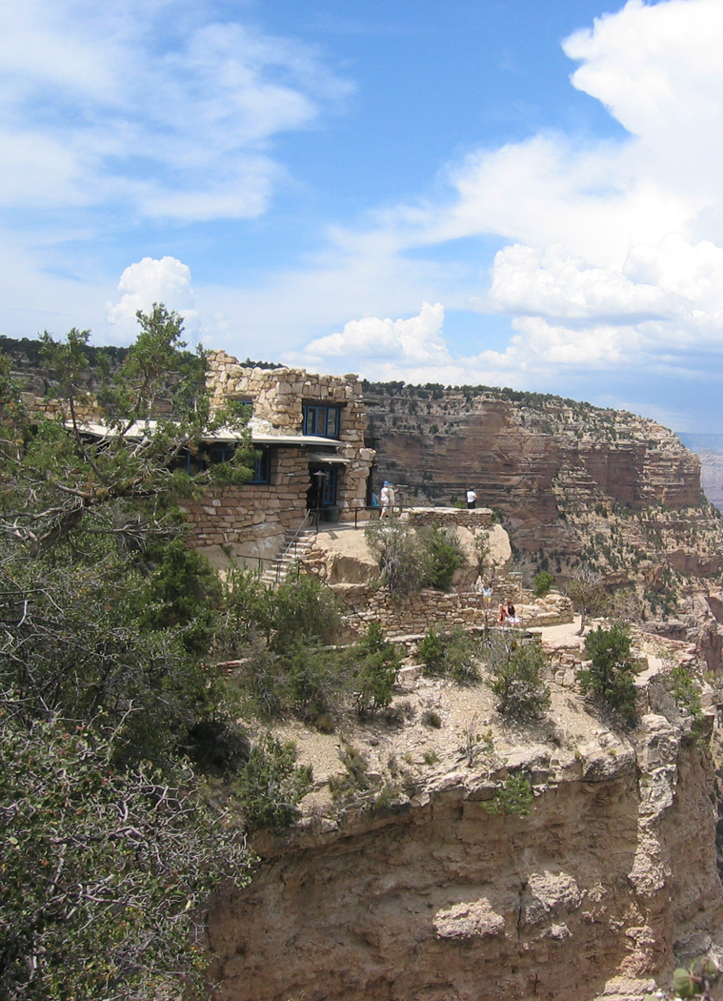
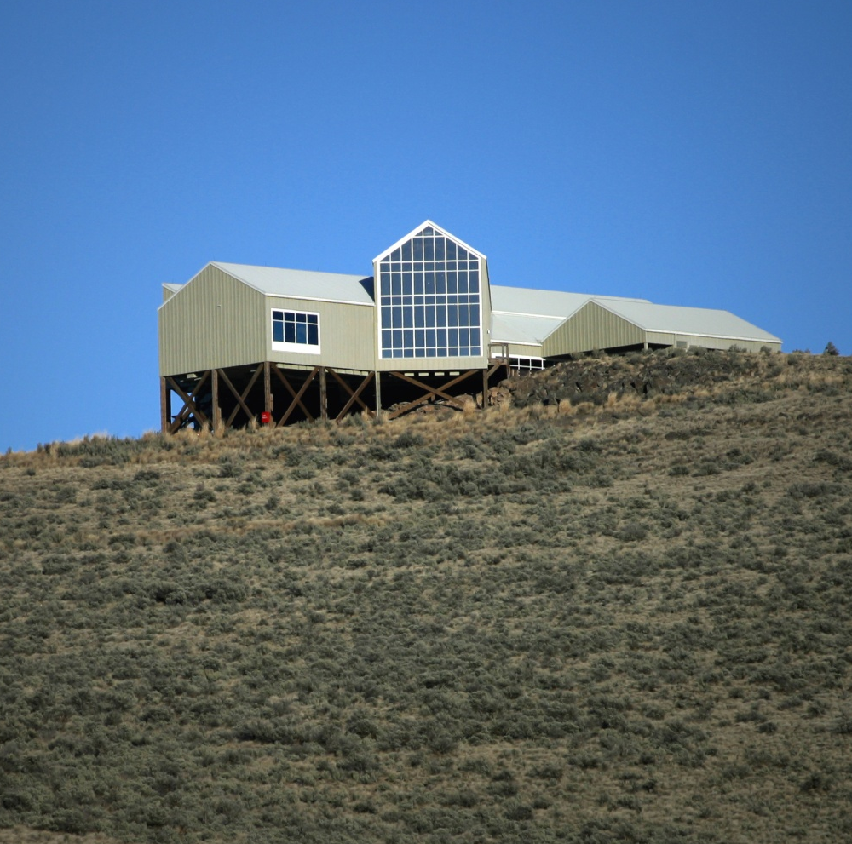
Project Planning Essentials & Envi Factors
Environmental Factors – Spatial Relationships
Elevated and exposed positions are more prominent than lower obscured positions

Slide 33

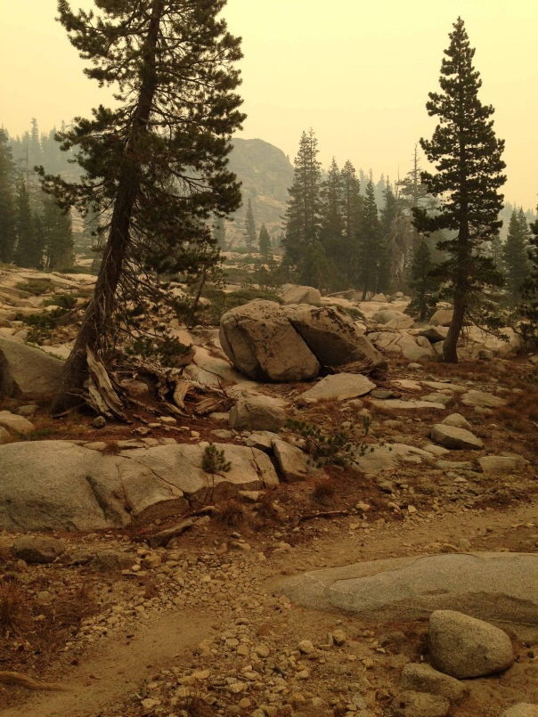
Project Planning Essentials & Envi Factors
Environmental Factors – Atmospheric Conditions
The impact of form, line, color, is reduced by clouds, fog or smog, precipitation, and wind motion

Slide 34
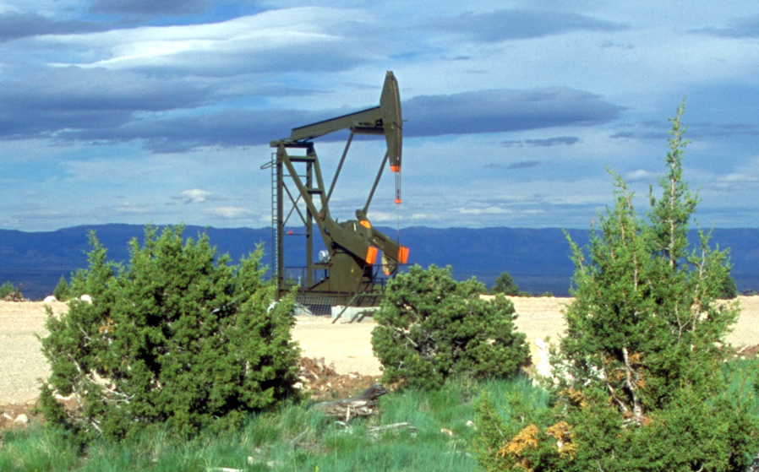
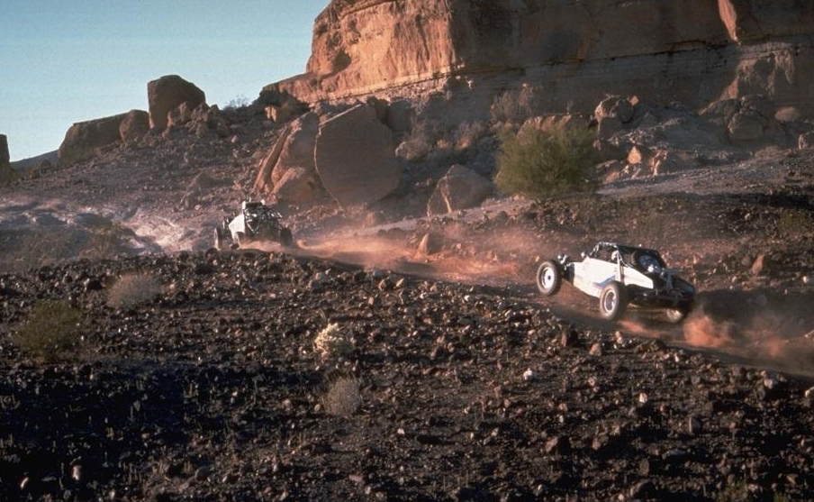
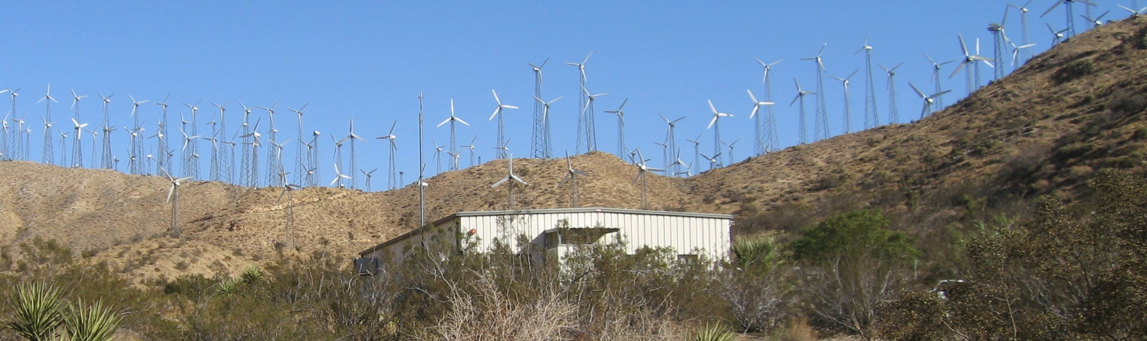
Project Planning Essentials & Envi Factors
Environmental Factors – Motion
Movement draws attention to a project or activity

Slide 35
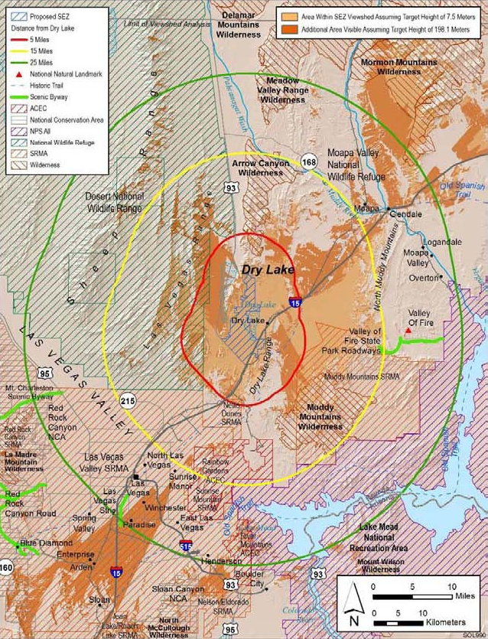
Project Planning & Environmental Factors
Environmental Factors
Viewshed analysis can help determine locations from which to conduct your impact analysis, but it should not be the only method used

Slide 36
Project Planning & Environmental Factors
Environmental Factors
Identifying Key Observation Points or areas within the Affected Viewshed
Environmental factors should be considered when assessing visual impacts of a proposed project or activity, and creating alternatives
Environmental factors can change - identify the most critical time or location to judge them

Slide 37
Project Planning Essentials
Summary
Remember the distinctions between Land Use Plan Conformance and NEPA Compliance for project proposals
Incorporate visual resource concepts and values early and throughout all phases of project planning
Integrate project planning, design factors, and 10 environmental factors to maximize protection of scenic values

Slide 38
The End

Slide 39
Project Planning & Environmental Factors
Project Planning
Analyze Impacts using VRI
  Integrate VRI (overall values & individual components)
  Establish Key Observation Points (KOPs)
    Consider the 10 Environmental Factors
  Conduct “viewshed analysis” appropriate to the scale of the proposal

Slide 40
Project Planning & Environmental Factors
Project Planning
Alternatives
  Formulate alternatives that meet Purpose and Need while mitigating visual effects
  Ensure conformance of each alternative with the RMP’s VRM Class objectives
  Explore ways to further reduce visual effects of otherwise conforming projects

Slide 41
Project Planning & Environmental Factors
Project Planning
If the Proposal Cannot Conform
  Contemplate RMP Amendment
      ONLY as a last resort
      Considering the intent/integrity of the original RMP
      Follow RMP Amendment procedures (major versus minor)
      And offset visual losses through offsite mitigation

Slide 42
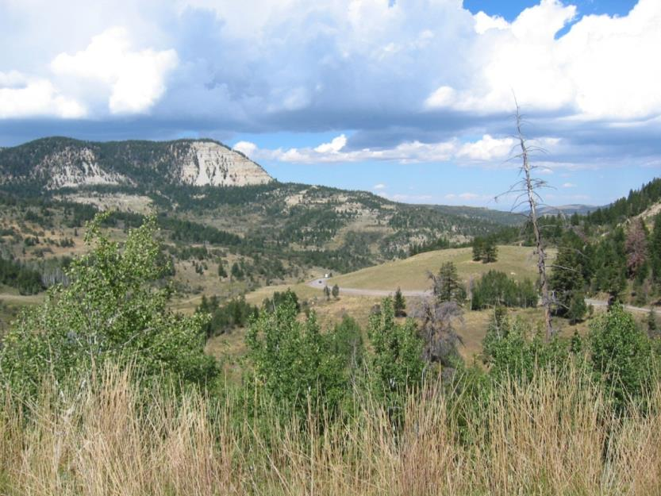
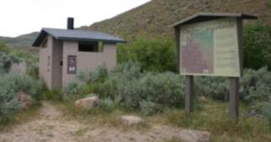
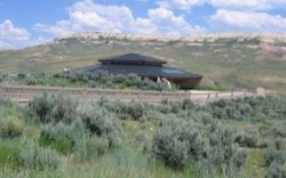
Project Planning & Environmental Factors
Project Planning
Don’t Jump to Design too Soon
  Thoughtful and comprehensive planning leads to better design and better projects
  Saves time and money if planning leads design

Slide 43
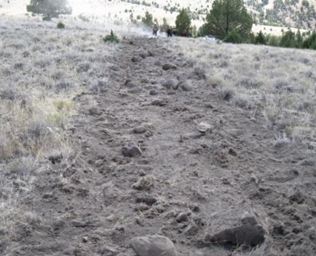
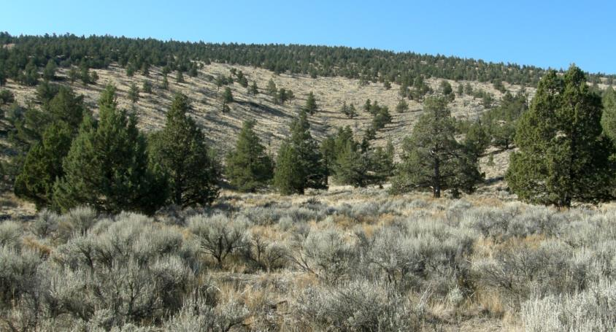
Project Planning & Environmental Factors
Project Planning
All Done and Dusted?
  Monitor implementation for compliance with design features
  Assess over time for effectiveness of design features

Slide 44
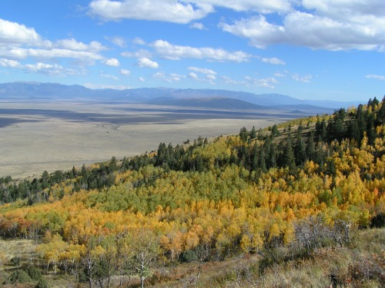

Project Planning Essentials & Envi Factors
Environmental Factors – Season of Use
Fall Colors and Hunting Season
Wildflower Season

Slide 45
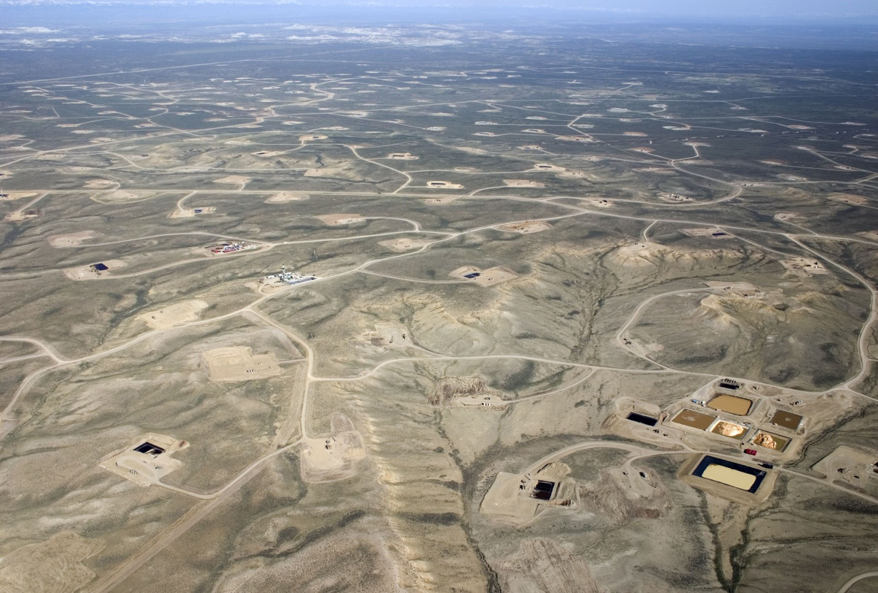
Project Planning Essentials & Envi Factors
Environmental Factors – Angle of Observation
Observer above – in addition to structures, surface disturbance is visible

