Slide 2


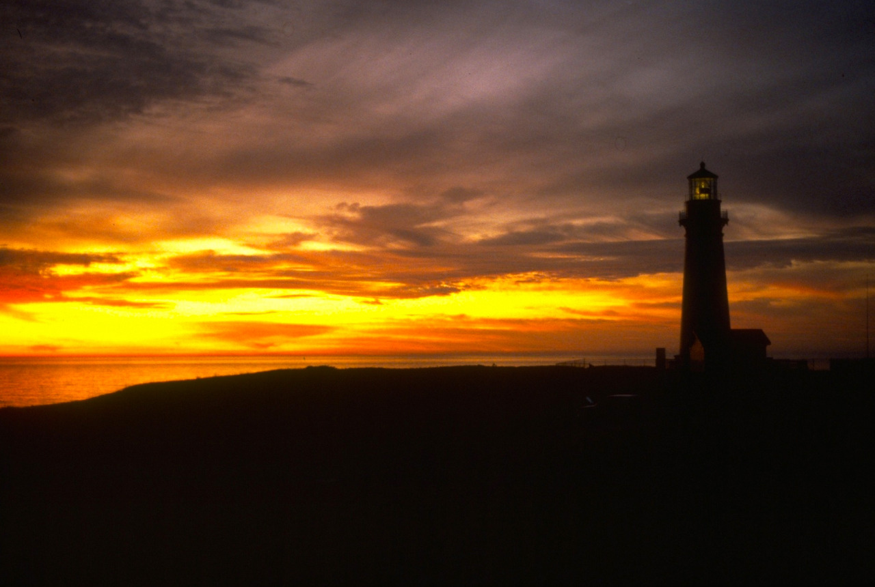

Slide 3
VRM Overview
Unit Objective
To revisit the overall purpose of the Short Course provide some final pieces of information.
Course objective is to provide a general overview of the VRM program, including:
  Why we inventory and manage visual resources.
  What legal authority drives the BLM VRM program.
  An overview of the policy and procedures of the VRM Program in place today, with an emphasis on the inventory process.
Other speaking points:
  Monitoring
  Amending the land use plan
  Additional viewshed and simulation considerations
  VRM Website

Slide 4
Overall Course Objective
Basic Principles
  Scenic resources are public resources, which are finite in supply.
  BLM has a legal obligation to manage for scenery.
  Visual Resource Management (VRM) is the BLM’s system for scenery management.
  VRM is not about blocking projects, but to make projects better integrated into their setting.
  Be mindful that visual impacts from BLM decisions have far reaching effects that extend well beyond BLM boundaries.

Slide 5
Overall Course Objective
VRM Program Objectives
  Manage for protection
  Establish consistency in managing visual resources
  Minimize adverse visual impact.
  Establish an inclusive framework for interaction between VRM and other resource programs.
  Encourage balanced management of visual values with other resources for now and into the future.
  Ensure management of visual resources in accordance with applicable laws and regulations.
  Provide adequate information for informed visual resource land use planning, project design, and landscape monitoring.

Slide 6
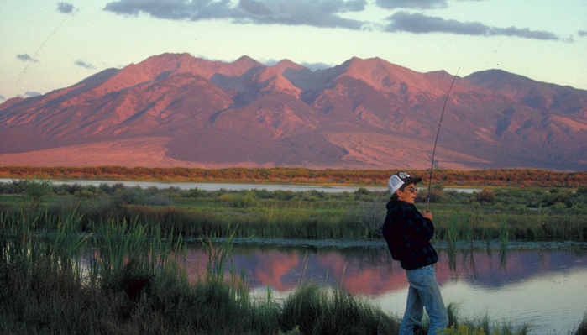
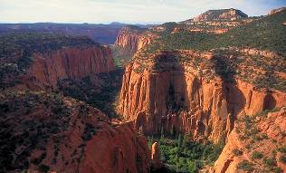
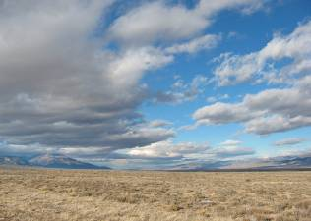
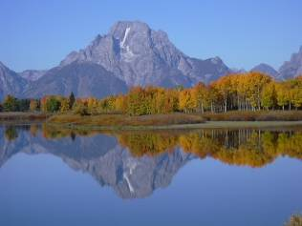
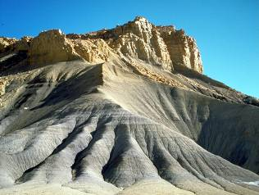
Overall Course Objective
BLM has legal obligation – FLPMA/ NEPA
  IBLA Decisions
    144IBLA070 - Utah Decision
    173IBLA313 - Beaver Rim_Lander FO
    174 IBLA 078 -Tom Van Sant – California
    IBLA 2016-74 – Moab Burrito Trails

Slide 7
Overall Course Objective
VRM system
  Inventory for visual values
  Establish Mgt. Classes
  Evaluate/design activities to meet classes
  Monitoring projects and character change
  Updating the VRI

Slide 8
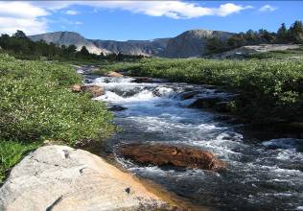
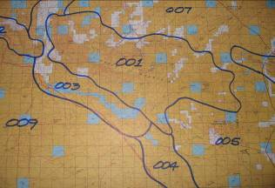
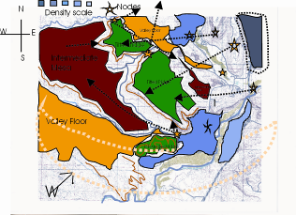
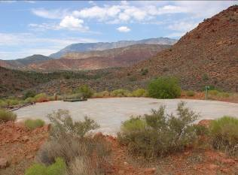
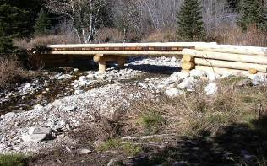
Overall Course Objective
Language for Landscapes
  Types of Landscapes
  Elements of Landscape Character
  Analysis Factors
Project Level Planning Essentials
  Project Site Planning Considerations
  Human and Environmental Factors
  Observation
Design Fundamentals
  Site Selection (10 Environmental Factors)
  Form, Line, Color, Texture AND Scale
  Adverse Visual Contrast Reduction

Slide 9
Overall Course Objective
Project Analysis and Evaluation
  Visual Contrast Rating System
    Project Description
    Affected viewshed determination
    Identify VRM Objectives
    Key Observation Points (KOP)
    Visual Simulations
    Contrast Rating Form
    10 Environmental Factors
    Design modification
    Reevaluation

Slide 10
Overall Course Objective
NEPA & VRM
  Proposed Action
  Alternative
  Affected Environment
  Environmental Consequences (setting & values)
  Mitigation

Slide 11
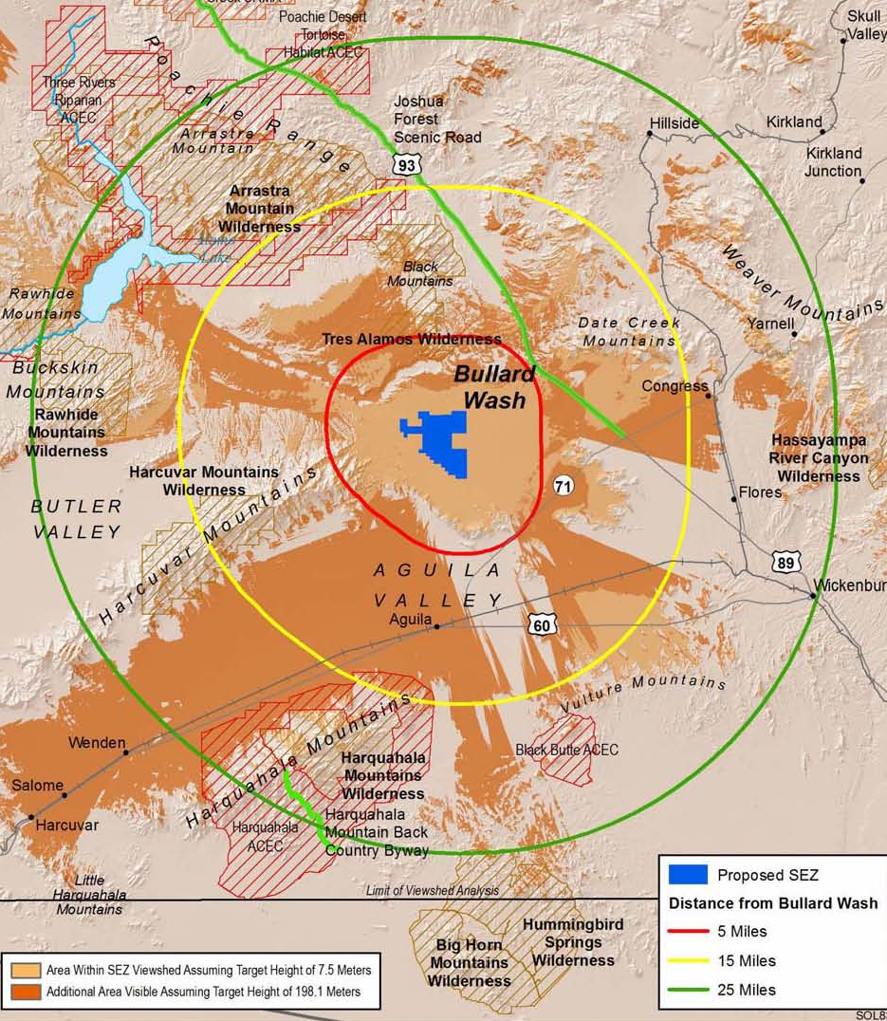
Viewshed Assessment
Evaluating potentially affected lands from the project site
  Viewshed modeling

Slide 12
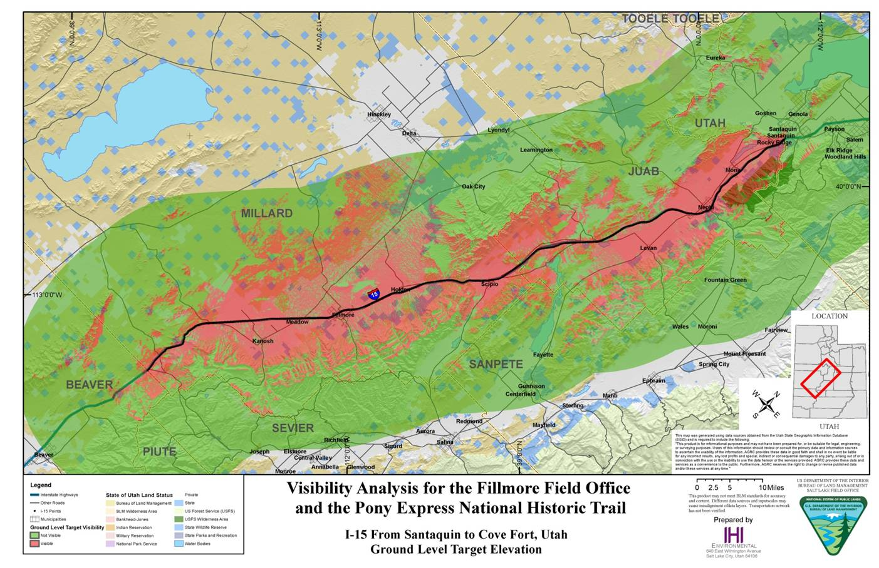
Viewshed Assessment
Evaluating from a Single Platform: At ground level
  Visibility study/ viewshed modeling/ land use plan decisions

Slide 13
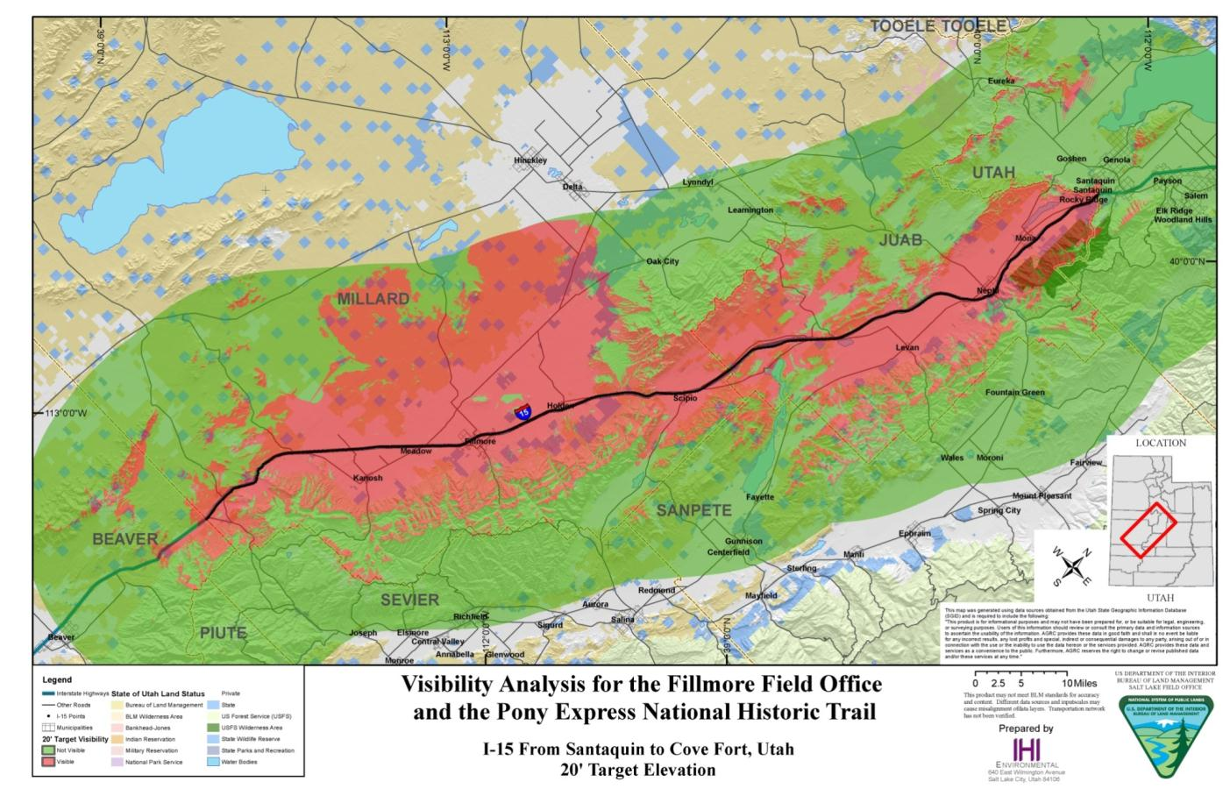
Viewshed Assessment
Evaluating from a Single Platform: At the 20 ft. target height
  Visibility study/ viewshed modeling/ land use plan decisions

Slide 14
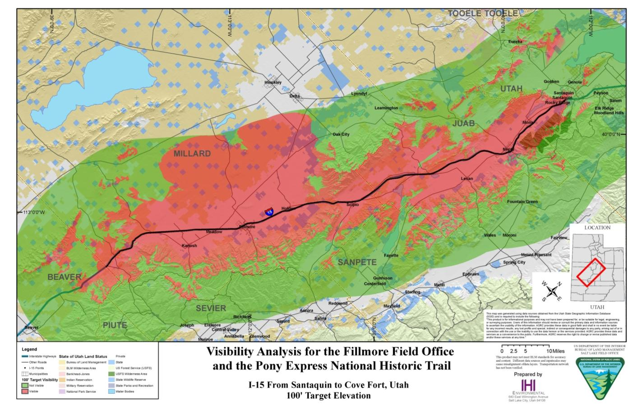
Viewshed Assessment
Evaluating from a Single Platform: At the 100 ft. target height
  Visibility study/ viewshed modeling/ land use plan decisions

Slide 15

Visual Simulation Time Lapse Demo
Notes:
Contrast changes throughout the day based on the angle of the sun, glint / glare. Season may also impact the simulation. There should be emphasis placed on ensuring that the simulations capture a good range of alternatives.

Slide 16
Overall Course Objective
Monitoring
  Compliance
  Effectiveness
  Adaptive Management
  Land Use Plan
  Regional Landscape Scale Planning & Mitigation Strategy

Slide 17
Why we monitor
To confirm:
  Compliance – comply with the terms, conditions and mitigation requirements identified in the land use plan and project NEPA decisions. Are we meeting our commitments to the public?
  Effectiveness – Are the decisions achieving the intended environmental objectives, and are the predicted environmental effects accurate? Validating that the outcome is as anticipated.
  Adaptive management – If decisions are not meeting the purpose and need, nor achieving desired outcomes, then monitoring is used to identify necessary changes.

Slide 18
Project Level Monitoring
What are some of the methods or tools that can be used?
  Develop a photo documentation protocol & maintain a record
  Establish monitoring photo points
  Compare Visual Impact Analysis simulations to project’s results
  Contrast Rating evaluation comparisons
  Construction plans compared to as-built results
  Assess the magnitude of affected viewshed as being built and after completion
  Are there unanticipated impacts? Is there a need to mitigate the unanticipated residual impacts?
Notes:
Establish monitoring photo points
Convenient locations to record progress;
From selected KOPs

Slide 19
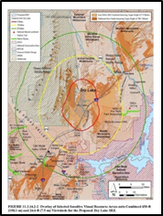
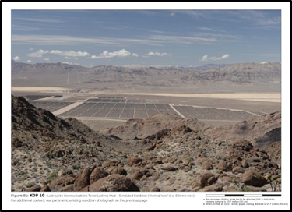
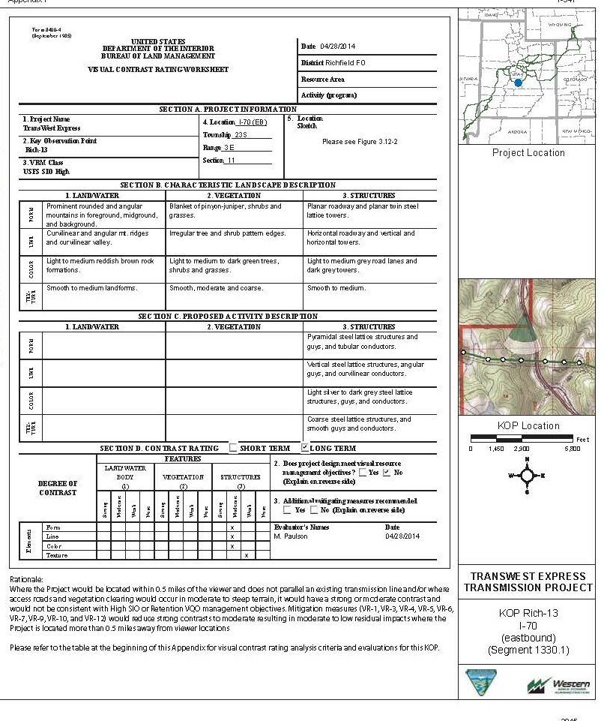
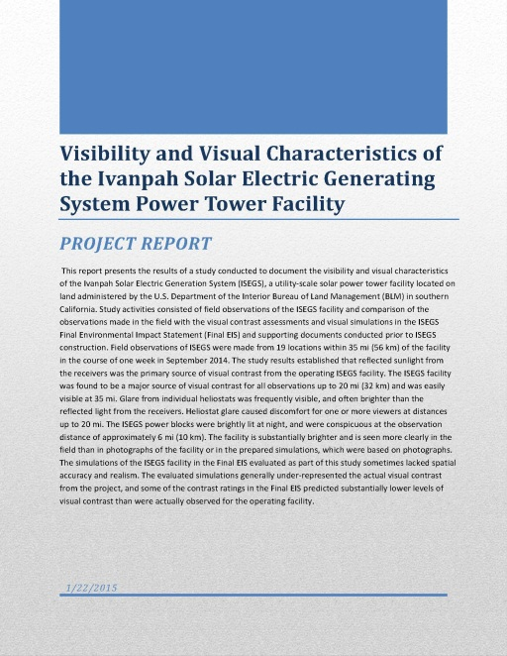
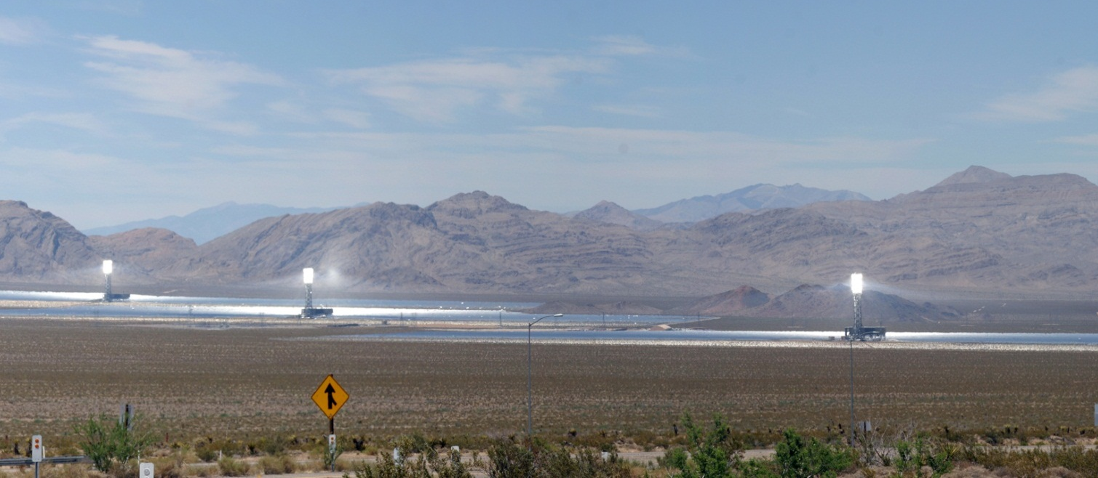
Project Level Monitoring

Slide 20
Project Level
Other tools to use?
  Construction plans and specifications
    Grading plans
    Surface preparation
    Topsoil specification and testing
    Seed mix and germination test
    Seeding methods
    Mulching

Slide 21
Non-conforming action/ LUP Amendment
Contemplating a land use plan amendment: An amendment shall be initiated by the need to consider the following criteria (43 CFR 1610.5-5):
  New or revised policy.
  New data.
  A change in circumstances.
  Findings from monitoring and evaluation.
  A proposed action that may result in a change in scope of resource uses.
  A change in the terms, conditions, and decisions of the approved land use plan.
Notes:
Add slides on DRECP and 368 corridor issues

Slide 22
VRM Overview
Non-conforming action/ LUP Amendment
Contemplating a land use plan amendment: Also carefully consider and evaluate before making the final decision to amend the VRM class objectives:
  Existing land use plan’s rationale for the current VRM class objective.
  If the public benefits associated with the proposed action’s purpose and need outweigh the public benefits associated with the purpose and protection level of the current VRM class objective.
  Effects on other resource values and land use plan decisions that may result from modifying the level of visual resource protection.
  The need mitigate offsite to offset for any loss of or reduction to visual resource value

Slide 23
VRM Overview
Non-conforming action/ LUP Amendment
Contemplating a land use plan amendment: Also carefully consider and evaluate before making the final decision to amend the VRM class objectives:
  The BLM shall disclose the impacts to visual resources and explain the tradeoffs and benefits of amending the land use plan.
  In circumstances in which a land use plan amendment allows a proposed action to move forward, conditions of approval shall include mitigation of adverse visual resource impact and evaluation of the opportunities for compensatory mitigation for recovering lost or reduced value to the VRI factors.

Slide 24
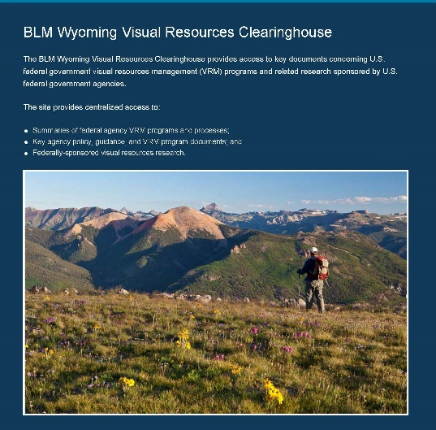
Wrap Up
Other reading
Visual Resource Clearinghouse
blmwyomingvisual.anl.gov
http://blmwyomingvisual.anl.gov/

Slide 25
Summary Questions:
  Are Visual Inventory Classes & VRM Management Classes the same thing?
  Is VRM
    discretionary, a “soft” decision?
    do we manage project beauty?
    allows activity within VRM Class IV to go unmitigated?
    a way to preclude or exclude projects from happening?
  Does VRM apply to existing valid mineral rights?
  Does VRM Management Class IV mean the area has low visual value?
  Are Contrast Rating Evaluations required for all projects?
  Who is responsible for VRM?
  If the VRM objective is different at the KOP location from that of the project location, which VRM Class Objective must the project conform to?

Slide 26
Final Comments
VRM is a Collaborative Process – internally and externally.
Is your Visual Resource Inventory up to date?
Take the time to do comprehensive planning – carefully study VRM/VRI/Allocations compatibility – knowing the industry’s challenges, but capabilities, too.
VRM Class IV should be given as much consideration as VRM II and III.
Plan amendment should be the exception to the rule and not viewed as the easy out.

Slide 27
In closing . . .
Please be assertive stewards of our BLM settings in protecting BLM’s Visual values
Share your challenges and successes with us and your fellow students
Encourage customers to use qualified contractors the conduct VRM analysis.
Call upon the instructors, if you need assistance

Slide 28
Stay in Touch
John McCarty
Chief Landscape Architect
Washington Office
jhmccart@blm.gov
202.912.7284

